Slide 1
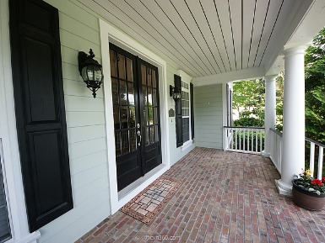
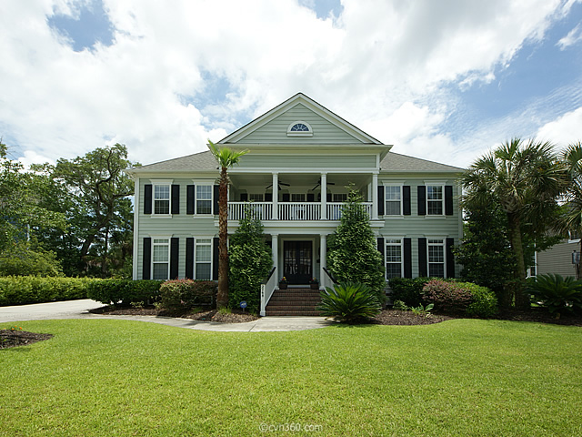
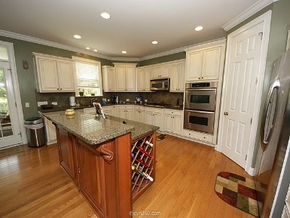
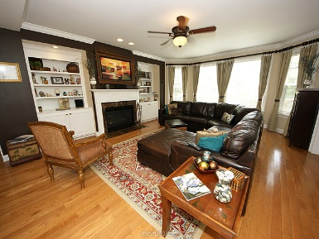
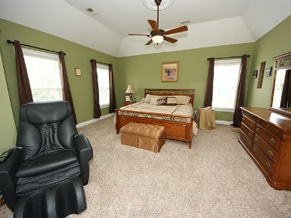
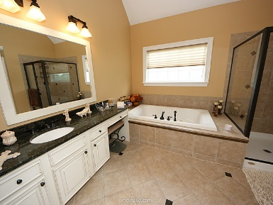
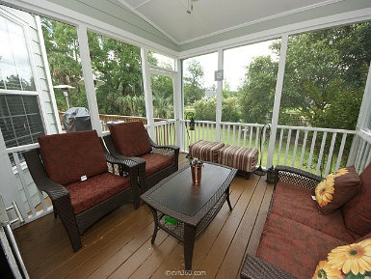
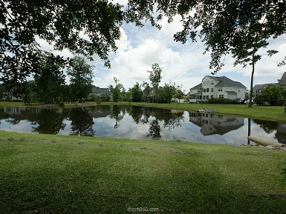


2768 Oak Manor Drive Dunes West ~ Mt Pleasant ~ MLS# 15015585 ~ $859,900
Presenting an open, flowing floor plan, ideal for casual family living as well as formal entertaining. 2768 Oak Manor Drive is a home that has it all! This amazing 3 story home with double porches that overlook the Wando River across the street from the front and provides a beautifully fenced landscaped private oasis with a pond view from the back, provides breathtaking sunsets and sunrises. A grand 2-story foyer greets visitors into this spacious home. 5 bedrooms, (extra space could be a 6th bedroom), and 5 baths, provide ample living space for the growing family. Gorgeous hardwoods throughout the first floor living areas and crown moulding throughout all three floors set this executive home apart. The gourmet kitchen is well appointed with granite countertops, cherry island bar, pantry, breakfast area, antique white cabinets, a gas stove, double convection ovens, and stainless steel appliances. The first floor also includes a bed/bath, perfect for an in-law suite, that opens to the back deck. Elegant formal living and dining spaces, and a great room with a gas fireplace that opens to a beautiful sun porch and deck all equipped with sound, round out the entertainer's dream floor plan. The second floor's spacious Master Bedroom suite has a jacuzzi tub, oversized tile shower, granite countertops, his and her closets and a private retreat space that overlooks the pond. Three additional bedrooms and two baths including a Jack and Jill bath, and an open and inviting family room on the second floor make this unique home perfect for family time. Upon entering the third floor, guest are greeted with over 800 square feet of "play area" including a space large enough for a ping pong or pool table and a media area with surround sound to enjoy your favorite movies. There is also a full bath room and an expansive storage area that could serve as a 6th bedroom. The large, side load 2 car garage offers plenty of room for parking and storage. This is a very special home that truly offers something for everyone.
Wine, Cheese, & Gift Card Open House Event ~ Wed, July 15th
Cheryll Woods-Flowers
ABR, e-Certified, SHS
(843) 442-2219
www.woodsflowers.com

