Slide 1
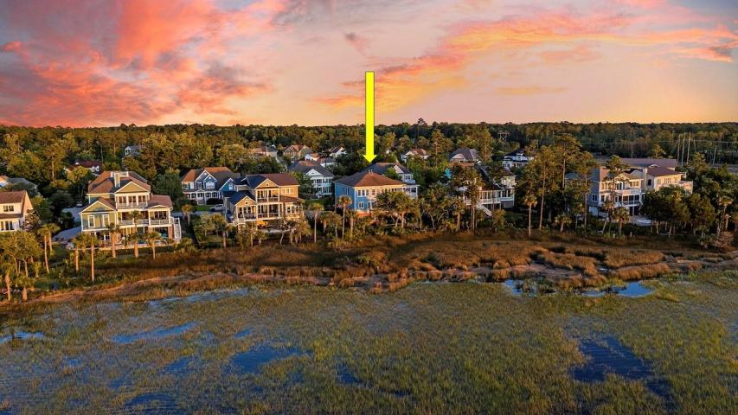



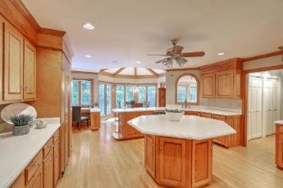
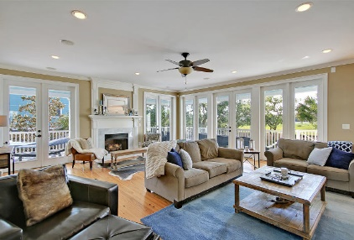



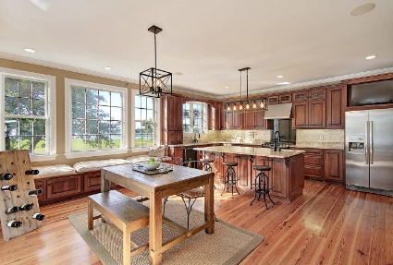

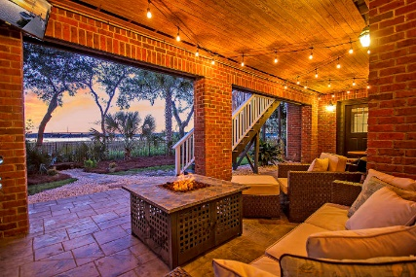
Parkshore Marshfront
Dunes West Waterfront Beauty
2769 Oak Manor Drive
Mount Pleasant, SC 29466 ~ MLS# 20012736 ~ $1,149,000
Luxurious waterfront living on the Wando River awaits you in this breathtaking custom build in Dunes West! Pristinely manicured landscaping welcomes you with the circular drive, the dual curved staircases leading up to the front door and the 3-car garage that can accommodate three vehicles and has been fully outfitted to make any car enthusiasts jaw hit the floor. What's equally impressive about the finishes you will find on the inside of this home are the three amazing wrap around outdoor living spaces that all look out to the water. There is no shortage of spaces for entertaining in this residence! The spacious living room boasts a fireplace, the dining room can accommodate a large crowd and the inviting kitchen is overflowing with warmth and high end touches. This home is a must see!
Additional features include:
Two story foyer
Hardwood floors
Surround sound
Dining room has columns, tray ceiling and wainscotting
Office with pocket doors and built-ins off of the foyer
Kitchen has a built-in bench, center island with breakfast bar seating, SS appliances, two sinks and a gas range
Family room/media room is located on the ground level
Completely renovated master suite and bath! Master bedroom has a tray ceiling, access to balcony, walk-in closet and en-suite bath with dual vanities, stand alone tub and walk-in shower
Home is outfitted with a Control4 smart home system with built-in speakers in nearly all the rooms and porches
Home is just a few doors down from dock shared with 9 homeowners and privately owned and deeded boat slip
Book your showing today!
Christopher Smith christopher@mattoneillteam.com 843-267-0735

