Slide 1
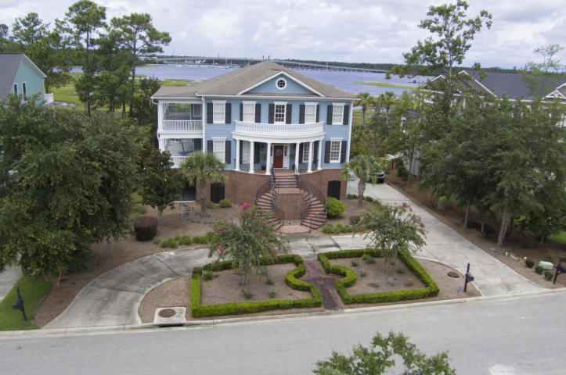
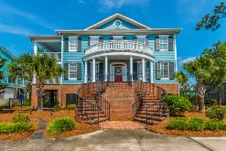
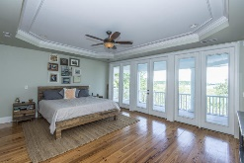
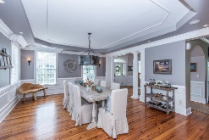
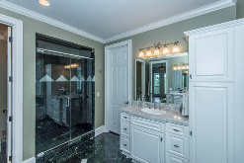
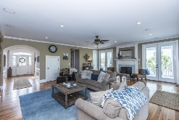
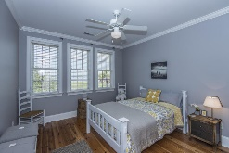
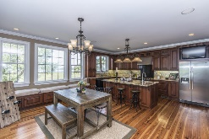
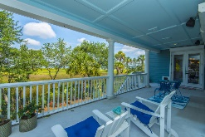
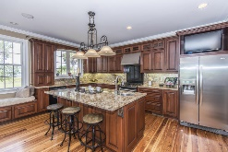

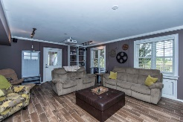
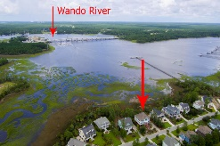
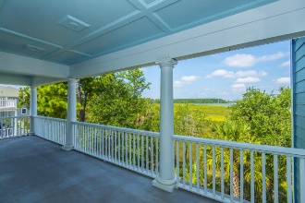
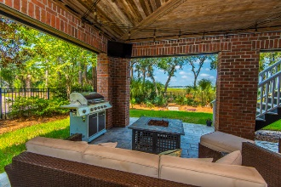
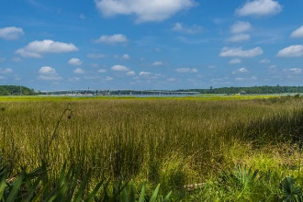

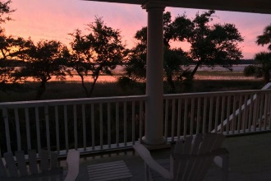
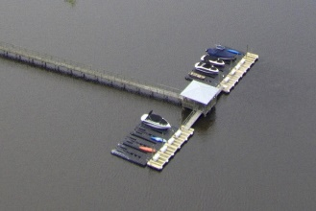


2769 Oak Manor Drive Dunes West ~ Mt Pleasant
Direct Waterfront
on The Wando River!!
Have you been searching for a home that allows you to live the resort lifestyle year-around? Are you an avid boater who dreams of direct river access to come and go as you please without being subject to the highs and lows of a tidal creek? This stunning custom home sits directly on the Wando River and comes adorned with all of the extras that make everyday feel like a vacation, including a deeded boat slip steps from your front door. This jet dock can accommodate boats up to 25 feet! Just approaching the circular driveway you'll immediately notice this home is exceptional. The brick skirt, the split curved staircase and the circular porch with columns lend an air of Greek Revival architecture to this Lowcountry home. Step inside and prepare to fall in love!
Asking $1,200,000
MLS# 17023051
3,692 SqFt
4 Bed/3½ Baths
Short Drive to Historic Downtown Charleston & Beaches
Don Dawson 843-514-0452 ddawson@carolinaone.com Carolina One Real Estate • 2713 Highway 17 North • Mount Pleasant, SC 29466
www.TeamDawsonSC.com

