Slide 1
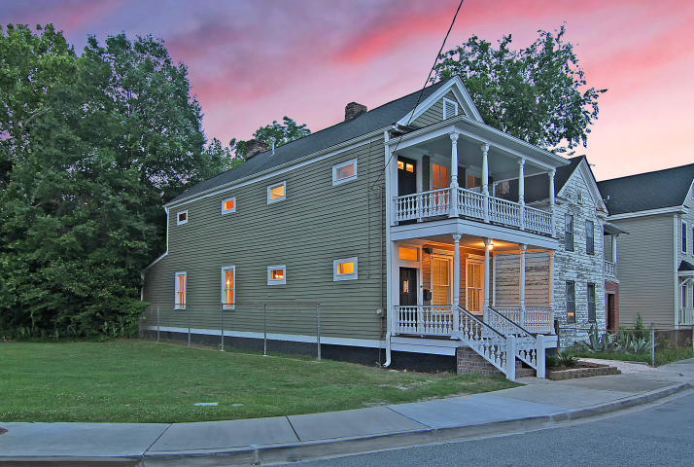
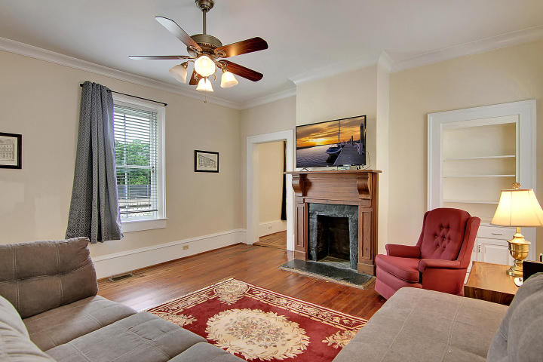
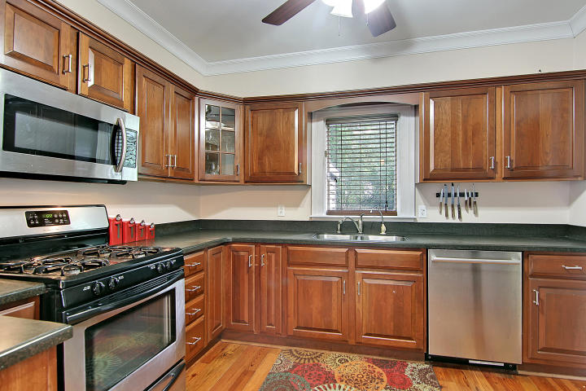
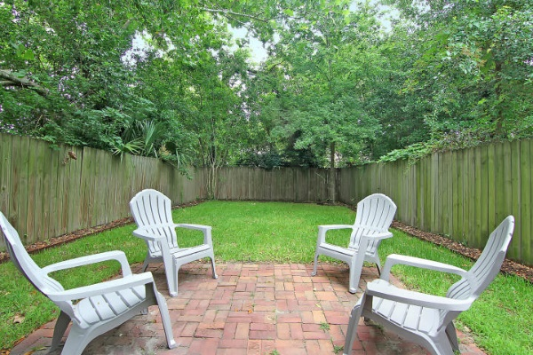
Price Reduced in Dunes West! New A/C Units With Nest Controllers PLUS a 10 Year Warranty
INCREDIBLE LOCATION!
276 Coming Street Elliotborough ~ Charleston, SC 29403 ~ MLS# 18025824 ~ $499,000
One block from King Street & walking distance to beautiful, scenic, Hampton Park in downtown Charleston, this historic home makes a great downtown getaway or an amazing investment opportunity. The home features original hardwood floors, baseboard molding, high ceilings, built-ins & several fireplaces throughout the home.
Nate Gainey nate@mattoneillteam.com 843-513-2038

