Slide 1
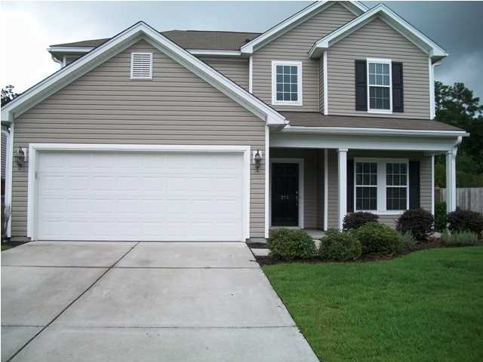
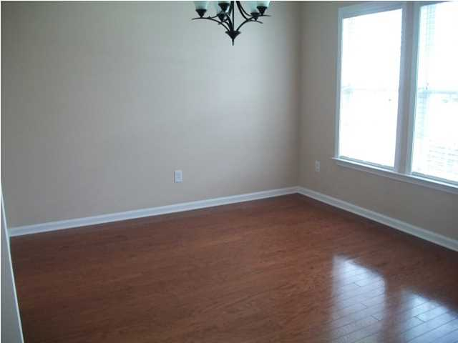
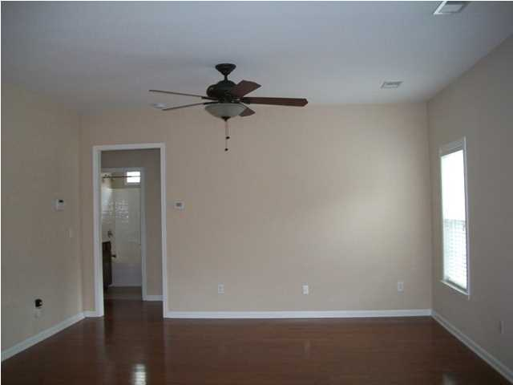
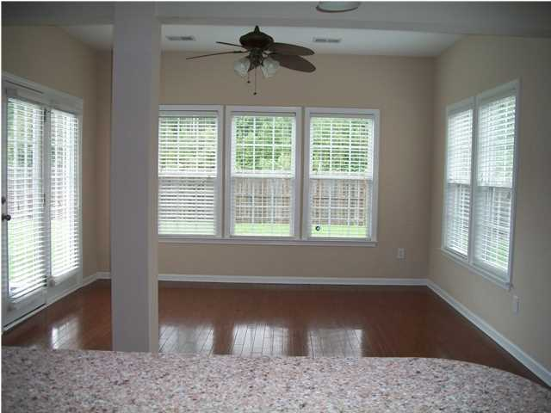
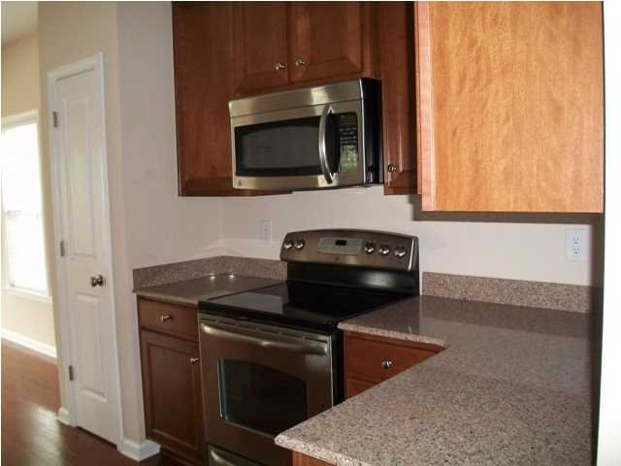
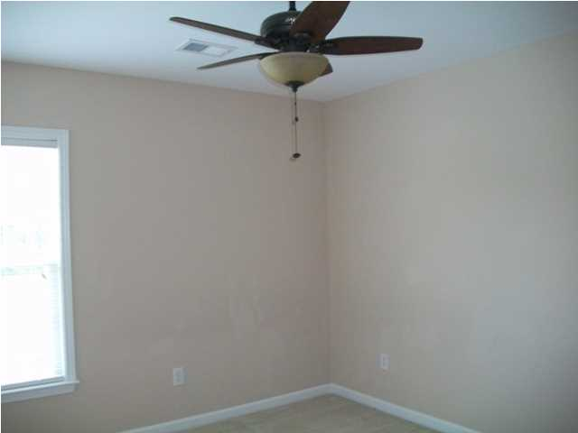
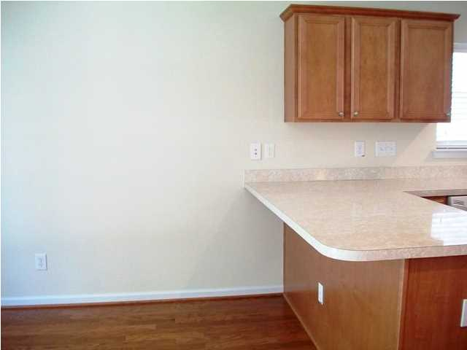
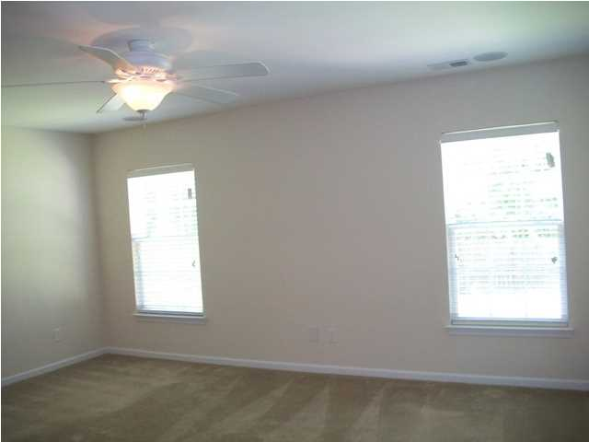
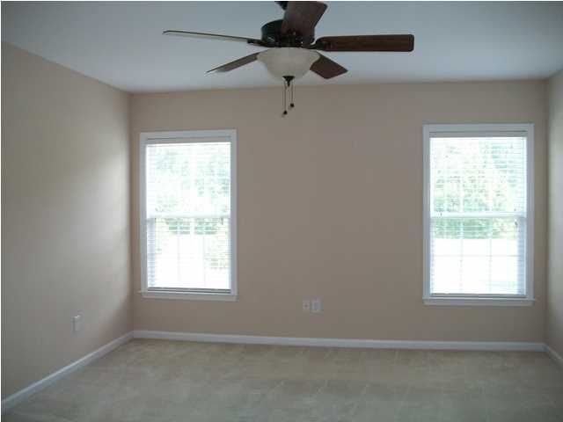
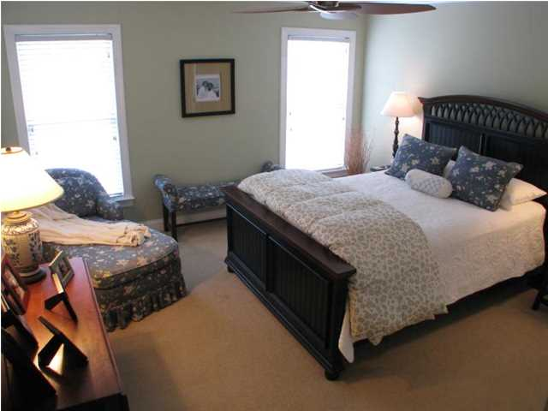
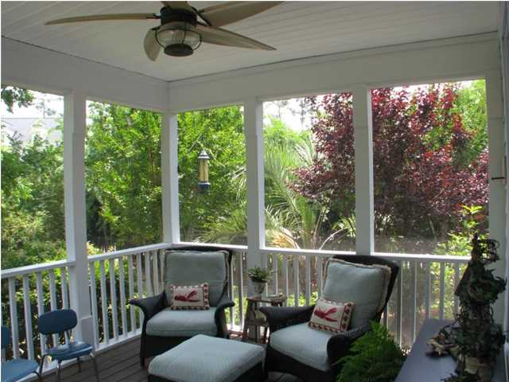
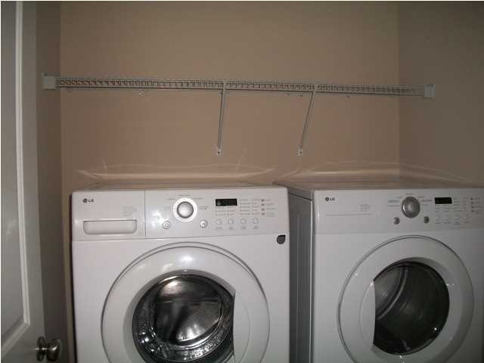
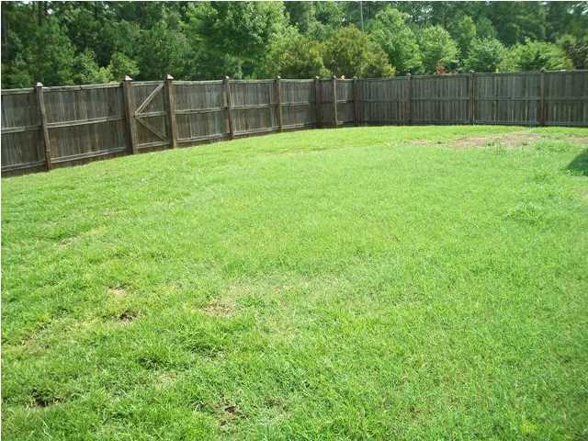


276 Mayfield Dr
Brickhope Plantation
Goose Creek
MLS# 1420850
$197,900
4 Bedrooms | 3 Baths | 2,148 sf
Great Location!!! Move in ready home that features an open floor plan with 4 bedrooms, 3 bathrooms, foyer, separate dining room, eat in kitchen, family room, sun room, fenced back yard and a 2 car garage. Why wait for new construction? There are many extras in this home that make it a must have home. Upgraded lighting has been installed throughout your home with ceiling fans/lights and window blinds. Beautiful wood flooring in the foyer, dining room, family room, kitchen, eat in kitchen and sun room. The kitchen is top of the line with Silestone counter tops, upgraded 42" kitchen cabinets with crown molding and Stainless Steel appliances including the refrigerator. Kitchen and breakfast bar is fully open to the family room and sun room which is great for entertaining or enjoying family time. Sun room has lots of natural light and a ceiling fan. Sun room leads to the patio which great for grilling in the privacy of your back yard (privacy fenced installed). Downstairs has its own bedroom and a full bathroom. Upstairs you will find the master bedroom with natral and a ceiling fan. A luxury master bathroom has raised vanities, separate garden tub, stand up shower and a walk in closet. The 2 upstairs bedrooms are good size and have ceiling fans. Laundry room is upstairs and includes the washer and dryer. Your home comes with extra storage space for all those seasonal items. Community amenities include swimming pool, play park, owners facility with workout equipment and separate clubhouse for entertaining. Great location-close to schools, Boeing, Charleston Naval Weapon Stations, shopping, Charleston Air Force Base, resturants, Joint Base Charleston, Bosch, Trident Hospital, medical offices, and I-26. Your home comes with a one year home warranty.
Immaculate Move In Ready Home!
Debbie Toombs
843-345-7895
debbie.toombs@cbunited.com
www.cbunited.com

