Slide 1
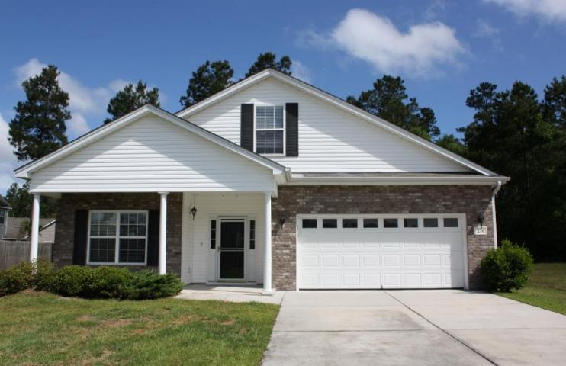
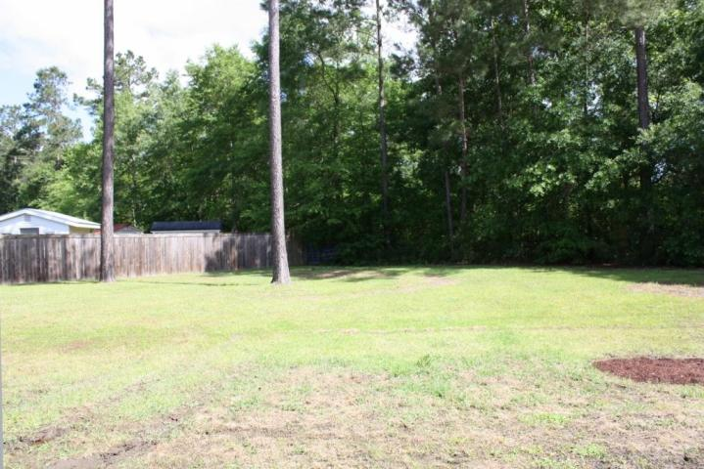
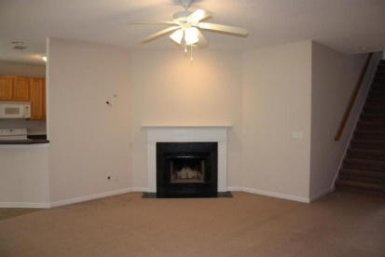
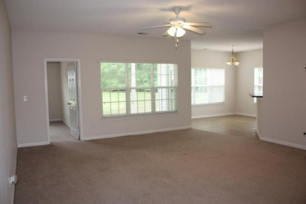
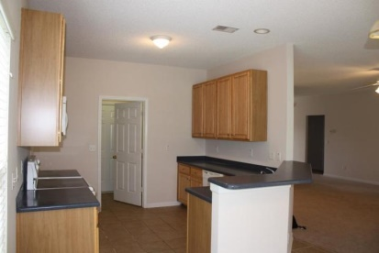
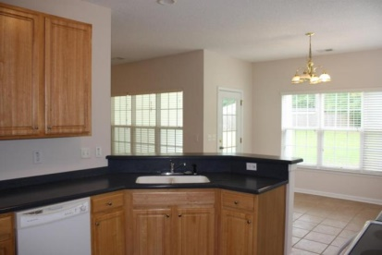
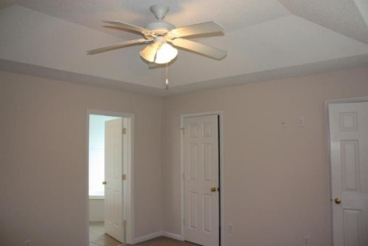
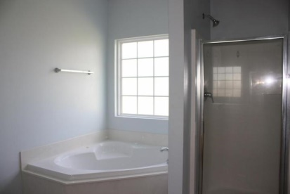
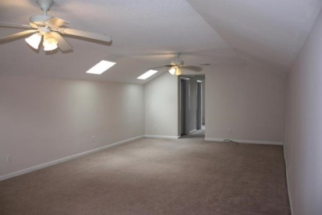
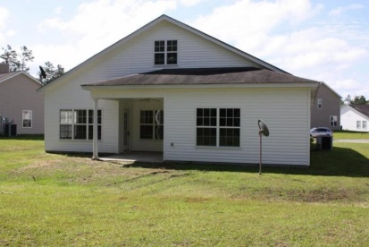


Price Reduced! Move-In Ready Home!
276 Westbrooke Road
Felder Creek | Summerville, SC 29483 | MLS# 15012295 | $215,000
This beautiful 1-story ranch is situated on a HUGE lot in a quiet neighborhood. Enjoy a quick commute with easy access to I-26. This home features a large front porch, perfect for a pair of southern rocking chairs. The eat-in kitchen with Corian counters is open to a spacious living room with fireplace. A large pantry and laundry room are conveniently located off the kitchen, leading to the garage. The first floor master suite includes a tray ceiling, jetted tub & shower and dual sinks. Two additional bedrooms, linen closet, and a full bath complete the downstairs. At the top of the stairs you'll find an office area, half bath and a HUGE 4th bedroom. Spend your evenings out back on the covered patio or in the huge private back yard. Home has been cleaned, painted and ready for new owners.
Marie Hamilton
Mobile - (843) 324-4774
mariehamiltonsc@gmail.com
Keller Williams Realty Charleston West Ashley
1180 Sam Rittenberg Ste 105
Charleston, SC 29407

