Slide 1
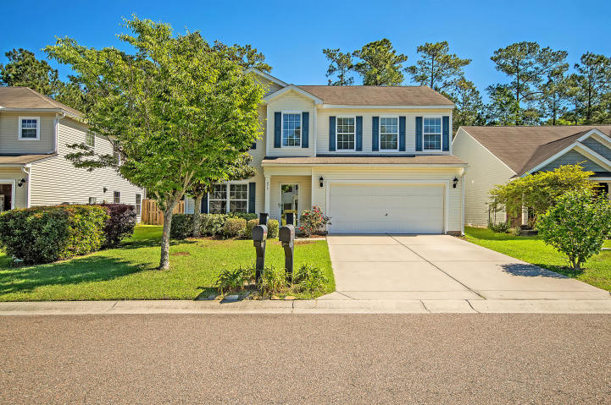
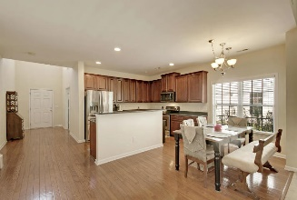
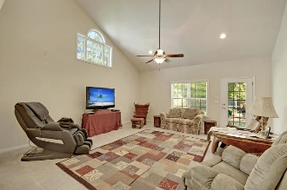
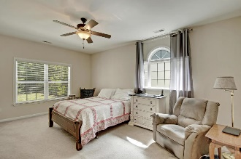
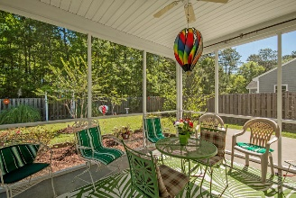
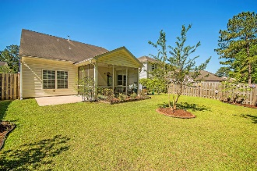
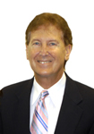

CERTIFIED BEST BUY
$15,000 Agent Bonus
with ratified contract by 4/15/18
277 Sweet Alyssum Dr
Summer Park
Ladson, SC 29456
MLS# 19012159
$275,000
$12,100 Under
Recent Appraised Value
This Remarkable detached 2 story home is situated on a quiet tree-lined street and is surrounded by a large private fence yard. This Unbelievable home offers exclusive ceiling fans, distinctive lighting fixtures, energy efficient tankless water heater, has 4 bedrooms, upstairs offers 3 large bedrooms and a valuable loft area that is perfect for a kids playroom. There are several large rooms on the main floor including the Spacious master bedroom suite that offers a huge walk-in closet and a stylish master bathroom with double vanities, an awesome walk-in shower & useful linen closet, the living room or private office is perfectly located just off the grand entry foyer with 18 ft ceilings and gorgeous wood/laminate flooring. The modern, spacious kitchen is appointed with beautiful crafted 42 inch wood cabinets, selected wood/laminate flooring, upgraded built-in stainless appliances and stylish hard surface counter tops. The dining area is adjacent to the kitchen, offers gorgeous wood-laminate flooring and is filled with natural light from a large picture window. The Grand gathering room is open and offers 18 ft. ceiling with a classic ceiling fan and is perfect for relaxing or entertaining.
There is private walk-out to the important screened-in porch that is perfect for morning coffee or relaxing in the evening. Continuing on to the over sized patio and the large landscaped back yard is perfect for outside entertaining and cook-outs.
This Amazing home is located in the Dorchester 2 school system. Priced for a quick sell! Bring your checkbook.
The Line Forms Here! Age, sqft, taxes, acreage, HOA dues, flood zone and schools are approximate, buyer to verify any and all information deemed necessary.
William R Everett, Jr
(843) 693-8539– C (843) 576-2701 – O
bill@theeverettgroup.net
RE/MAX Pro Realty, 9209 University Blvd, Charleston, SC 29406

