Slide 1
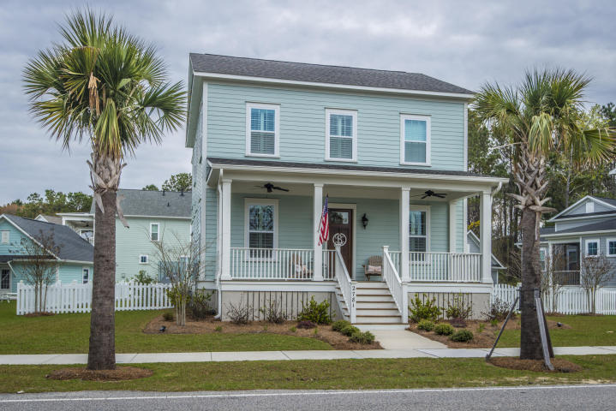
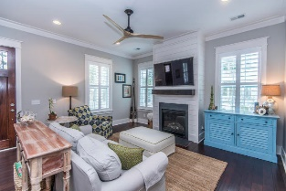
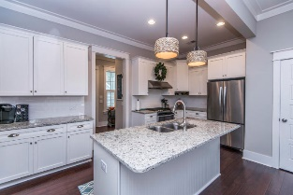
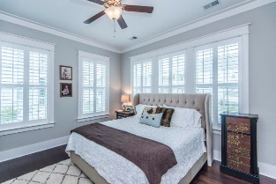
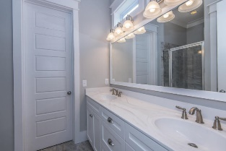
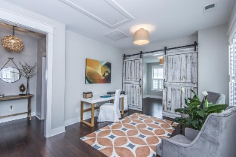
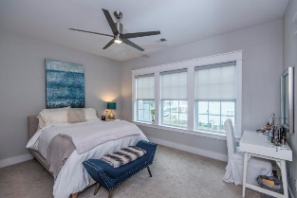
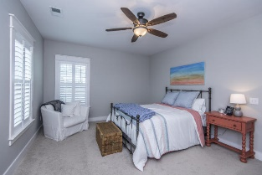
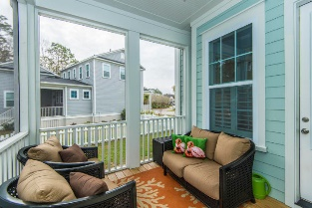
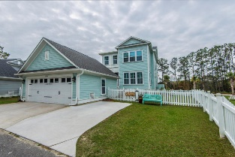


2781 Rivertowne Parkway
Mount Pleasant, SC 29466 ~ MLS# 18006167
Rivertowne ~ Reduced to $509,900
Gorgeous Charleston Single in the new Tributary subsection of Rivertowne features a modern open living space with beautiful hardwood floors, a kitchen with matching stainless appliances, granite counter tops, and large center island. A wall of windows gives the whole downstairs an abundance of natural light, and highlights the custom fireplace trimmed with shiplap and featuring a reclaimed wood mantle. There is an en suite master bedroom located downstairs and a second master bedroom upstairs along with two additional secondary bedrooms which share a charming Jack-and-Jill bathroom. A generous bonus room with distinctive reclaimed wood barn doors finishes off the spacious second floor and can used as a home office, extra bedroom, or second family room.
Come to Rivertowne Tributary and spend your evenings relaxing on the full front porch or taking in the view from the private screened porch out back.
($1,900 credit available toward buyer's closing costs and pre-paids with acceptable offer and use of preferred lender.)
Kristin Schatmeyer
Cell - (843) 697-7370
kristin.schatmeyer@carolinaone.com
www.KristinSchatmeyer.com
Carolina One Real Estate
2713 Highway 17 North
Mt. Pleasant, SC 29466

