Slide 1
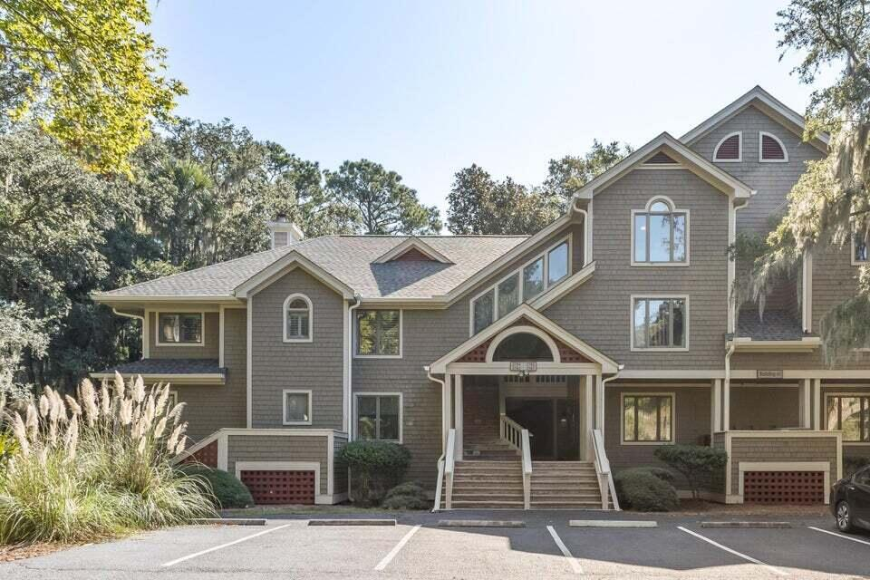
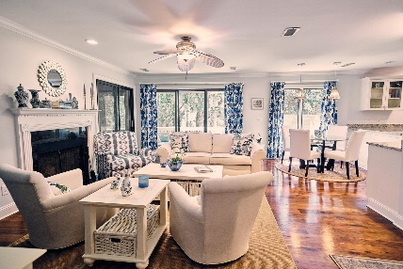
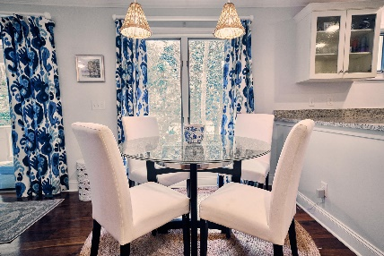
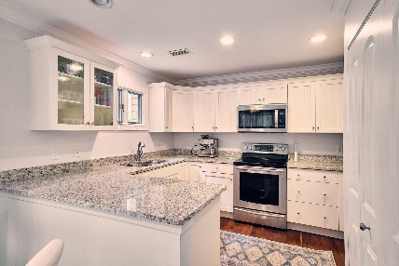
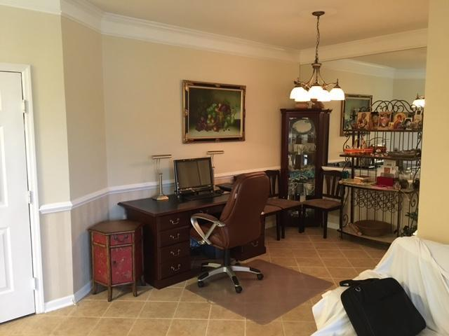
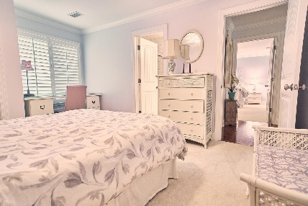
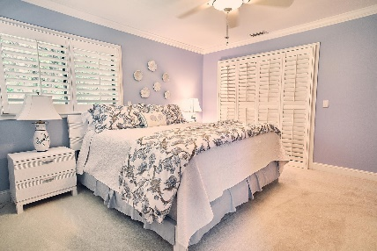
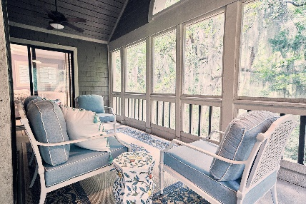
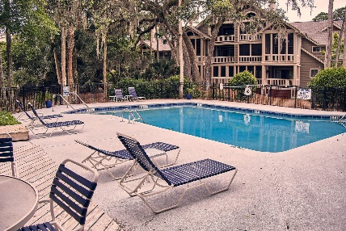


Open Houses Thursday & Friday
2784 Hidden Oak Drive
Seabrook Island, SC 29455 | MLS# 24010741 | $685,000
Nestled among majestic oaks, this meticulously maintained townhome is a slice of the Seabrook Island dream. Wonderful upgrades in the kitchen and baths, as well as appliances, make this unit turn-key and allows you to immerse yourself in everything that is Seabrook. The upstairs unit, with both wooded and golf views, offers unmatched privacy. Live Oaks has its own pool, and is minutes from the trail head of the Live Oaks walking trail and St Christopher Camp, as well as within walking distance to Pelican Beach. The incomparable Seabrook Island boasts world-class amenities and a life of social and sporting opportunities. Amenities include two championship golf courses - Willard Byrd designed Ocean Winds and Robert Trent Jones, Sr. designed Crooked Oaks, a tournament grade tennis center, pickleball courts, full-service equestrian center, fitness and aquatics complex, beautiful beaches, a seasonal variety of indoor and outdoor dining venues for lunch, dinner or your own private event. Minutes away are Freshfields Village and Bohicket Marina. Located between Seabrook Island and Kiawah Island, Freshfields Village is a destination for shopping, fine and casual dining, convenient services and family-friendly outdoor events. Bohicket Marina is a full-service marina with wet slips, dry storage slips as well as wonderful restaurants and shops.
Chris Patricola
732-778-4385
patricolare.sc@gmail.com
www.coldwellbankerhomes.com
Coldwell Banker Residential Brokerage
1127 Queensborough Blvd. 103
Mt Pleasant, SC 29464

