Slide 1
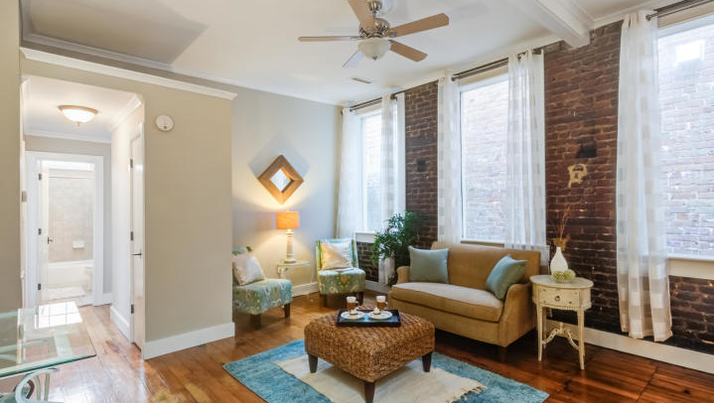
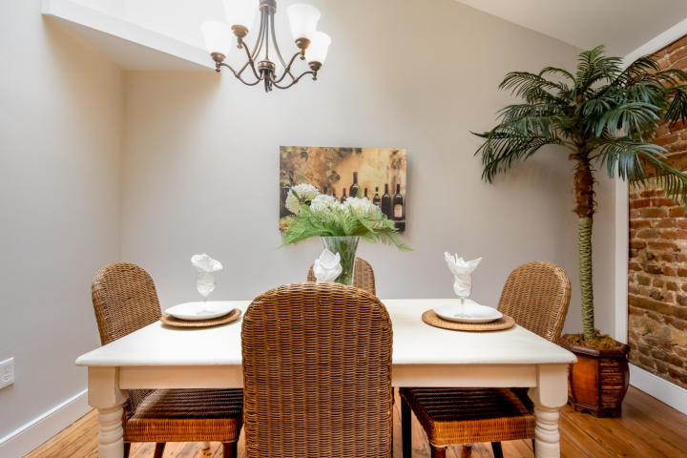
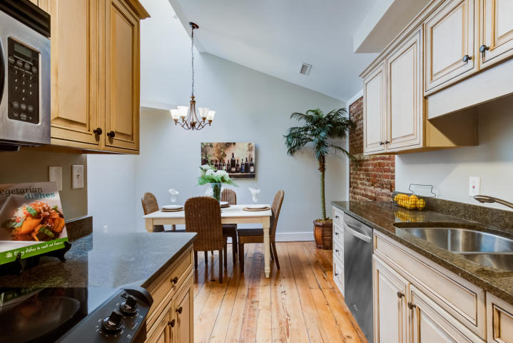
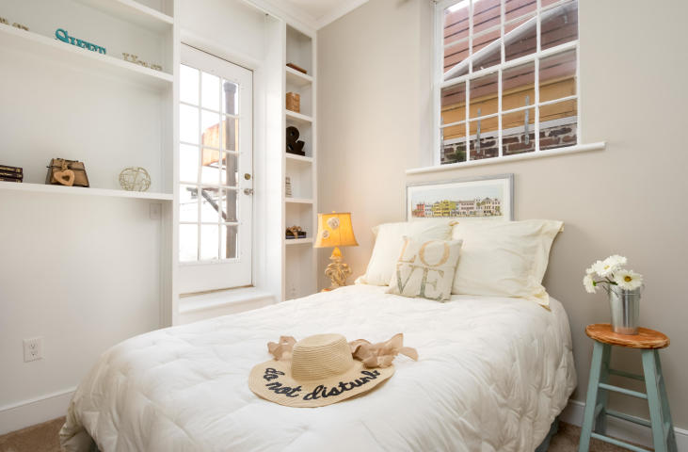
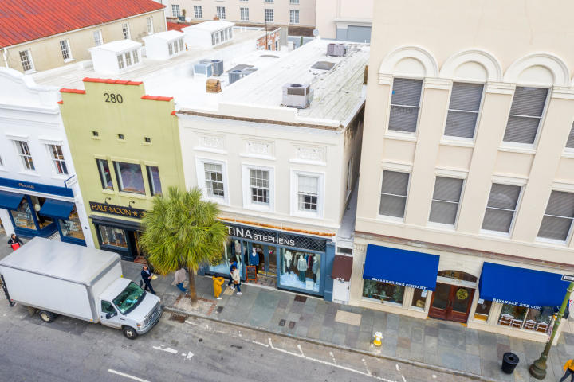


4 bed, 3.5 bath
Agent Open House | January 17th | 11-12:30
Private Boatlift
Welcome home to 205 Magnolia Road, the best location in Charleston!
This 3 bedroom, 2 bath, 1636 sqft charming craftsman style cottage is footsteps from the most popular shops and restaurants of Avondale. Loaded with updates and upgrades, there is nothing you won't love about this home. Wonderful curb appeal and an adorable front porch with custom gate. Fresh paint throughout the entire downstairs. Gorgeous original hardwoods. Main floor master bedroom with oversized closet could almost double as an office! Brand new privacy fence captures one of the largest lots in the neighborhood. Kitchen loaded with updates and gas for cooking. Bathrooms have been updated / upgraded, bathtub re-glazed. Lighting has been updated with custom fixtures. Loads of storage. Oversized mudroom/laundry room. Huge storage shed with electrical provides endless options for use. All a few short minutes from downtown for work and play. This is the location and property in excellent condition that everyone's looking for. Come make this charming house your new home!
Offered for $470,000
278-C King Street
Downtown Charleston | MLS# 18033109 | $499,000
Don't miss the best pied-á-terre offered on King Street!
Featuring 2 beds, 1.5 baths, 1,042 sqft, renovated, exposed brick walls
Crissy Rowell
Mobile - (843) 377-5177
crissy.rowell@carolinaone.com
www.crissyrowell.com
Carolina One Real Estate | 195 W Coleman Blvd | Mt Pleasant, SC 29464

