Slide 1
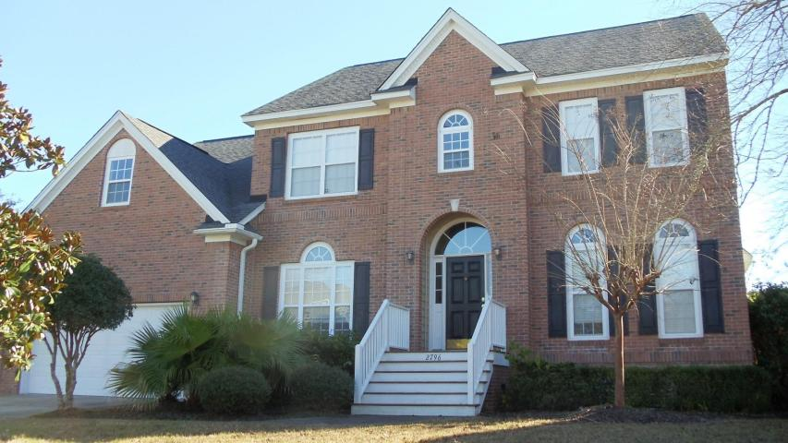
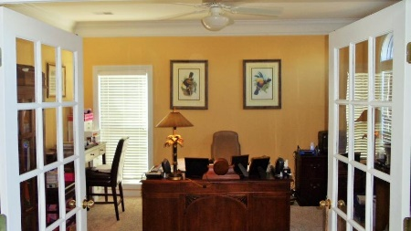
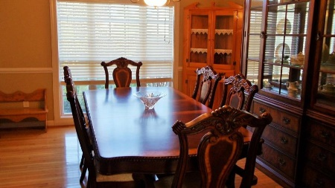
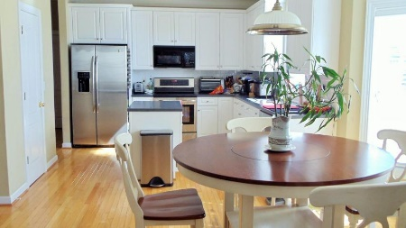
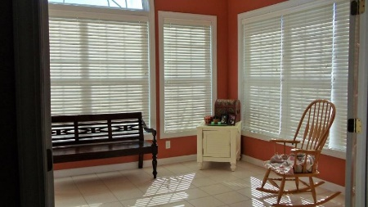
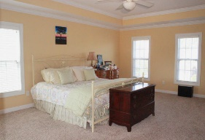
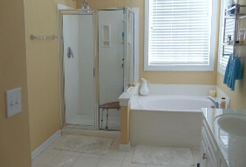
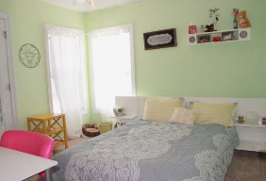
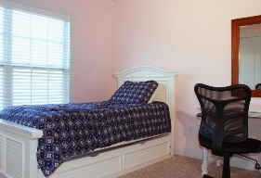
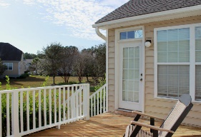
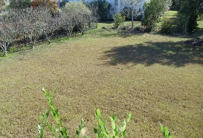


2796 Carolina Isle Dr
Mount Pleasant, SC 29466
MLS# 15031453
$490,000
5 Bedrooms | 2½ Baths | 3,571 sf
Open House this Saturday Feb 20th Noon-4pm
Lowest priced home per square foot in the desirable Rivertowne Country Club with nearby neighborhood amenities offering the areas only Arnold Palmer Signature Golf Course, resort style swimming pool, amazing clubhouse, tennis courts and walking paths. As you enter the home you'll notice the 2 story foyer with an office to your right and separate formal dining room to your left. The dining room flows into the kitchen via a butler's pantry. Plenty of cabinet and counter space with Corian counter tops outlining the kitchen and center island to match. The very spacious layout offers a large family room with recessed speakers and remote gas fire place with marble surround. Off the family room are French doors leading into the spacious tiled sunroom which leads directly out to the rear deck overlooking the large backyard. This home has lots of large windows allowing plenty of natural light and extensive molding throughout this home. Downstairs features nice hardwoods and carpeting with carpeted staircases, hallway, and bedrooms on the second level. The upstairs master suite features trey ceilings with large master bath featuring his and her vanities and separate shower/garden tub as well as large walk-in closet. All bedrooms are a very nice size and the LARGE frog can be used as your 5th bedroom, mother-in-law suite, or game room with plenty of storage, full bathroom and second staircase leading back downstairs. It's hard to beat this price for this size home anywhere in Mt. Pleasant! Schedule your showing today, don't let this opportunity pass you by.
Stephen Kugelman
(843) 330-0403
steve@agentowned.com
www.kugelmanrealestate.com
AgentOwned Realty Co. Premier Group, Inc. | 824 Johnnie Dodds Blvd | Mt Pleasant, SC 29464

