Slide 1
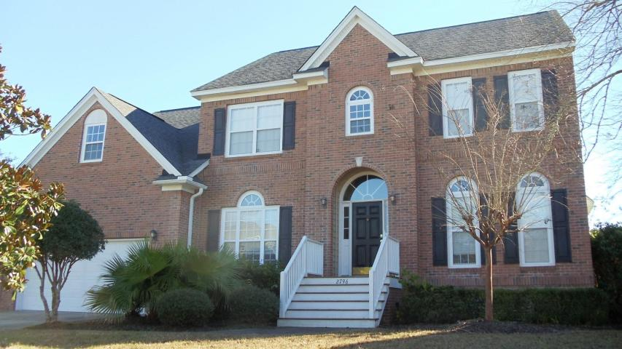
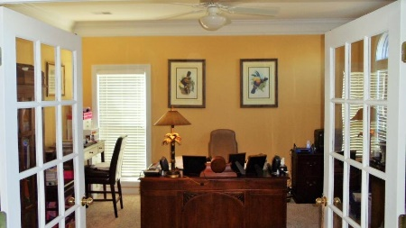
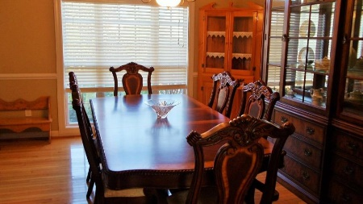
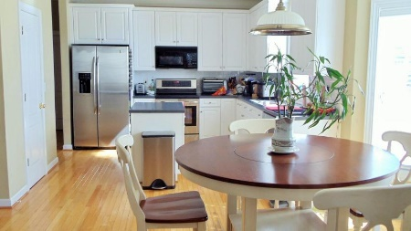
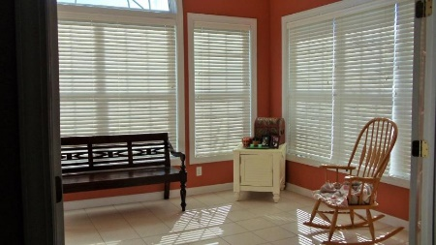
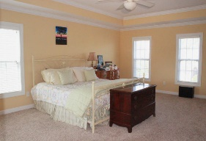
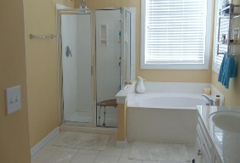
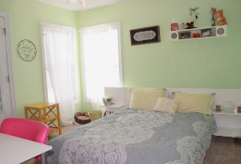
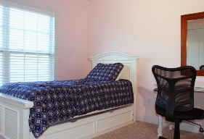
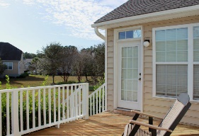
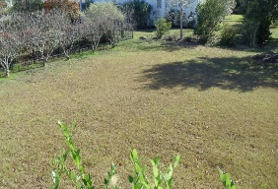


2796 Carolina Isle Dr
Mount Pleasant, SC 29466
MLS# 15031453
$474,500
5 Bedrooms | 2½ Baths | 3,571 sf
Open House this Saturday, May 7th, 12-3pm
**BELOW MARKET VALUE...WITH BIG PRICE REDUCTION** Lowest priced home per square foot in Rivertowne Country Club with open floor plan and space, space, space make this home the perfect combination of livability, style and one great deal!!! This well laid out home is located in the desirable Rivertowne Country Club. Ride your golf cart around the corner to nearby neighborhood amenities offering the area's only Arnold Palmer Signature Golf Course, resort style swimming pool, amazing clubhouse, tennis courts and walking paths. As you enter the home you'll notice the 2 story foyer with an office to your right and separate formal dining room to your left. The dining room flows into the kitchen via a butler's pantry. Stainless steel appliances and tons of cabinet/counter space in the kitchen. Backsplash and center island to match. The open layout offers a large family room with recessed speakers for surround sound and remote gas fire place with marble surround. Off the family room are french doors leading into the spacious tiled sunroom which exits directly onto the back deck overlooking the large backyard complete with irrigation system. If desired you could put in a nice sized pool and still have plenty of room for family fun! The floor-to-ceiling windows allow plenty of natural light along with extensive molding/trim work throughout the home. Downstairs features nice hardwoods and carpeting with dual carpeted staircases, hallway, and bedrooms on the second level. Even the laundry room is spacious with utility sink, cabinet space, and storage closet. The upstairs master suite features trey ceilings with large master bath featuring his and her vanities separate shower/garden tub as well as large walk-in closet. All bedrooms feature large customized closets to help with organization. All bedrooms are a very nice size and the LARGE frog can be used as your 5th bedroom, mother-in-law suite, or the kids play room with plenty of storage, full bathroom and the second staircase leading back downstairs. It's hard to beat this price for a home like this anywhere in Mt. Pleasant! Put your own style and touches on this home and still be well within market comps. Schedule your showing today, don't let this opportunity pass you by.
Stephen Kugelman
(843) 330-0403
steve@agentowned.com
www.kugelmanrealestate.com
AgentOwned Realty Co. Premier Group, Inc. | 824 Johnnie Dodds Blvd | Mt Pleasant, SC 29464

