Slide 1
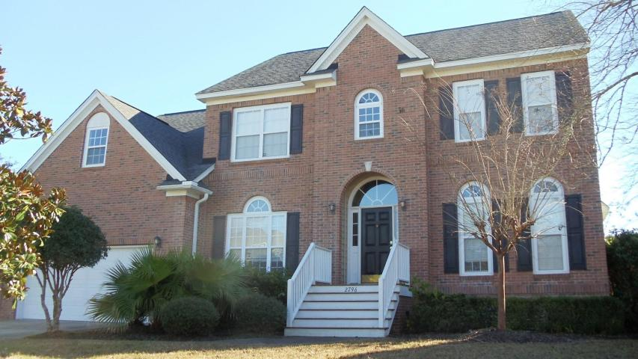
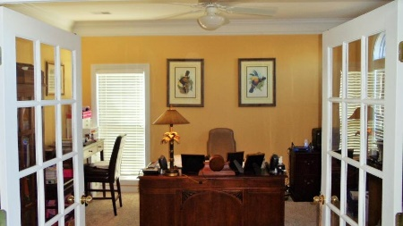
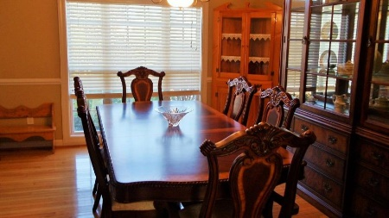
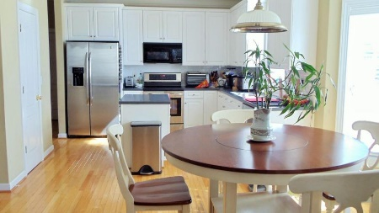
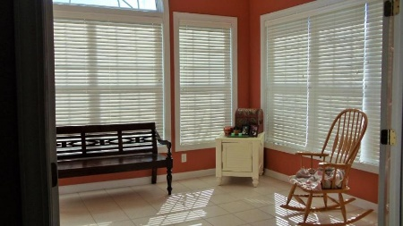
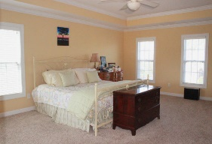
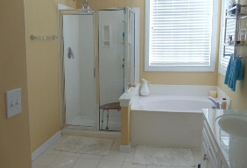
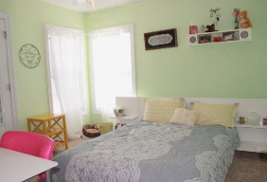
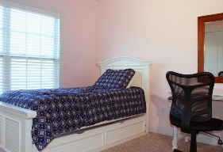
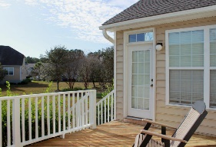
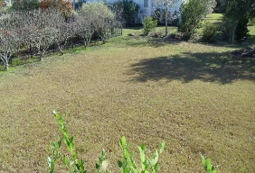


2796 Carolina Isle Dr Mount Pleasant, SC 29466 MLS# 15031453 $490,000 5 Bedrooms | 2½ Baths | 3,571 sf
One of the Best Deals in RiverTowne
WOW lowest priced home per square foot in the desirable Rivertowne Country Club with amenities offering the areas only Arnold Palmer Signature Golf Course, a resort style swimming pool, amazing clubhouse, tennis courts and walking paths. As you enter the home you'll notice the 2 story foyer with an office to your right and separate dining area to your left. This home offers hardwoods and carpet along with Corian counter tops in the kitchen and extensive molding throughout.
Off the family room are French doors leading into the spacious sunroom which leads directly out to the rear deck overlooking the large backyard. There is plenty of room for storage and entertaining. The upstairs master features trey ceilings along with a large tiled master bath featuring dual vanities and a separate shower and garden tub and large walk-in closet. The LARGE frog can be used as the 5th bedroom or game room with plenty of storage, full bathroom and staircase leading to the laundry room and kitchen. This home is priced to sell quickly! Stop in today and see one of the areas best deals around.
Stephen Kugelman
(843) 330-0403
steve@agentowned.com
www.kugelmanrealestate.com
AgentOwned Realty Co. Premier Group, Inc. | 824 Johnnie Dodds Blvd | Mt Pleasant, SC 29464

