Slide 1
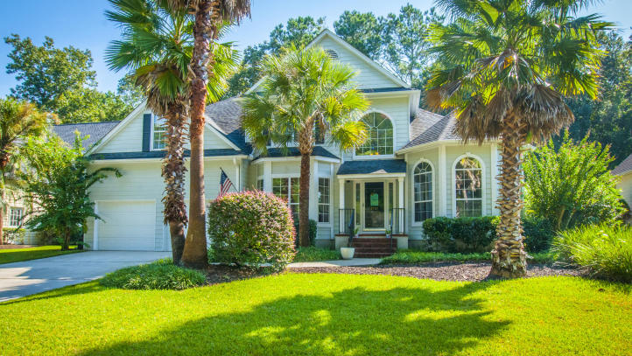
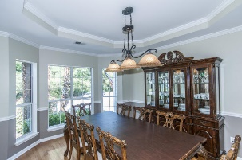
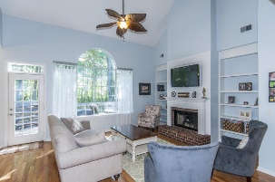
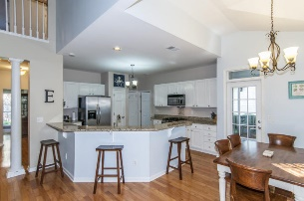
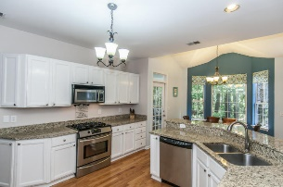
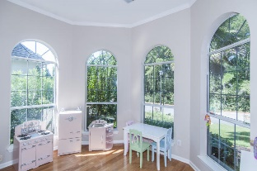
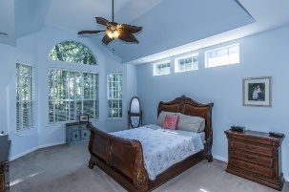
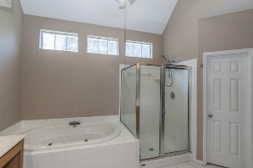
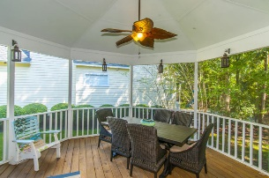
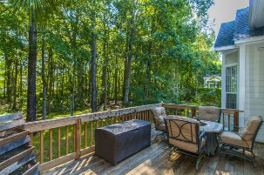



New Listing!!
2797 Rosedown Point
Brickyard Plantation - Mount Pleasant - MLS# 16026730 - $490,000
Everyone wants community and a great view! This home has both! Brickyard Plantation is an amazing neighborhood with a private boat launch, clubhouse, pool, tennis courts and walking trails. This 4 bedroom, 2.5 bath home has an OPEN floorplan and is located on a quiet cul-de-sac. The master bedroom and bath is located on the first floor. The kitchen opens to the living room and boasts granite countertops and a gas stove. The back deck and screened porch provide a perfect retreat to enjoy the amazing trees and wetland in the private backyard!
Del Shaffer
843.408.6821
dshaffer@carolinaoneplus.com

