Slide 1

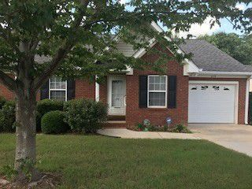

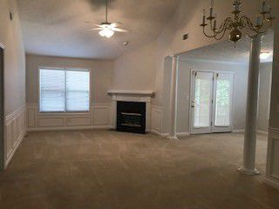
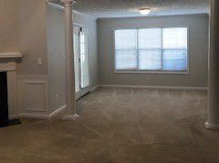
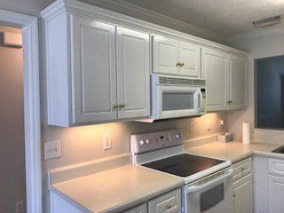
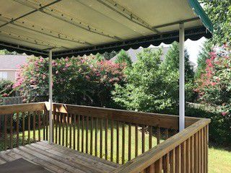
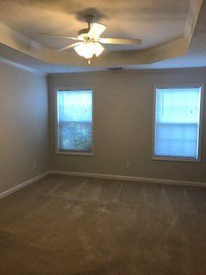
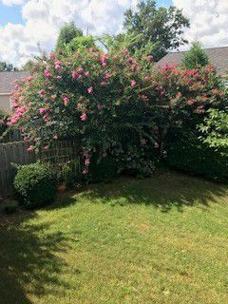


279 Southbank Dr
Aiken, SC 29803
$124,500 ~ MLS# 99285
2 beds 2 baths 1,334 sqft
Show and sell! This home has been impeccably maintained, fresh interior paint throughout, carpets have been cleaned, this home is spotless and move in ready.
Great location in neighbor with wonderful covered deck overlooking beautifully landscaped, private backyard. Great for entertaining or just relaxing, this home is a MUST SEE!
Valli Catchpole
803.617.8540 / valli1@me.com
Property Consultants of the South, 1429 Lyon Dr SE, Aiken, SC 29801 / www.FineSouthernLiving.com

