Slide 1
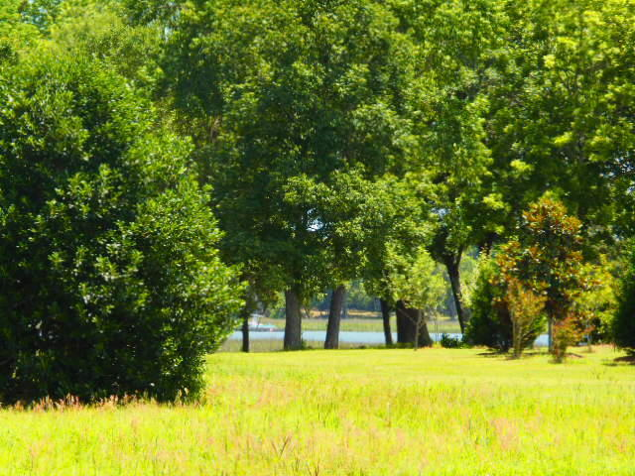
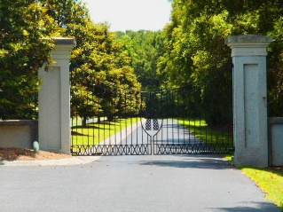
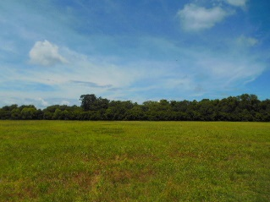
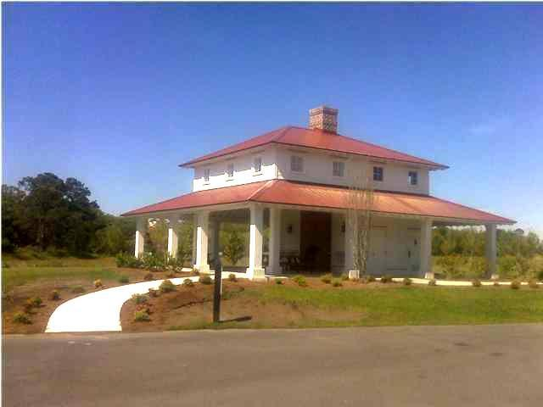
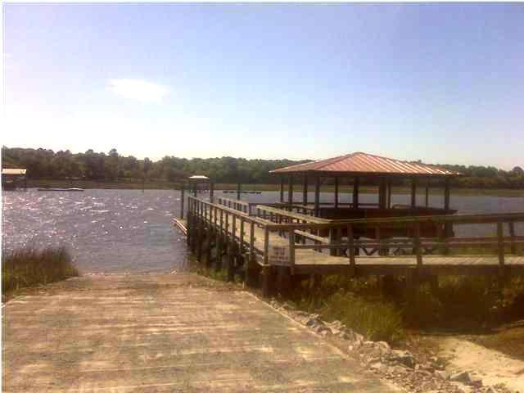
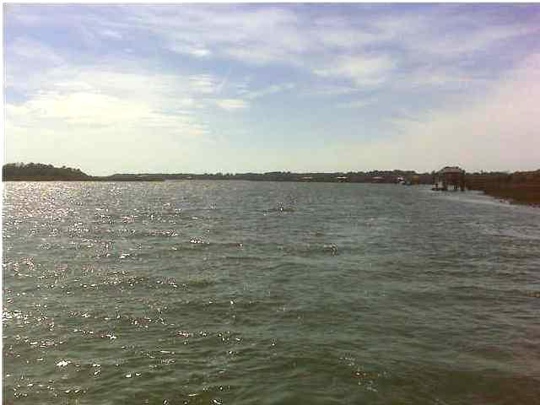


27 Anchor Watch Drive
Anchorage Plantation | Wadmalaw Island, SC 29487 | MLS# 15015094 | $90,000
Upscale Gated Waterfront Community
Motivated Seller
Xcellent high buildable 3 acre lot in an upscale waterfront community. Anchorage offers all of the privacy and amenities you would want. Private boat ramp to launch your boat, community dock, boat wash area, amenity center with picnic area, BBQ grills, picnic tables, restroom and fireplace down by the waters edge making it the perfect place for your private functions. Unobstructed access to the Atlantic Ocean and Intracoastal water way. High bluff not in a flood zone
Neil Schneider
(843) 200-8902
neil@charleston.info
AgentOwned Preferred Group of Mt Pleasant
824 Johnnie Dodds Blvd, Mt Pleasant, SC 29464
www.buycharlestonscrealestate.com

