Slide 1

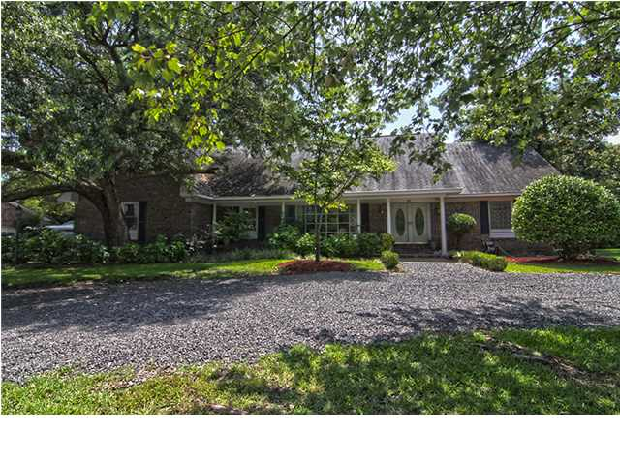
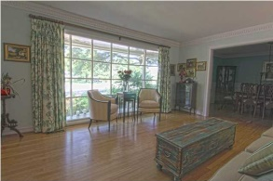
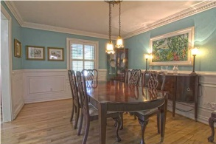
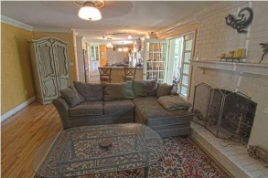
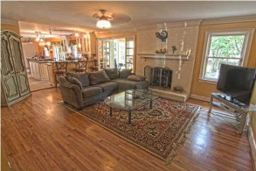
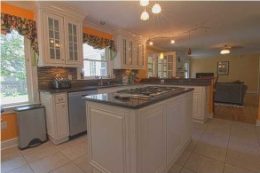
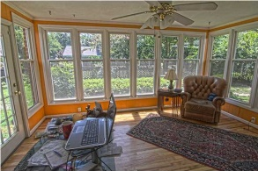
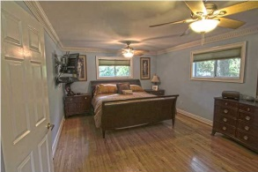
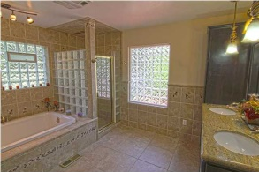
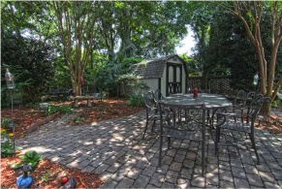
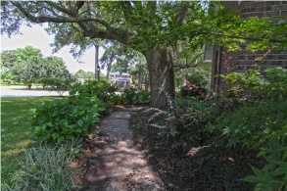


Agent Open House ~ Wednesday, August 20th ~ 2-4pm
27 Old English Dr Wespanee Plantation • Charleston • MLS# 1420105 • $519,000
Large updated traditional 2 story brick home perfect for large family or lots of guests. Great Location. Convenient to MUSC & St. Francis Hospitals. Easy access to city, airport and beaches. Restaurants, grocery stores and 2 pharmacies just minutes away. Move-in Ready! Just bring your kids, furniture and dog. Yard is already fenced! Attention was given to every detail when updating. Custom Crown Molding throughout, wainscoting in the formal dining room, smooth ceilings throughout most of home, hardwoods and tile floors as well as a marble foyer. Family room with fireplace opens to large eat-in kitchen including lots of granite counter space and an island with gas cook top and oven. Stainless steel appliances and custom made cabinets add charm and value. The large first floor master suite has a large cedar-lined walk-in closet and a spa bathroom with jetted tub and glass shower. The second level offers 4 nice size bedrooms plus a bonus room and 2 full baths. If you are truly looking for a family home that brings comfort and style to both adults and children, this just may be the home for you!
Susan Garfinkel
843-696-5838 | susanrealtor44@gmail.com
Elaine Brabham and Associates, LLC • 1890 Sam Rittenberg Boulevard, Suite 217 • Charleston, SC 29407

