Slide 1
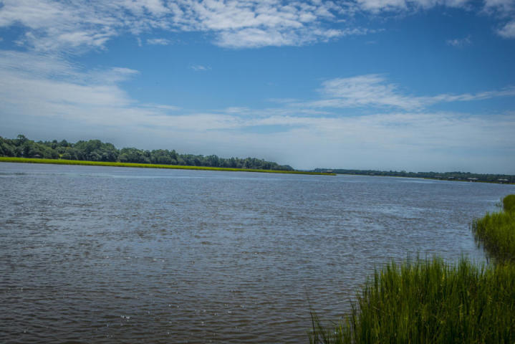
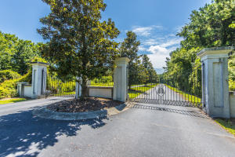
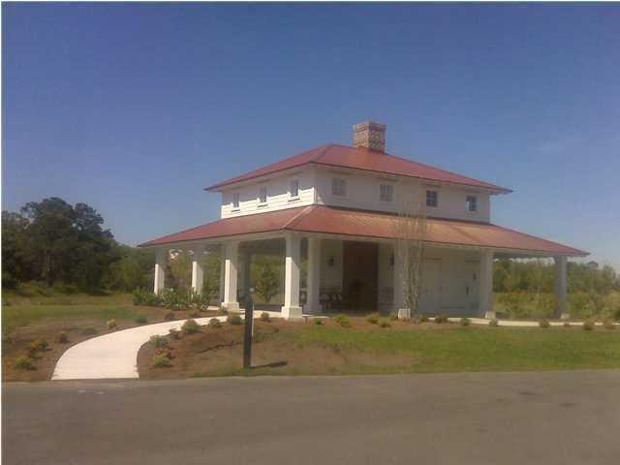
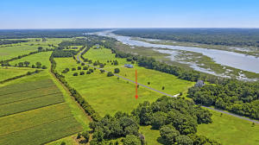
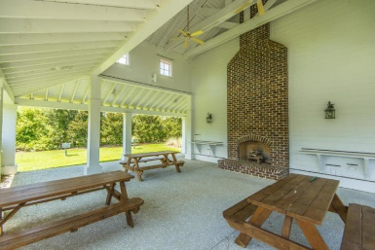
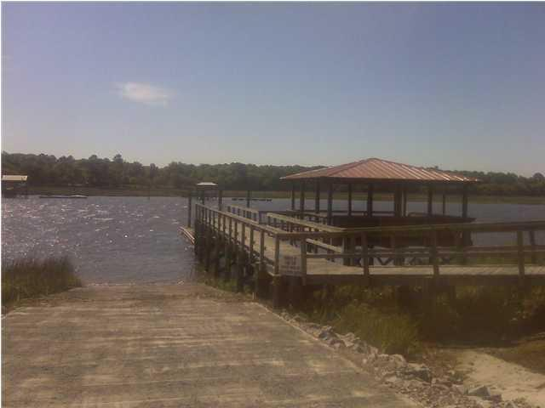
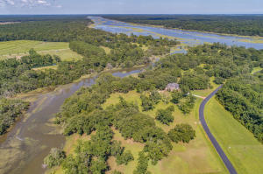

27 Anchor Watch Drive Anchorage Plantation · Wadmalaw Island · MLS# 20012901 · $119,900
3 Acre Estate Sized Lot In Deep Water Community
Fantastic Deal in Nexton
Seller will pay buyer's agent $5,000 at closing
with accepted offer by noon June 7, 2019!
THIS IS A HIGH VERY NICE LOT IN ANCHORAGE PLANTATION. ANCHORAGE IS A PRESTIGOUS GATED WATERFRONT COMMUNITY WITH COMMUNITY BOAT RAMP, DOCK, BOAT WASH OUT AREA AND AMENITY CENTER WITH BBQ GRILLS, PICNIC TABLES AND FIRE PLACE. THIS IS A 3 ACRE LOT THAT HAS BEEN CLEARED YEARS AGO AND IS READY TO BE BUILT ON AND LANDSCAPED TO YOUR PREFERENCE. AGENT IS OWNER.
Art T Cope
O 843-725-0135
M 843-200-1308
artcope1@comcast.net
AgentOwned Realty Co.
Preferred Group, Inc.
824 Johnnie Dodds Blvd
Mt Pleasant, SC 29464
www.agentownedrealty.com

