Slide 1
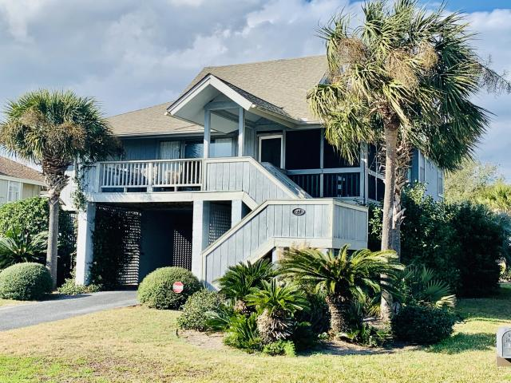
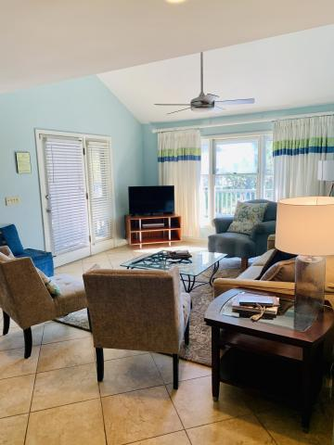
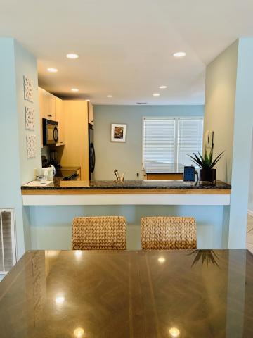
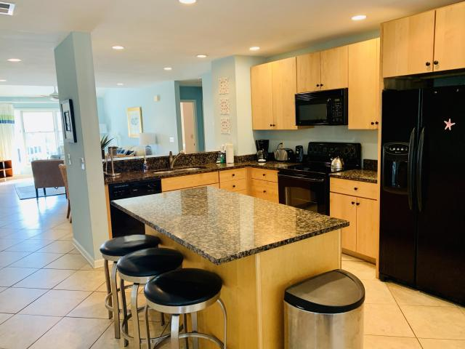
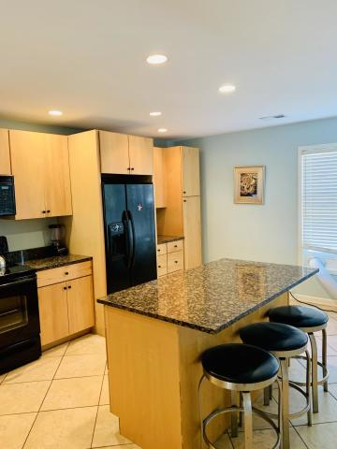
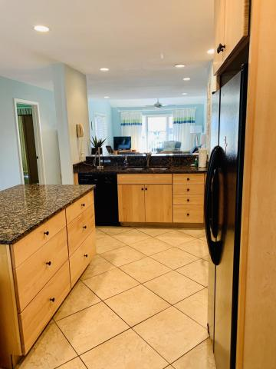
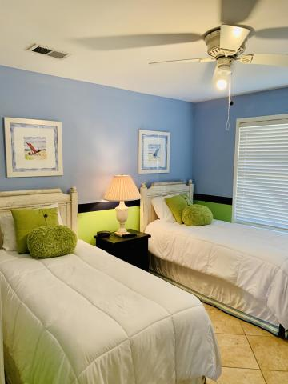
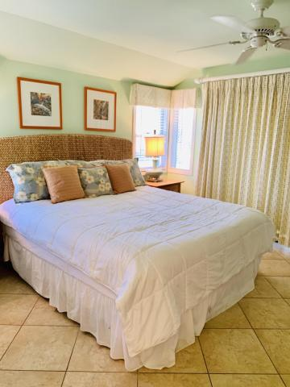
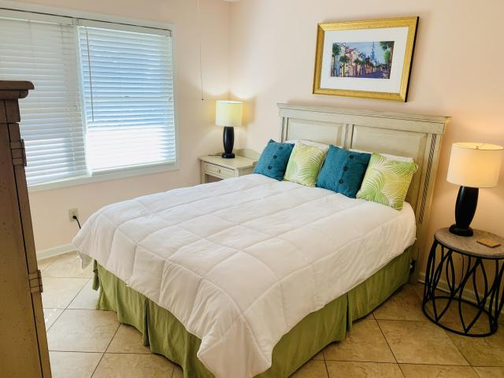
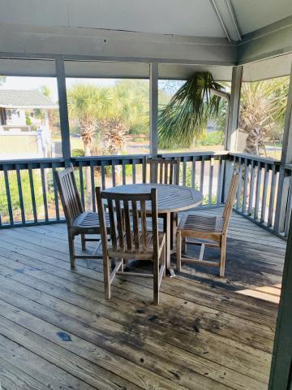
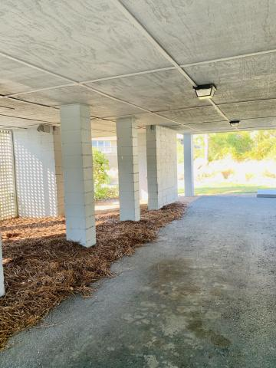

Open House
Sunday 1-4
27 Beachside Drive
Isle of Palms, SC 29451
MLS# 20000986
$825,000
Lovely 3 BD 2 BA cottage located just a block from the ocean! Rare opportunity to own in Beachside! Quiet Oceanfront Community offers beach access, swimming pool, tennis court and is within walking distance of island shops and restaurants. Tiled flooring throughout, kitchen island with granite counter tops, open floor plan,12x12 screened porch and 10x17 deck off the front of the home. Elevated construction allows for car, boat and beach toy storage. Includes covered secure area for additional storage. Perfect for year round living, rental or retirement. House sold furnished.
A Must See!!!!
Elizabeth Chase
Dargan Realty & Associates
(843) 813-5050
Elizchase@hbrtwn.com
www.elizabeth.hbrtwn.com

