Slide 1
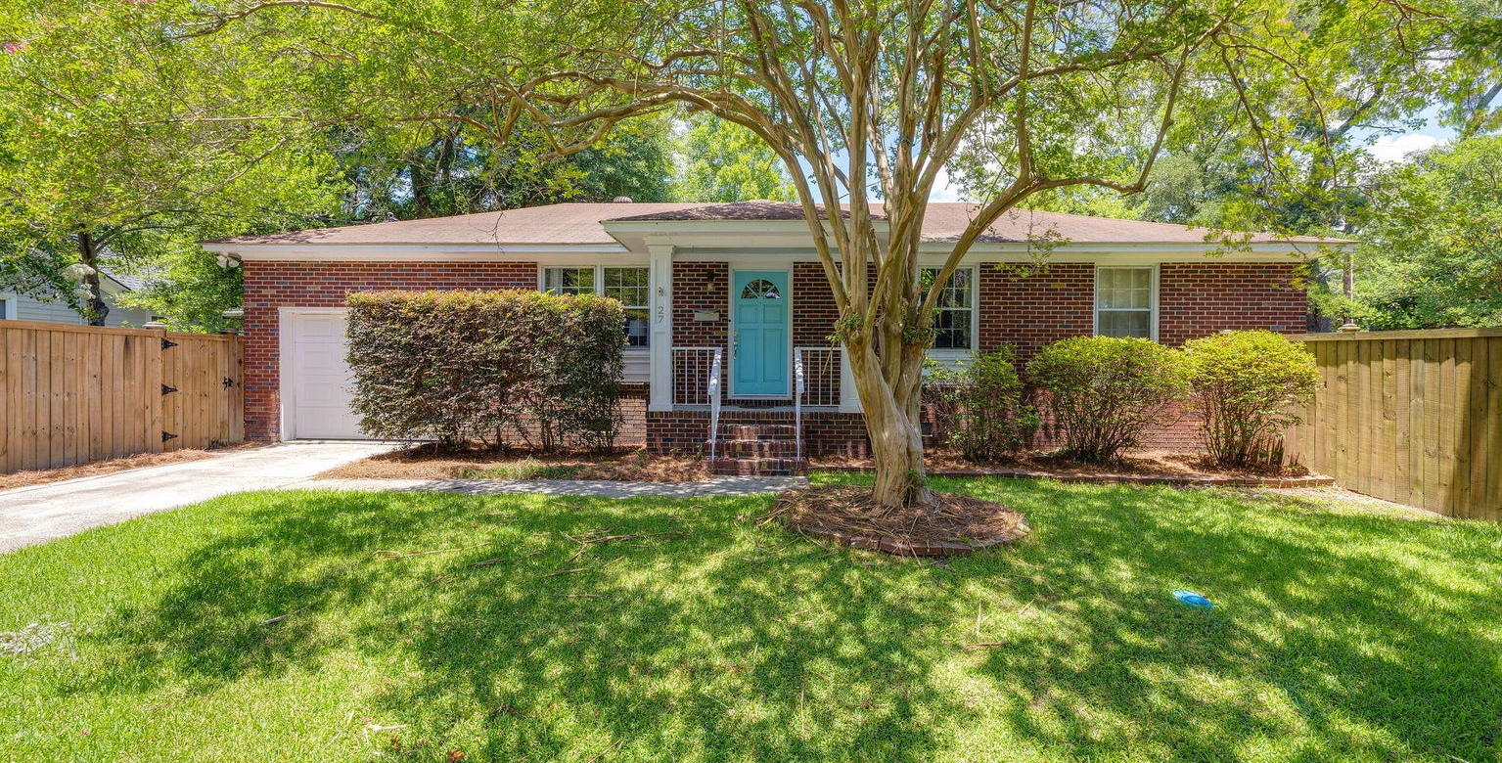
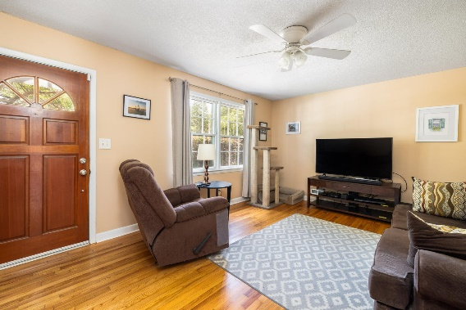
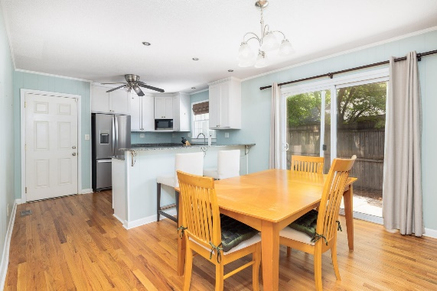
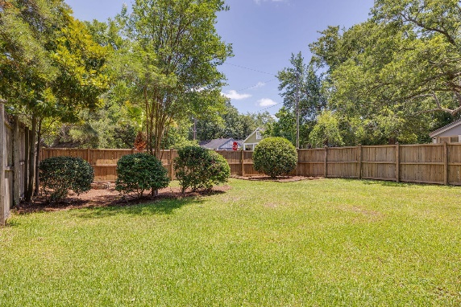

Just Listed in Avondale
27 Lolandra Avenue
Carolina Terrace | Charleston, SC 29407 | MLS# 24015696 | $639,000
Welcome to 27 Lolandra Ave, a charming and beautifully updated home located in the heart of Charleston, SC. This delightful 3-bedroom, 2-bathroom residence spans 1,132 sq ft and offers a blend of modern amenities and classic charm. Situated on a generous 0.15-acre corner lot, this property features a completely fenced-in backyard, ideal for entertaining or relaxing on the large patio. With one-car garage parking plus additional off-street parking, convenience is at your doorstep. Step inside to discover a formal living room featuring large front windows that bathe the home in natural light. The eat-in kitchen boasts granite countertops, stainless steel appliances, and ample counter seating perfect for casual dining.
Built in 1966, this home has been thoughtfully maintained & updated. Nestled in a quiet & friendly neighborhood with no HOA, the residence is steps away from a lovely neighborhood park, enhancing its appeal. The home's prime location is a short walk from the vibrant downtown Avondale area, where you can enjoy a variety of restaurants and shops. It's just 5 minutes to downtown Charleston and 15 minutes to the picturesque Folly Beach, offering the best of both city and coastal living. Additionally, the property is conveniently located near Charleston's newest Whole Foods Market.
Don't miss this opportunity to own a slice of Charleston charm, perfectly positioned close to everything you need. Schedule a viewing today and experience the best of Charleston living at 27 Lolandra Ave!
Kelly Snyder
843-457-5951
kelly.snyder@agentownedrealty.com
Greg Gelber
843-494-2354
greg.gelber@agentownedrealty.com
AgentOwned Charleston Group | 902 Savannah Hwy | Charleston, SC 29407-7802

