Slide 1
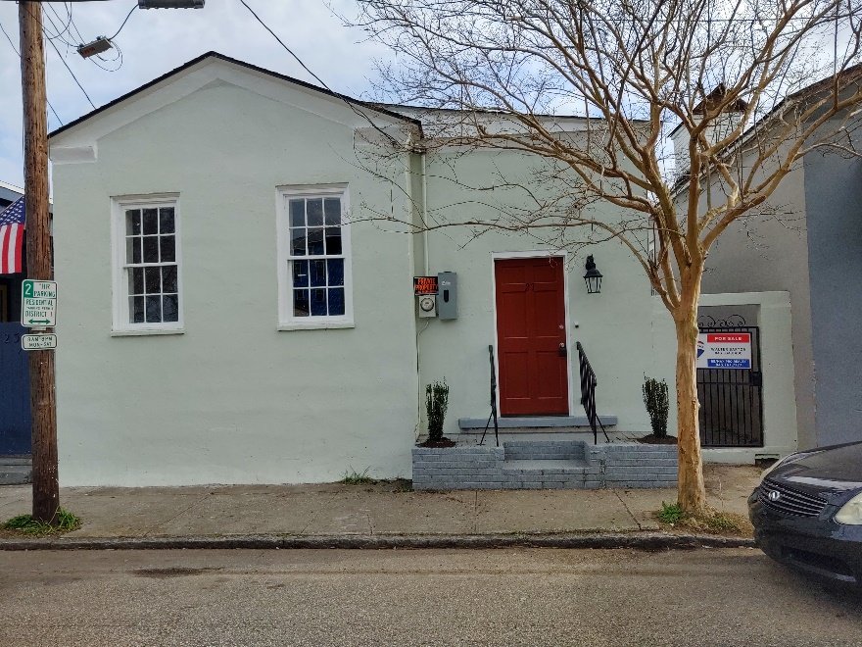
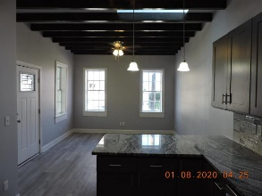
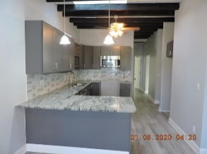
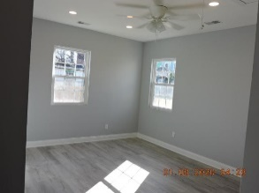
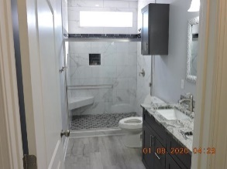
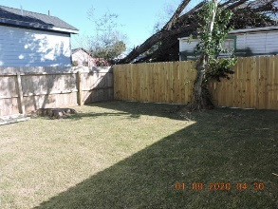


Like New Home ~ Open House
$15,000 Agent Bonus
with ratified contract by 4/15/18
27 Sheppard Street
Eastside
Charleston, SC 29403
MLS# 20001959
$424,900
$12,100 Under
Recent Appraised Value
Open House Wednesday, August 5th from 11-1
Welcome to Rainbow row Eastside. This 1920 home is one of 15 stucco homes in a row from Sheppard street around the corner and includes Nassau Street. COMPLETLY redone, effective age 2020. Solid stucco home all updated. Walk in to an big open area with kitchen and living room, even skylights. All granite in kitchen and bathrooms. Big back yard. All windows replaced except front (2). Easy to show, all offers need to have letter of pre-approval or proof of funds. No off street parking. Ceiling fans in all bedrooms and living room. One block to Meeting Street. This area is on high ground.
Walter Barton
843-834-8400
walterebarton@gmail.com
RE/MAX Pro Realty, 9209 University Blvd, Charleston, SC 29406

