Slide 1
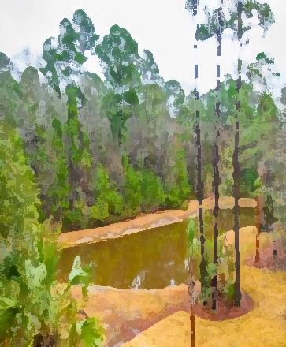
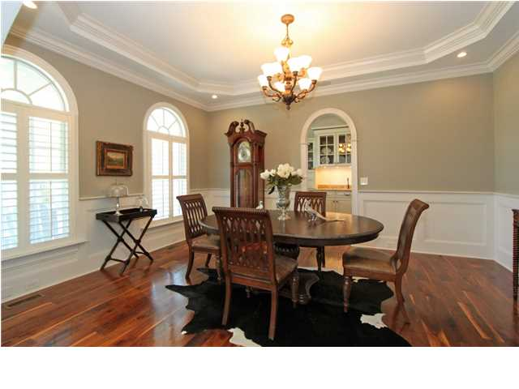
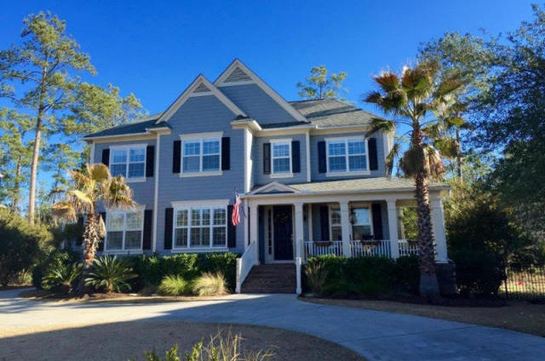
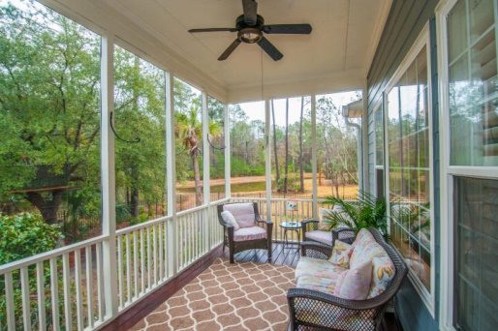
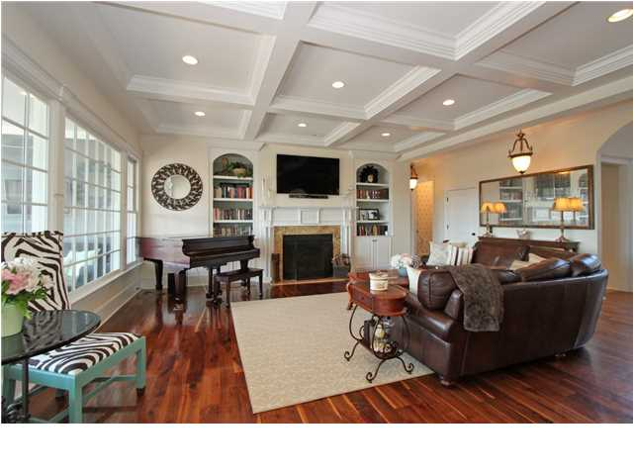
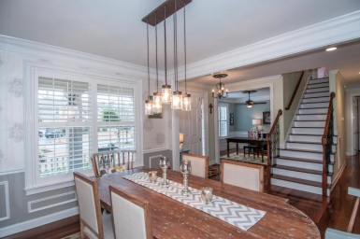
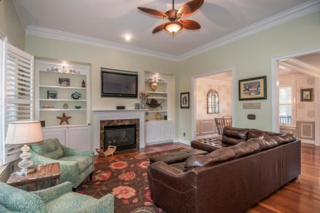
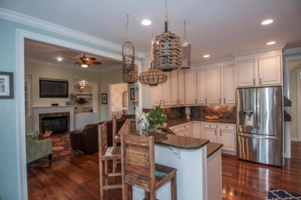
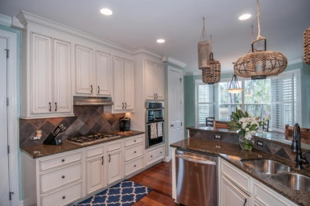
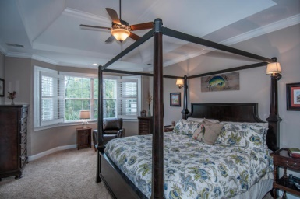
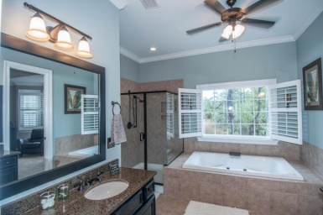
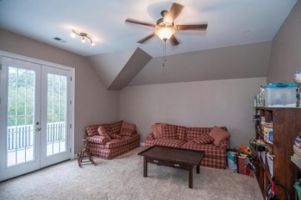
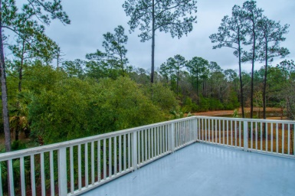


2802 Oak Manor Drive
Dunes West - Mount Pleasant - MLS# 15004039 - $649,000
Back on the Market!
Price Reduced for a Quick Sale! Looking for a gorgeous marshront Lowcountry home situated in a gated community? Surrounded by mature foliage this exceptional property will please even the most discriminating buyer. Beautifully finished to include wide planked hardwood floors, plantation shutters and heavy moldings throughout, this home will not disappoint! Upon entering you'll be greeted by a spacious foyer flanked by a study on one side and well sized formal dining room on the other. Towards the back of the home a gracious family room and well appointed kitchen take full advantage of the exceptional marsh and river views as well as a fully stocked pond. The designer kitchen includes granite counter tops, custom designed subway tile, stainless appliances and overlooks the family room creating an open design conducive to entertaining. Take advantage of evening breezes and outdoor dining on the spacious screened porch located off the kitchen. Need an exceptional space for guests? The full bath and guest room on the first floor offer privacy, comfort and convenience for guests. An oversized side entry garage opens into a carefully planned mudroom with custom built in cabinetry. The second floor includes a generously sized, luxurious master suite with large windows, a sitting area and soaring ceilings overlooking the marsh and pond serving as a private retreat for the homeowners. The master bath includes dual vanities, granite counter tops, tile floors and a large master closet as well as a separate tub and shower. Also included on the second floor are Jack and Jill bedrooms sharing a full bath as well as an additional bedroom featuring a private bath. A large media room with French doors leading to an upper level porch offers additional living and entertaining space. Complete with a beautifully landscaped yard and fully fenced backyard it's clear there is no expense spared in this meticulously cared for home.
Katherine Cox
Mobile - (843) 568-3193
katherine.cox@carolinaone.com
Carolina One Real Estate
2713 Highway 17 North
Mt. Pleasant, SC 29466

