Slide 1
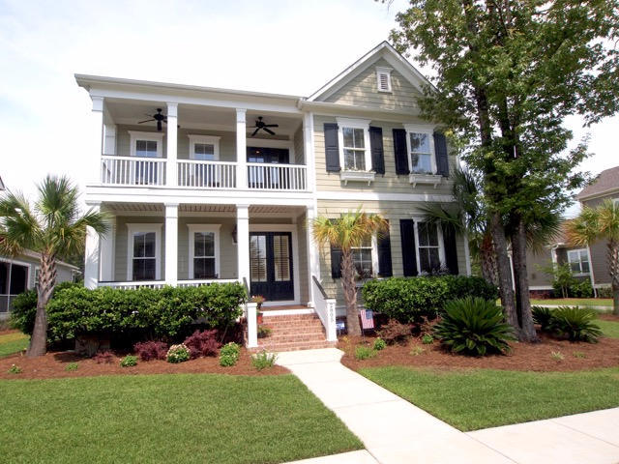
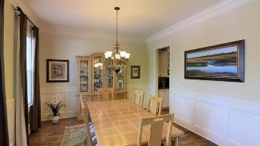
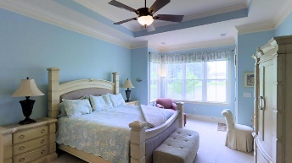
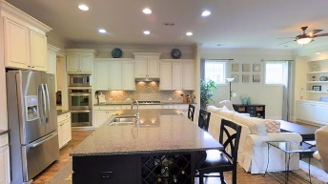
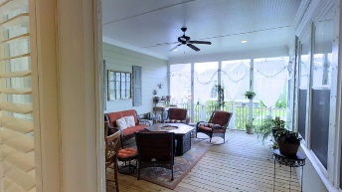


Price Adjustment
2805 River Vista Way
Dunes West :: Mount Pleasant :: MLS# 16016480 :: $649,000
Five, yes five, porches. And two of them are screened. One is a grilling deck off the informal dining area --- this versatile floorplan really brings the outdoors in. The two screen porches are essentially extra rooms of the house, they are so attractive and blend into the floorplan so well. The one off the master bedroom overlooks the openness of the glistening pond whose relected light fills the back of the house. Large master suite with oversized tile bath and deep walk-in closet really accent this first floor master so many buyers shop for these days. There is another secondary bedroom downstairs with its own bath. The shower has a unique sliding door to camouflage it when you want to use it just as a powder room while entertaining. The sellers will truly miss the brightness and open flow of the first floor. The upstairs has a large and functional game room; the owners currently have a bar set up in the alcove of this room. Two bedrooms and a full bath make this a great place for guest quarters, or for your older kids to have their own separate space. The lot accesses a large scenic pond in the rear. A shared private alleyway leads to the side-loading garage with ample outside parking pad space. Sellers have a wheelchair ramp disassembled in storage to access the garage stairway that can be included with the sale it desired. The house has a classic attractive look since the garage is out of sight. Dunes West is a gated golf course community with 24/7 live security. (Membership in the golf, swim, and tennis club is separate from the homeowners' association and is optional.) A launch ramp and boat storage area are available amenities. Miles and miles of walking and bike paths through manicured areas with frequent sightings of eagles, deer, and other wildlife run throughout the large creekside community. First choice public and private schools are nearby. Shopping, beaches and cosmopolitan downtown Charleston are all easily within a half hour drive. No matter where you are moving from, the transition is sure to be a treat. The owners may be willing to sell many of the furniture pieces.
John Crowley
843-819-4951
John.Crowley@AgentOwnedRealty.com
AgentOwned Preferred Group | 1400-G Palm Blvd | Isle Of Palms, SC 29451

