Slide 1
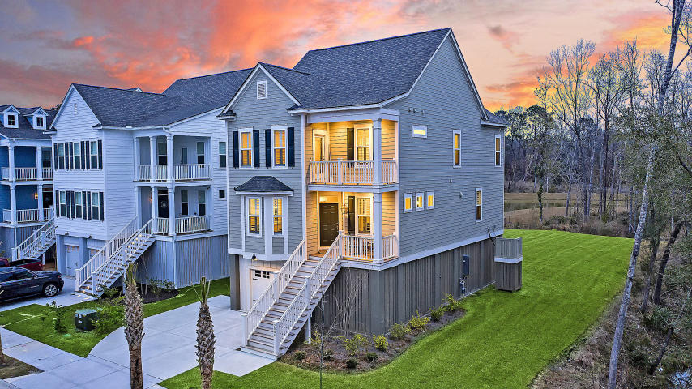



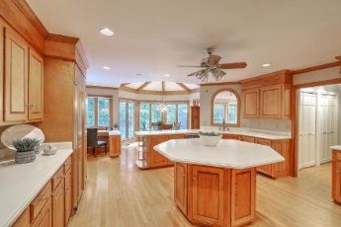
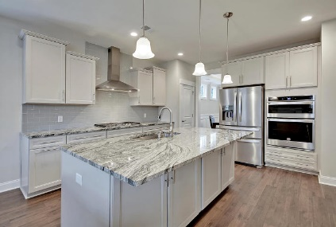



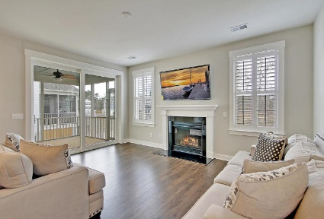

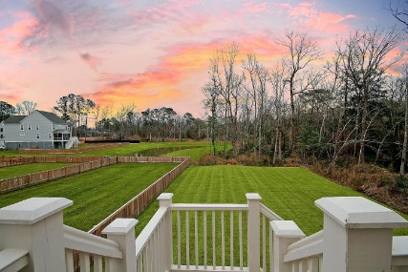
Parkshore Marshfront
Protected Views
2806 Merriams Drive
Carolina Bay ~ Charleston, SC 29414 ~ MLS# 20003776 ~ $585,000
With pond views in West Ashley's Carolina Bay, this elevate home is like new & move-in ready! This home boasts beautiful finishes including gleaming hardwood floors, gorgeous trim work throughout, a tray ceiling & wainscoting in the dining room, a fireplace in the living room, sliding doors to the screened-in porch & a gourmet kitchen featuring a center island with breakfast bar seating, granite counters, SS appliances & subway tile backsplash.
This floorplan offers 3 levels of living, a bedroom with en-suite bath on the main level, 3 bedrooms, 2 full baths, laundry & a loft on the 2nd level & then the top level can be another bedroom or extra space with an en-suite full bath! Because it is the first home on the cul-de-sac there is only one neighbor next to you, the other side is woods!
Christopher Smith christopher@mattoneillteam.com 843-267-0735

