Slide 1
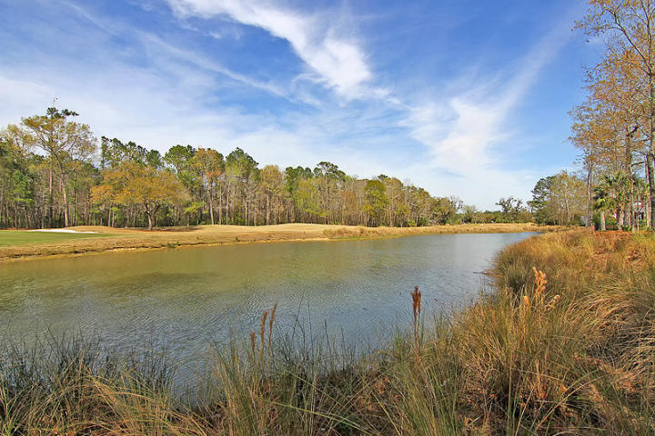
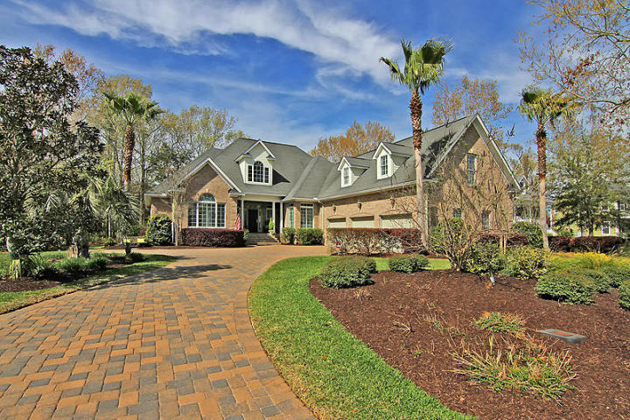
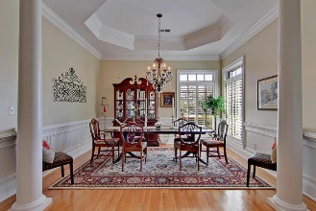
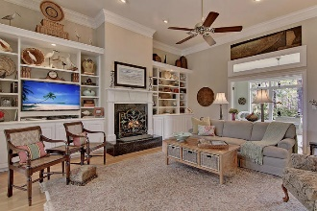
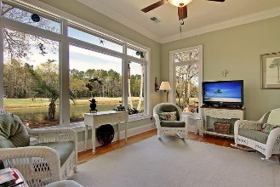
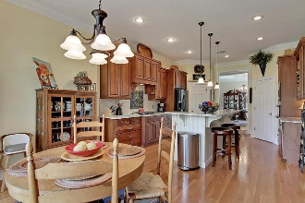
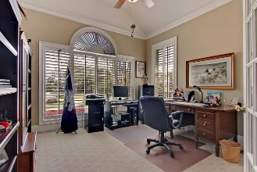
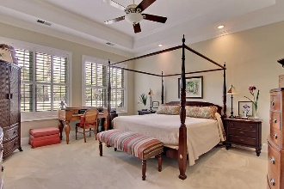
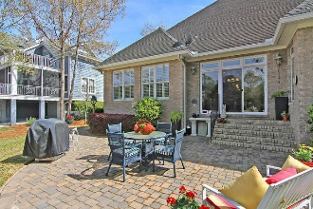
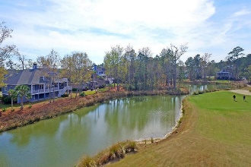
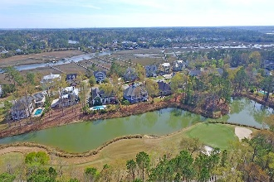
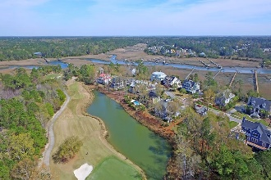


2808 Parkers Landing Road Rivertowne Country Club Mount Pleasant MLS# 17007238 $799,999
Single Story Living with Beautiful Views!
Classic and elegant, this stately all brick home is positioned to capture the breath taking views of the lagoon and the golf course's 14th green. Large single-story living is rare and this home offers details such as crown molding and plantation shutters throughout and hardwood floors in the main living areas. You'll first notice the attention to detail as you approach the home on the brick paver driveway. Upon entering the two-story, sunny foyer it's evident that this home was built to accommodate both everyday family living as well as entertaining. The floor plan features a spacious living room with custom built-in bookshelves flanking a gas log fireplace and opens to the sun-filled family room. This space is perfect for curling up with a good book or just admiring the gorgeous view.
Asking $1,650,000
MLS# 16003205
6,527 SqFt
5 Bed/5½ Baths
22,000-lb Boat Lift
Don Dawson 843-514-0452 ddawson@carolinaone.com Carolina One Real Estate • 2713 Highway 17 North • Mount Pleasant, SC 29466
www.TeamDawsonSC.com

