Slide 1
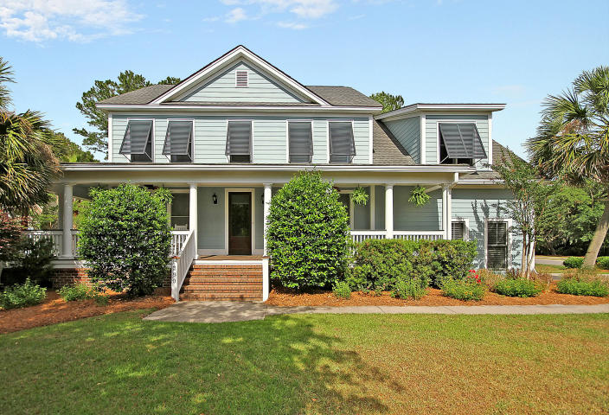
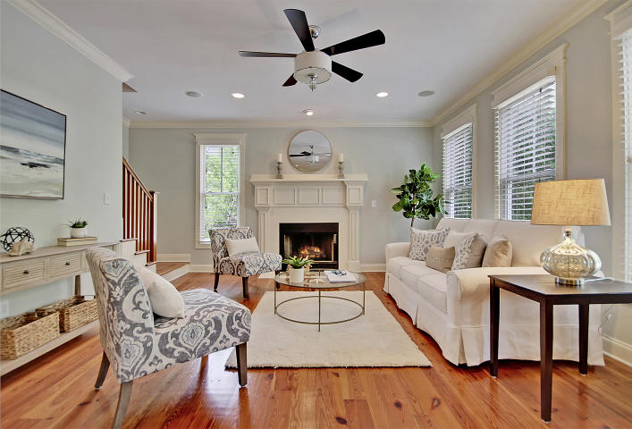
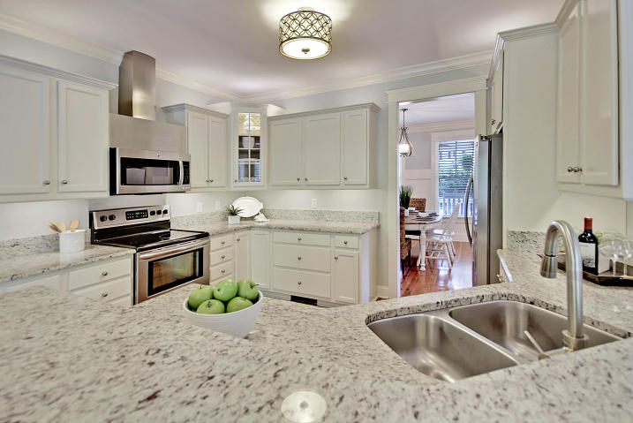
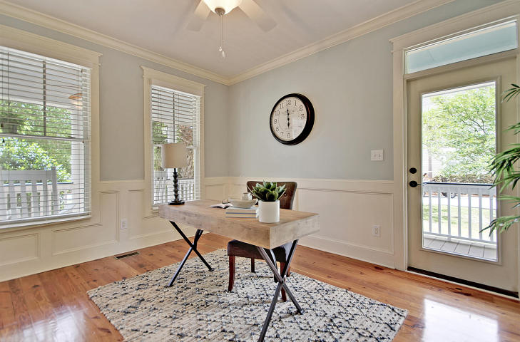
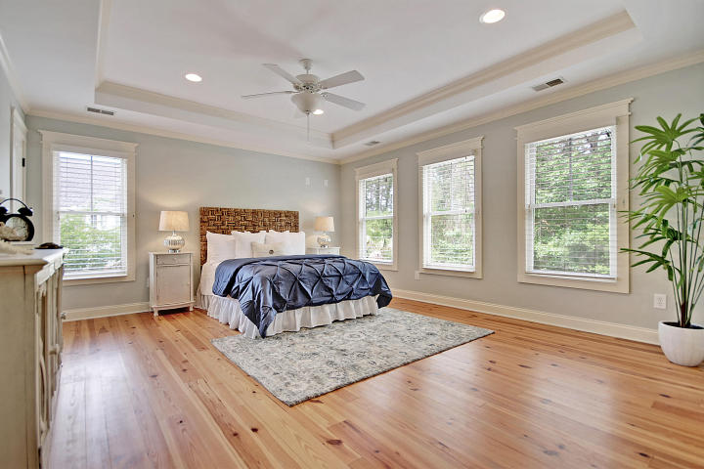
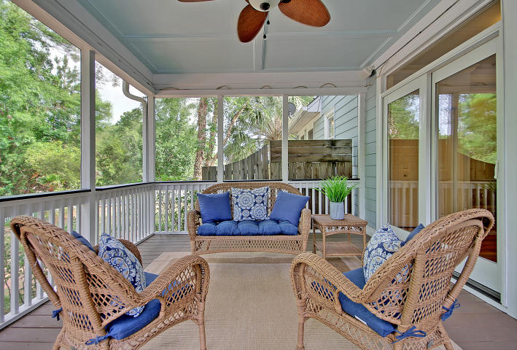
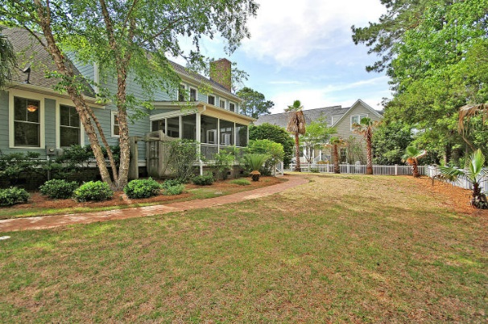
Great Downtown Investment Opportunity
Price Reduced!
280 Marsh Ibis Trail
Mount Pleasant, SC 29464 ~ MLS# 18014177 ~ $690,000
There's something timeless about a white picket fence and that's exactly what gives you that ''feels like home'' sensation as soon as you pull up to this amazing two story home on a large corner lot in Mount Pleasant's Grassy Creek community. The way the sun hits the wrap around front porch welcomes you into this gorgeous open floor plan home that shows like a model home. The main floor has a home office and a separate guest bedroom with a full bathroom. The master is upstairs and has his & her closets, and a luxurious en-suite bath with dual vanity, jacuzzi tub and walk-in shower. The bonus room upstairs would make for an excellent media room, 2nd home office, or playroom for the kids. Enjoy your morning coffee or evening glass of wine on the screened in back porch overlooking views of the fenced in backyard. Friends and family will gather at the granite breakfast bar in the kitchen and take notice of the amazing trim work throughout the home, as well as the crown molding and wainscoting. Additional features include gorgeous hardwood pine floors, fireplace in living room, surround sound built in speakers throughout the main living areas, stainless steel appliances in the kitchen, central vac, Bermuda shutters, and outdoor shower.
Grassy Creek community features - great family neighborhood, central location, pavilion, boat dock and play park.
Book your viewing today!
Paige Rhodes 843-830-3281
paige@mattoneillteam.com
Ben Laaper 843-642-3546
ben@mattoneillteam.com

