Slide 1
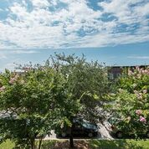
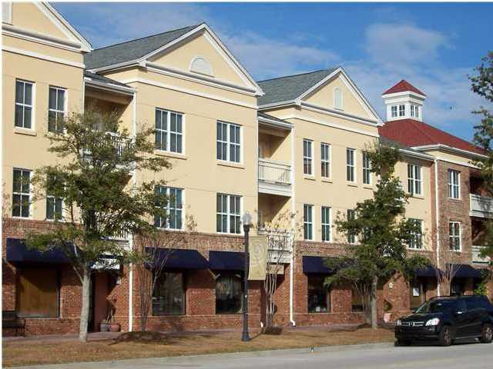
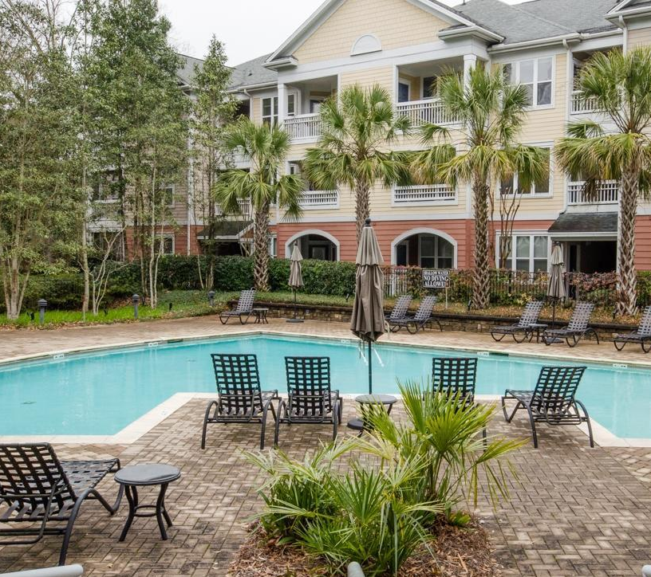
280 Seven Farms Drive #201 Daniel Island
Open House Sunday 8/16/15 2:00 – 4:00
MLS: 15018904 LP: $259,000
Connie Dittrich, Realtor 843.475.7993 cdittrich@carolinaone.com

