Slide 1
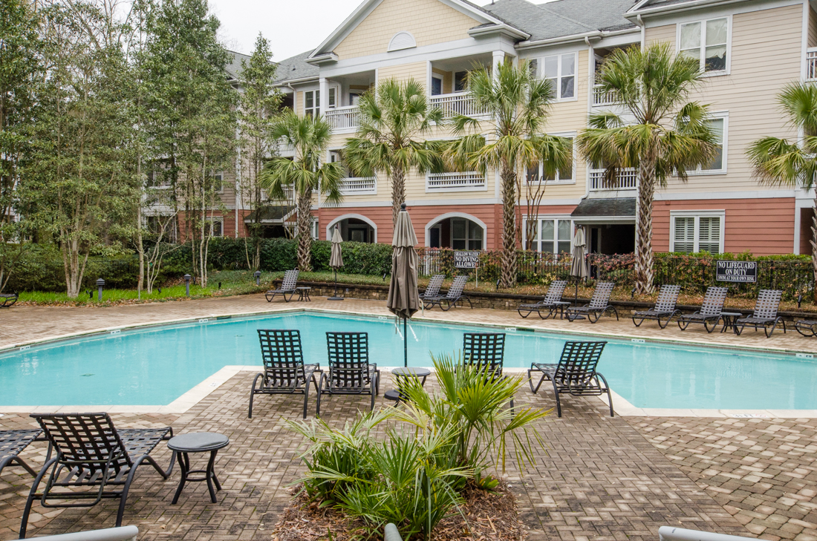
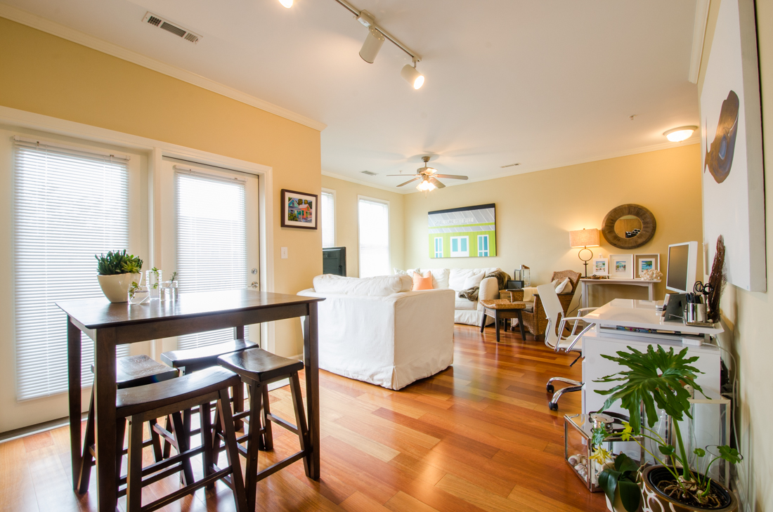
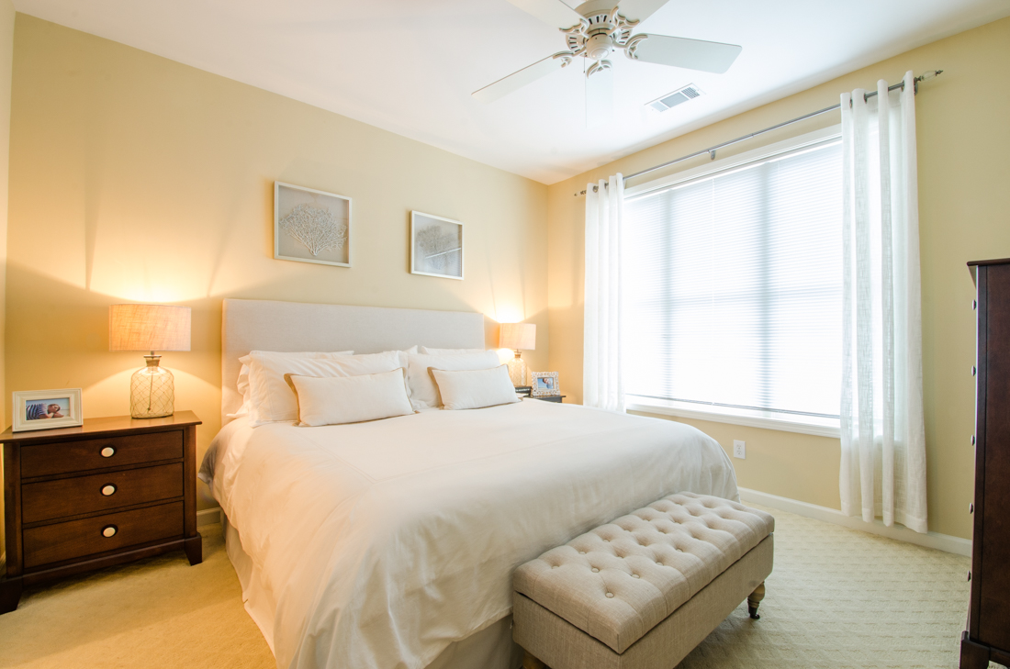
Just Listed
280 Seven Farms DRive Unit 201 Daniel Island
2 Bedrooms, 2 full Baths, Hardwoods, Garage, Washer/Dryer, & More!
Call Connie Dittrich, Realtor Caroline One Real Estate 843-475-7993 cdittrich@carolinaone.com
$259,000 MLS: 15005162

