Slide 1
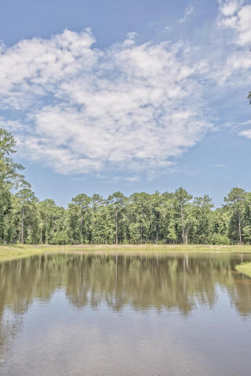
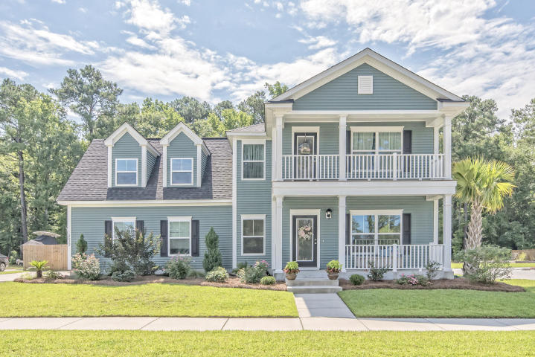
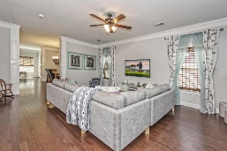
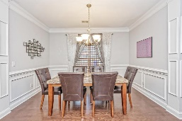
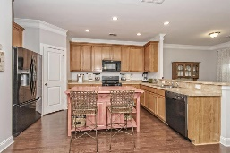
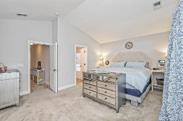
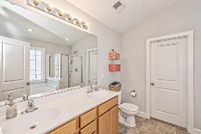
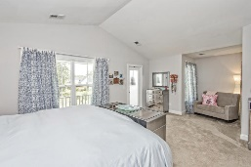
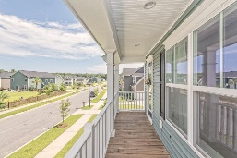
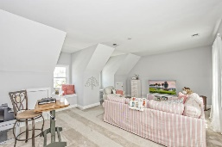
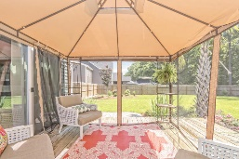
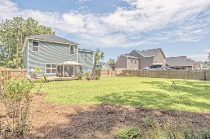
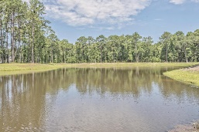
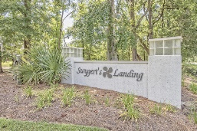


No Need To Wait For New Construction!
Like New Swygerts Landing Home! $3k Closing Costs
2812 Ortega Drive
Swygerts Landing | Johns Island, SC 29455 | MLS# 16018451 | $344,400
Welcome home to this like-new, beautiful Charleston Style home in Swygerts Landing, one of the most sought after Johns Island communities! Enter the spacious living area off of the inviting large front porch**Hardwood beveled floors throughout main floor**Luxury crown molding, 9' smooth ceilings & wainscoting throughout**Large, open kitchen equipped w/gas range, 42” cabinets w/plentiful counter & storage space**Family room leading onto back deck** Upstairs: Master suite w/ vaulted ceiling, sitting area, dual vanity sinks, garden tub, separate shower, large walk-in closet & entry onto porch overlooking green space**Huge bonus room, perfect for 4th bedroom, office or playroom**Two add'l guest bedrooms and full bath**Professionally landscaped yard w/privacy fence, backing to woods. Just perfect! Amenities include walking/nature trails around the 5 lakes, a neighborhood pool and cabana which is in the middle of being built. Minutes from Downtown Charleston, Golf Course, Dining, Marina, public boat landings and the public Beachwalker County Park at Kiawah.
Desiree Maurer
Office - (843) 416-2000
Mobile - (843) 327-9010
desiree.maurer1@gmail.com
www.yourcharlestonhousesearch.com
Keller Williams Realty
496 Bramson Ct Ste 200
Mt. Pleasant, SC 29464

