Slide 1
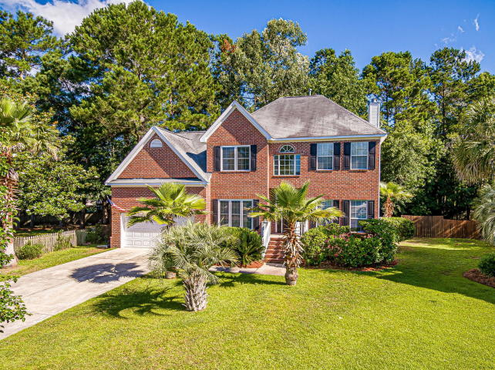
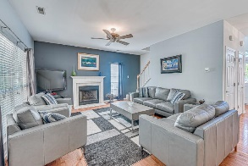
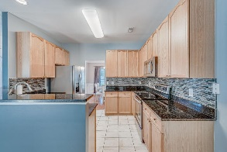
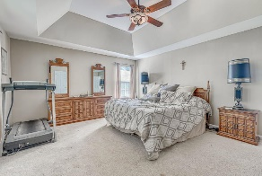
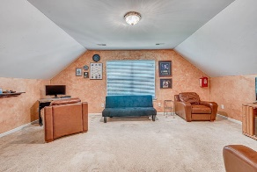
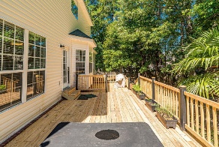
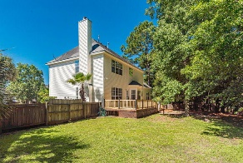


Welcome Home!
Starbucks card to first 10 agents
2813 Bottlebrush Court
Planters Pointe ~ Mt Pleasant ~ MLS# 20014919 ~ $439,000
Incredible opportunity to own a true 4 bedroom, 3 full bathroom brick front home with a FROG (Finished Room Over Garage), home office, and a formal dining room. Add a premium 12,200sqft fenced in lot with mature trees (one of the largest in the neighborhood) located on a quiet cul-de-sac, and you've just discovered something hard to find in Mount Pleasant under $450,000. Recent upgrades include 2 new HVAC units, new deck out back, and a new roof is being installed prior to closing! How about dual master bedrooms... one downstairs Mother-In-Law Suite and another larger true master bedroom upstairs with tray ceilings, ensuite bathroom, and an enormous walk-in closet. The finished room over garage can be used as a 5th bedroom, playroom, teenager retreat/game room, upstairs media room, or even another home office with its own door for quiet, distanced privacy, upstairs away from the distractions. The laundry room is also upstairs with all main bedrooms. There is a downstairs formal dinning room as well as a front office area that can be enclosed with doors. This home offers such a desirable floor plan with the kitchen open to the entire living room, a wall of rear windows overlooking the fenced in back yard and direct access onto the new wood deck, patio, and built-in hot tub. Sellers are offering an upgrade allowance of $6,000 with an acceptable offer for needed cosmetic touches on the upstairs carpet and paint. Use this money to pick out your own flooring and paint colors to truly make it your own! Planters Pointe schools currently attend Laurel Hill, Pinckney, & Cario in Park West as well as Wando High School. Excellent neighborhood amenities include gated access and secure fob entry into the swimming pool with cabana and grilling areas, club house, multiple tennis courts, fenced playground, picnic area, full size basketball courts, pickle ball courts, shuffle board, and paved walking/jogging trails that connect Planters Pointe to Rivertowne. Walk, bike, or ride your golf cart to the Harris Teeter grocery store, its about a 3 minute bike/golf cart ride and Planters Pointe even has its own access path directly to the grocery store...all with Golf Cart Parking at the store! Community red light for easy access. Lowes Food Store, Starbucks, Marco's Pizza, ice cream, sushi, and more just across the street as well. HOA dues are very low at $750 per year, compare that to other neighborhoods for what you get, and you quickly see why Planters Pointe is a hidden gem, and this house has it all!
Jerod Coulter, ABR, REALTOR
(843) 513-3741
jerod@realtor.com | www.HomesOfMountPleasant.com
The Boulevard Company, LLC | 35 Broad Street | Charleston, SC 29401

