Slide 1
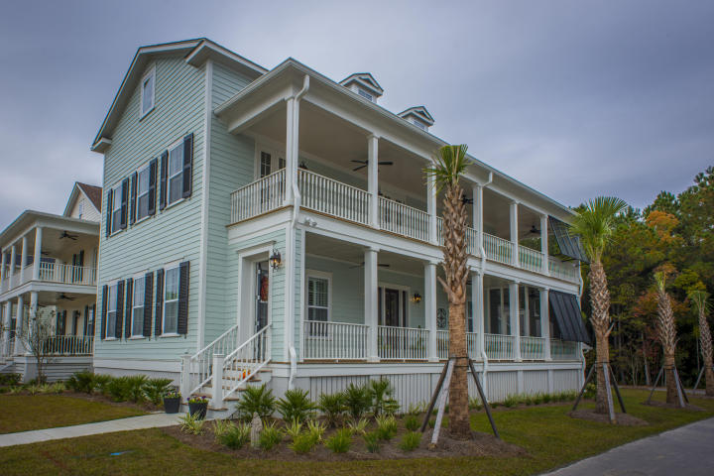
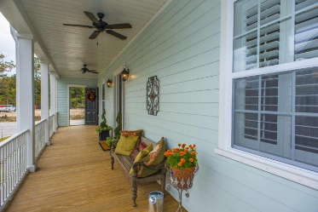
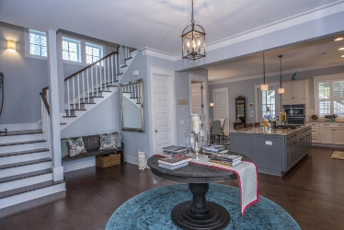
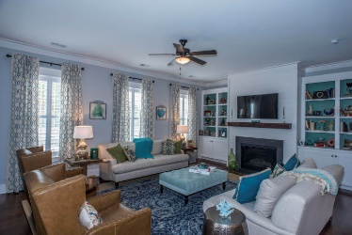
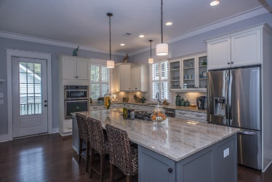
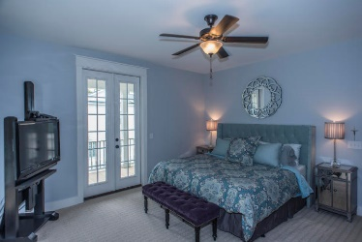
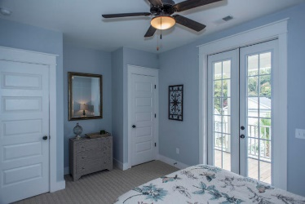
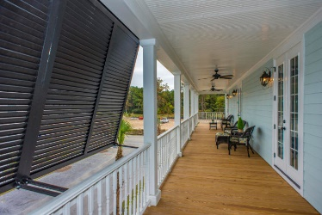


Best Upgraded Home On The Parkway
2813 Rivertowne Parkway
Rivertowne · Mount Pleasant, SC 29466
MLS# 17031797 · $548,900
Stunning and Classic, Lowcountry Charleston Single style home 4 BR/ 3.5 BA 3,068 SF Fenced yard Double front porch/screened porch Open floor plan Picturesque views from rear screen porch with home backing up to wetlands 2 car detached garage with additional parking next to the home Plantation style shutters Gas line underground to grill area – no more need to run out for propane. Stunning gourmet kitchen Re-purposed fireplace mantel from an old home on queen street est. 1830's. Beautiful Home With Double Porches And 3 Floors Of Living Space. The Lot Overlooks Protected Wetlands behind the home. Upgrades Include Plantation Shutters, Hardwood Floors Throughout The Living Areas And Stairs Custom Wood Closet Organizers, TankLess Hot Water Heater and Irrigation system. So many upgrades to see.
Bryan Thompson
Office - (843) 769-5100
Mobile - (843) 452-1686
bryan.thompson@agentownedrealty.com
www.bryanthompsonrealestate.com
AgentOwned Charleston Group | 902 Savannah Hwy | Charleston, SC 29407-7802

