Slide 1
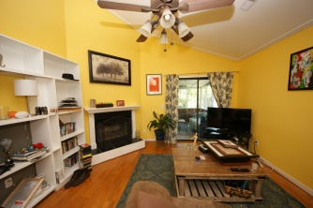
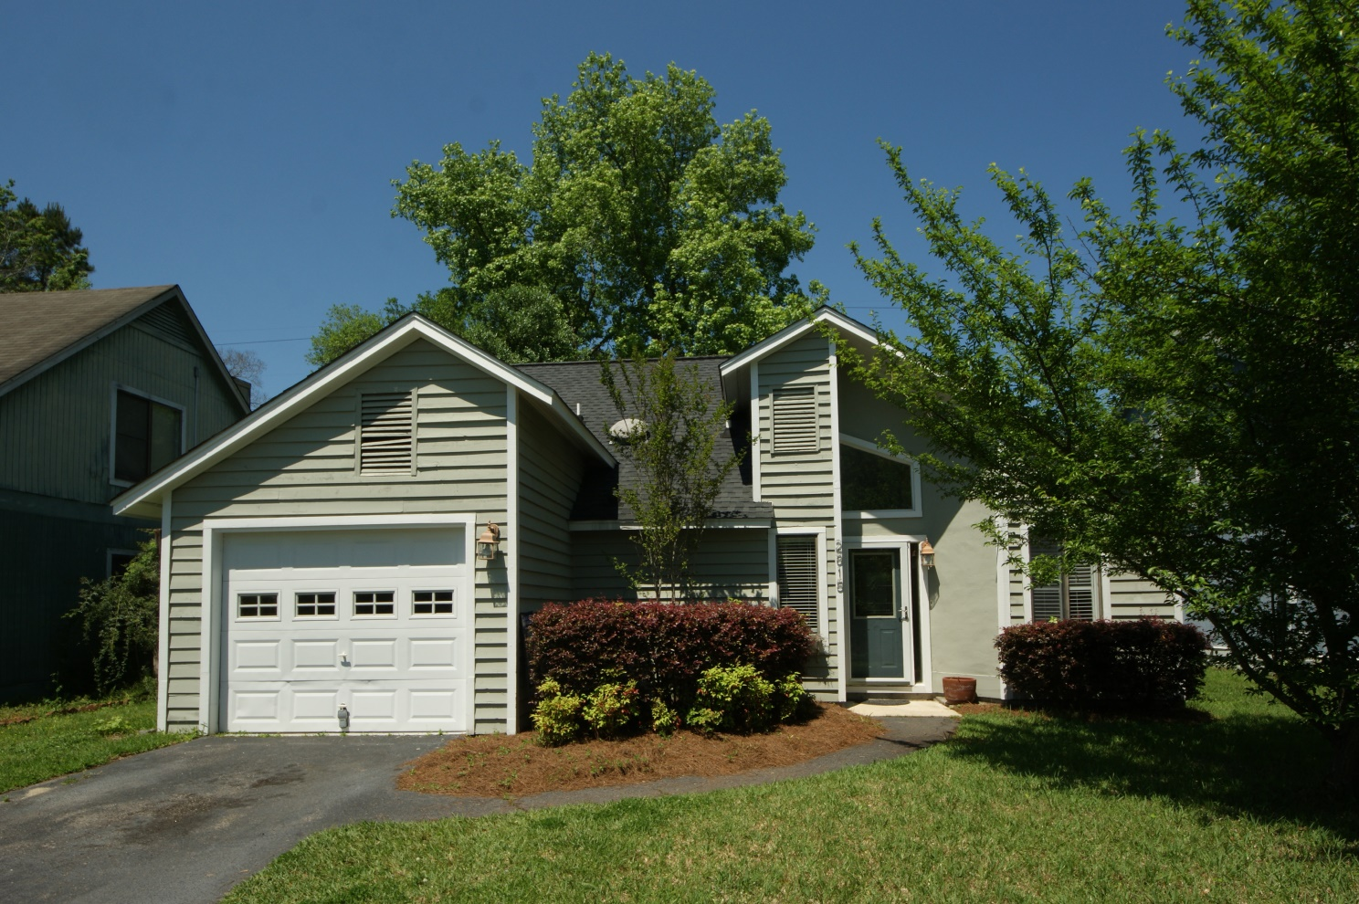
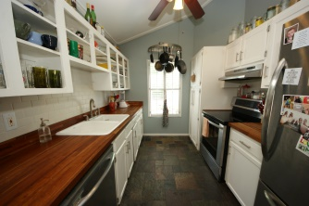
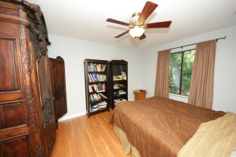
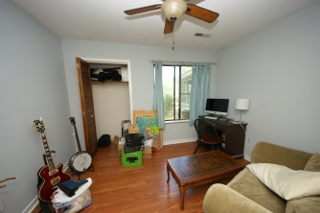
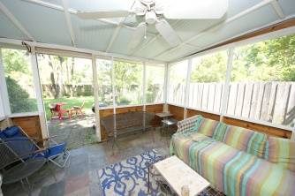
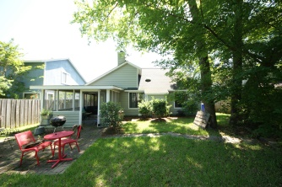
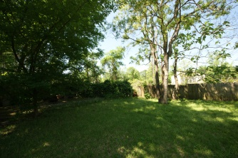

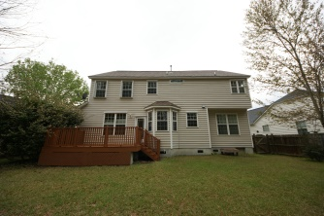
If you’re looking for a Lowcountry home with contemporary qualities, this may be it.
2815 Jobee Drive
Ashleytowne Village
Charleston
MLS# 15010436
$189,000
Great home in an established neighborhood
This home has lots of character showing off a rustic modern decor. Walk into a slate floored foyer with lots of natural light and lively colored walls into a spacious open floorplan! Dining and family room share one space with hardwood flooring, vaulted ceilings, wood burning fireplace with hearth and crown molding. The kitchen is very modern rustic with open white cabinets, stainless steel appliances, slate tile flooring, vaulted ceiling, butcher block countertops, and subway tile backsplash. Bedrooms have brand new laminate flooring and newly painted walls. Home has dual master bedrooms and a separate guest bedroom downstairs. The backyard is very private with a privacy fence and wonderful for entertaining with a large screen porch and brick patio. This home is not to be missed! Close to I-526, restaurants, shopping, and historic gardens & plantations! Amenities in neighborhood include boat ramp, swimming pool.
Karla Leahy
Realtor CRP, ASP, QSR
karlaleahy@gmail.com | (M) 843-452-6670
www.yourlowcountryproperties.com
Harbor City Real Estate Advisors | 510 Live Oak Drive | Mt Pleasant SC 29464

