Slide 1
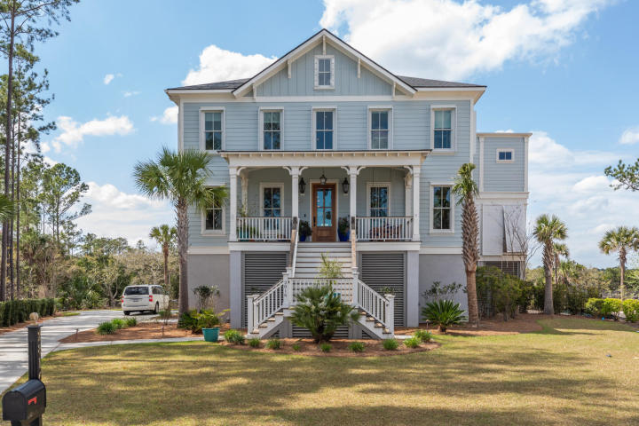
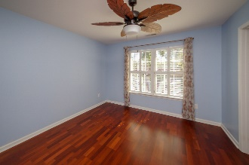
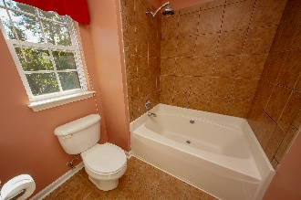
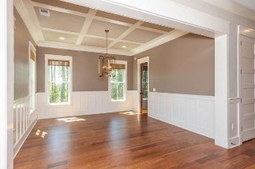
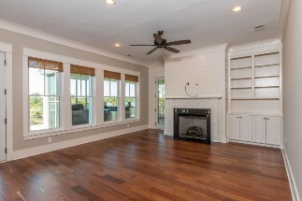
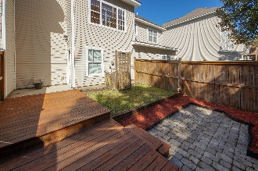
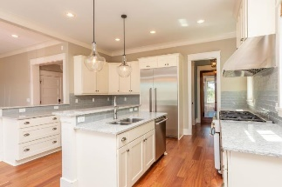
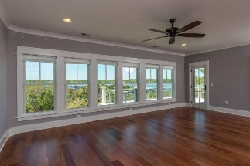
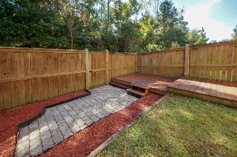
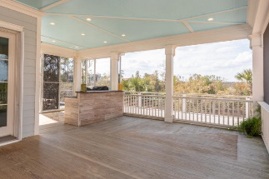
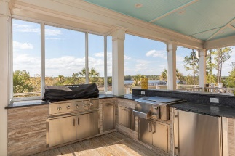
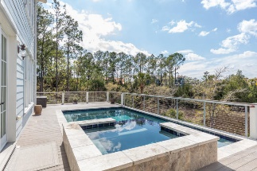
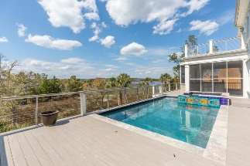
Welcome to Paradise
2816 Stay Sail Way
Dunes West | Mount Pleasant | MLS# 20008193 | $1,750,000
Wando Riverfront: Expansive marsh and river views and deepwater access separate this luxurious dual-master home. Savor captivating waterfront sunsets from your raised pool and a hot tub while you grill for family and friends in the newly outfitted outdoor kitchen. Enjoy meals and entertaining on the sweeping screened in porch that let you watch the hawks and herons while sitting in front of your outdoor fireplace. Retire to a luxuriously appointed top floor master suite that offers a 180Â° panoramic river view, a double vanity master bath, with artistically tiled steam shower and enclosed tub, custom built-in walking closet with connected laundry room, hidden safe room, and barn door separated office gym. A second, first-floor master is a perfect guest or in-law suite with opulent bathroom freestanding clawfoot tub, spacious walk-in shower, and two walk-in closets. Prepare family meals in the gourmet kitchen with dual stoves, retrieve a bottle of wine from your temperature-controlled wine room, and serve in the front dining room or on one of two granite-topped breakfast bars that adjoin an expansive, open family room. The lower level, accessible from both inside and outside stairways (and elevator), provides a game room and bathroom facilities for pool users. Sumptuous touches include Brazilian hardwood flooring throughout, hurricane shutters, smart thermostats, outdoor lighting, two laundry rooms, three-car garage, and private slip on a shared deepwater dock. Superb, secure location in an exclusive neighborhood offering golf, tennis, swimming, and miles of walking paths, just minutes away from shopping, dining, and doing.
Book an appointment today and see the documents section for more information.
Listing agent believes all information on the MLS to be correct, however, buyer should verify all information important to them. If square footage is important MEASURE!!! All information, including but not limited to HOA info, acreage, taxes, shared dock, flood zone, and schools, is solely subject to independent verification.
Susan Day
homes@charlestonbyday.com | (843) 900-0477 | www.charlestonbyday.com
Brand Name Real Estate | 4 Carriage Lane, Suite 106 | Charleston, SC 29407

