Slide 1
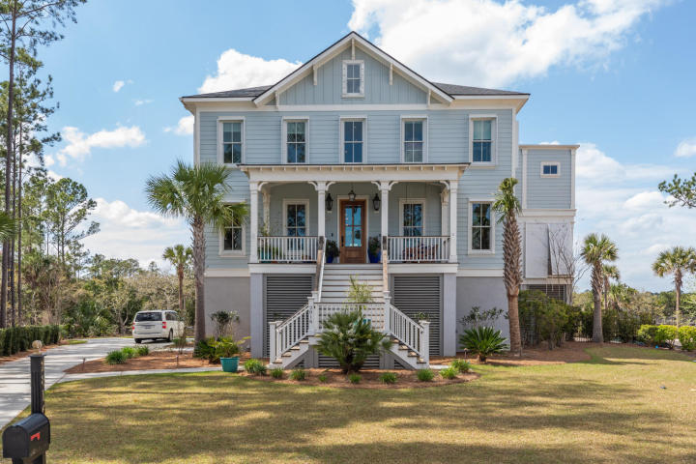
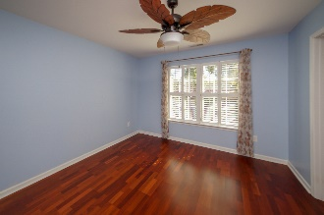
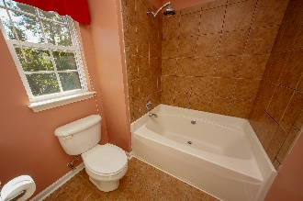
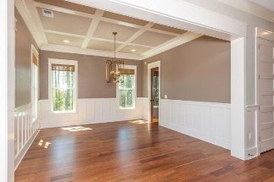
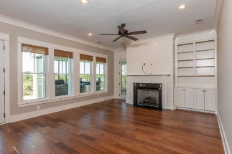
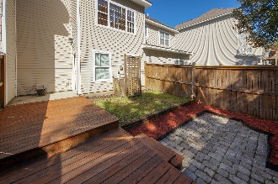
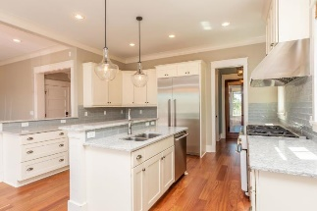
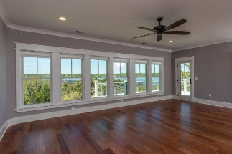
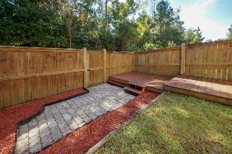
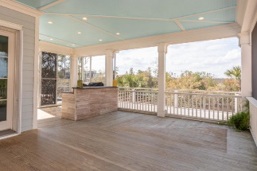
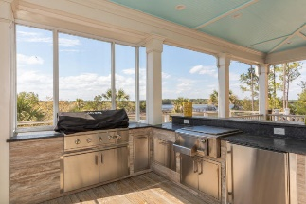
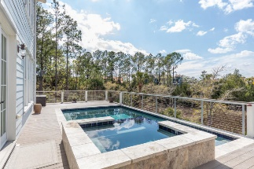
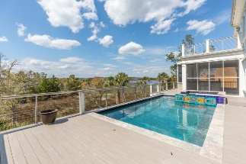
BACK ON THE MARKET! CONTRACT FELL THROUGH!
$175,000 Below Appraisal! Buy Now For $1,599,000
2816 Stay Sail Way
Dunes West | Mount Pleasant | MLS# 20008193
Priced $175,000 below appraised value this Wando Riverfront has expansive marsh and river views with a shared dock and deepwater access. This dual-master home is an amazing retreat for you to entertain family and friends. Savor captivating waterfront sunsets from your raised pool and a hot tub while you grill for family and friends in the newly outfitted outdoor kitchen. Enjoy meals and entertaining on the sweeping screened in porch that let you watch the hawks and herons while sitting in front of your outdoor fireplace. Retire to a luxuriously appointed top floor master suite that offers a 180Â° panoramic river view, a double vanity master bath, with artistically tiled steam shower and enclosed tub, custom built-in walking closet with connected laundry room, hidden safe room, and barn door separated office gym. A second first-floor master is a perfect guest or in-law suite with opulent bathroom freestanding clawfoot tub, spacious walk-in shower, and two walk-in closets. Prepare family meals in the gourmet kitchen with dual stoves, retrieve a bottle of wine from your temperature-controlled wine room, and serve in the front dining room or on one of two granite-topped breakfast bars that adjoin an expansive, open family room. The lower level, accessible from both inside and outside stairways (and elevator), provides a game room and bathroom facilities for pool users. Sumptuous touches include Brazilian hardwood flooring throughout, hurricane shutters, smart thermostats, outdoor lighting, two laundry rooms, three-car garage, and private slip on a shared deepwater dock. Superb, secure location in an exclusive neighborhood offering golf, tennis, swimming, and miles of walking paths, just minutes away from shopping, dining, and doing. Book an appointment today and see the documents section for more information. Please make sure you see the VIRTUAL TOUR at https://my.matterport.com/show/?m=HjvvpbUZvhz
Susan Day
homes@charlestonbyday.com | (843) 900-0477 | www.charlestonbyday.com
Brand Name Real Estate | 4 Carriage Lane, Suite 106 | Charleston, SC 29407

