Slide 1
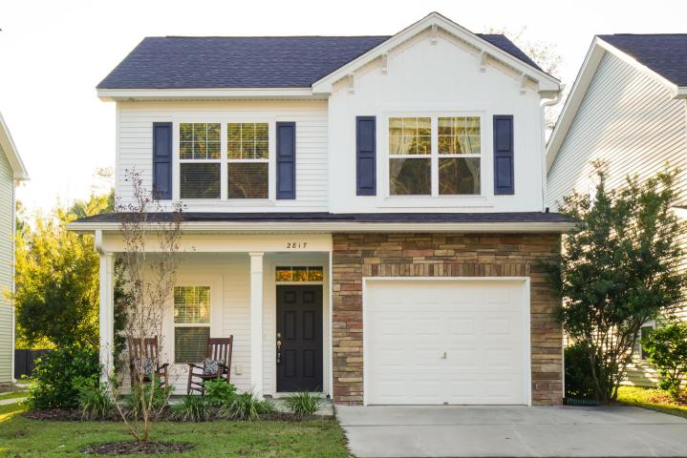
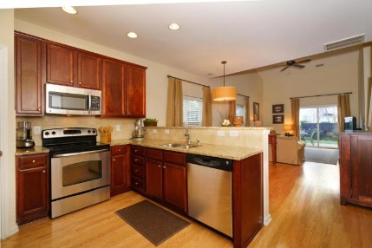
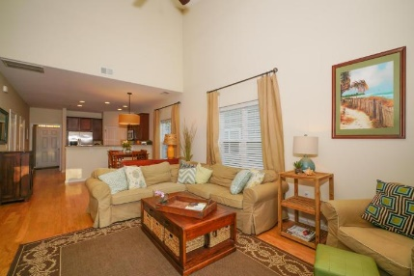
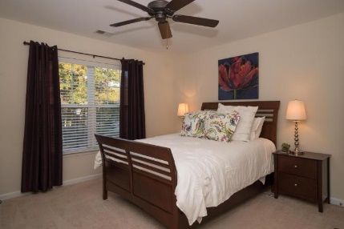
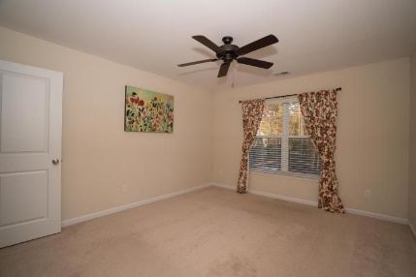
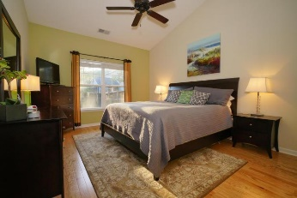
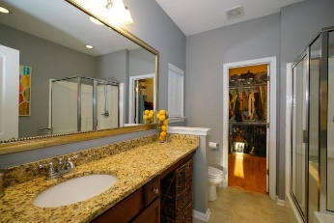
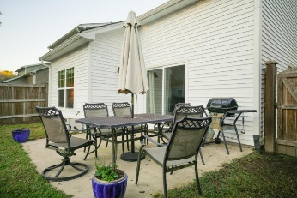
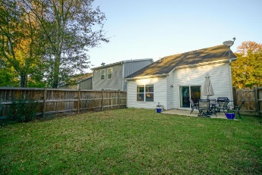
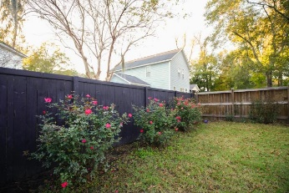


Great home & convenient location on Johns Island! Motivated Seller!
2817 Pottinger Drive
The Cottages at Johns Island | Johns Island, SC 29455 | MLS# 15030585 | $245,000
Welcome to the Cottages at Johns Island!! This beautiful home is located on a less traveled street in this newer community in the "heart" of Johns Island. As you enter you will notice beautiful hardwood flooring throughout the open floor plan. The kitchen boasts upgraded granite, tile backsplash, tall dark cabinetry and stainless steel appliances. In the dining area and throughout the home you will notice upgraded light fixtures. In the living room there is vaulted ceilings and an abundance of natural light that comes in from the large fenced in back yard. The spacious master retreat is downstairs with vaulted ceilings and hardwood flooring. The master bath has upgraded granite countertops, tile flooring, separate glass shower and a garden tub. Off the master bath is a huge walk in closet. Upstairs there are 2 additional guest bedrooms with walk in closets that share a large bathroom with porcelain tile. There is also an office area upstairs that is perfect for a small desk. Ample walk in attic storage space is off the office area. The laundry room and half bath are downstairs near the 1 car attached garage. Short 10 minute drive to downtown Charleston!
Carrie Leahy
Mobile - (843) 478-8095
cleahy@kw.com
www.lowcountrycoastalrealestate.com
Keller Williams Realty
496 Bramson Ct Ste 200
Mt. Pleasant, SC 29464

