Slide 1
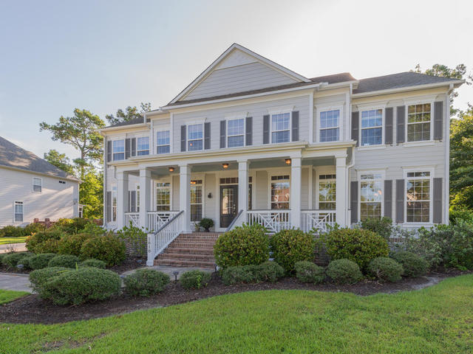
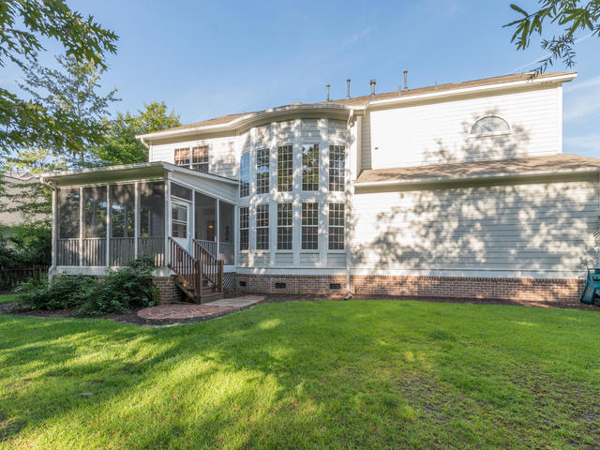
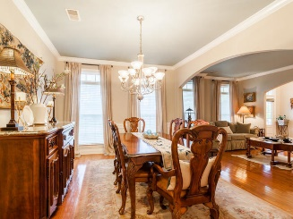
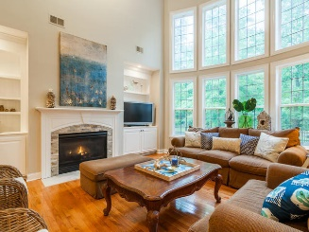
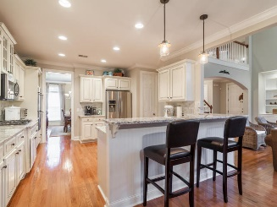
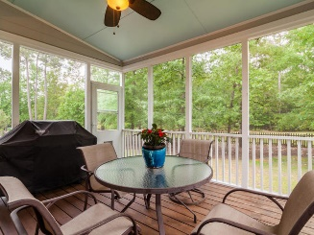
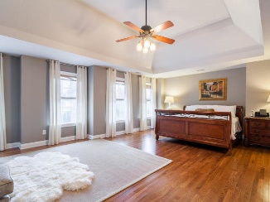
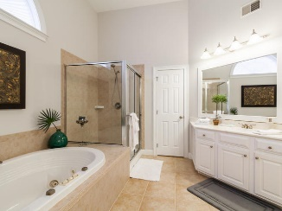
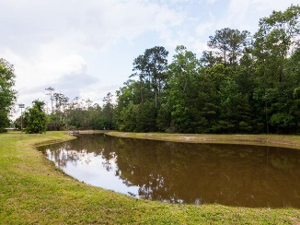
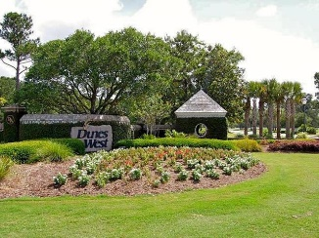


Move-in To Dunes West Before The Holidays
2818 Oak Manor Drive
Mount Pleasant, SC 29466 | MLS# 16022794 | $799,000
This stunning, one of a kind home offers tons of space and privacy on a very large lot. Updated kitchen, hardwood floors, 5 bedrooms, 5 bathrooms, 3 car garage, huge bonus room, library and separate office (or 6th bedroom). Renovated kitchen offers antique white cabinets, stainless steel appliances with double ovens, gas cooktop, farmhouse sink, walk in pantry, marble backsplash and granite counters. The home’s exterior was painted in 2015. Fully landscaped yard has a fence and enough room for a pool. First floor bedroom plus a full bathroom. Library with built in bookshelves from floor to ceiling. Fireplace surround was updated with stacked stone. Upstairs laundry room, computer/tech space and 4 additional bedrooms including the massive sized master suite with two walk in closets, tub and separate shower. Wired for surround sound in the ultimate man cave, bonus room or media room plus an additional bedroom or office and full bathroom on the 3rd floor. So many possibilities for those who might work from home or need a playroom or game room. Only minutes from the local beaches, Boeing, shopping and restaurants, top rated schools and historic downtown Charleston.
Residents have the option to join The Club at Dunes West which offers resort style amenities including 3 swimming pools, tennis courts, exercise equipment and golf course. The community has miles of walking trails, crab dock, and play parks.
Paula Watts
Mobile - (843) 819-1582
Fax - (843) 416-2232
paula@paulawatts.com
www.paulawatts.com
Keller Williams Realty Charleston
496 Bramson Ct Ste 200
Mt. Pleasant, SC 29464

