Slide 1
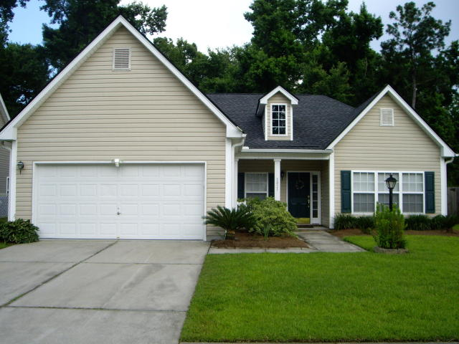
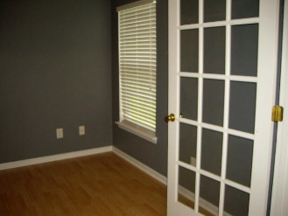
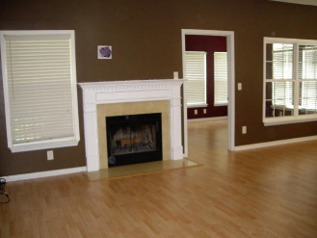
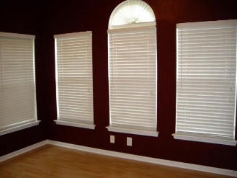
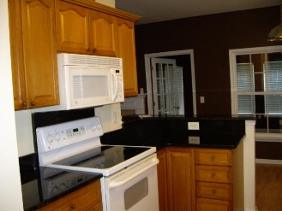
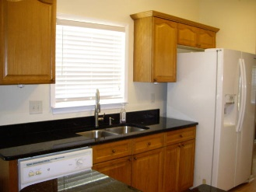
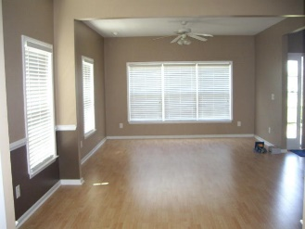
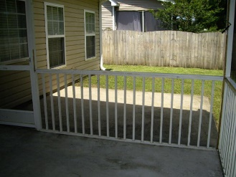
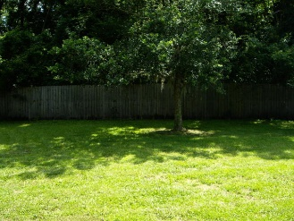
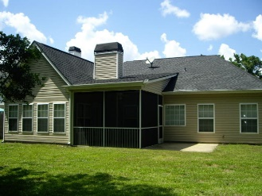


2821 August Road
Summertrees
Johns Island, SC 29455
MLS# 18017090
$288,000
Just Reduced to $279,900
Lovely one-story newly refurbished with open floor plan features 9' ceiling, extra windows for added sunlight. Chair rail molding in the dining area. Large open family room with wood burning fire place. The open kitchen has granite counter tops, oak cabinets and a breakfast bar. The new roof was installed in 2016, New HVAC was installed on 6/15/2018, 5 year warranty will be extended to 10 years if the new owner registers and requests within 90 days.
New laminated wood floors throughout the entire house and tile floors in the bathroom. Recessed lighting. There are ceiling fans throughout the house including the screened porch. Sunroom with extra windows. Fenced and screened porch overlooking spacious backyard. 2 car garage. Home is not in a flood Zone. There is an extra room adjacent to the master bedroom that can be used as a nursery or office.
Thank you for showing.
Cathy Rosenblum
843-817-7869
crosenblum@comcast.net

