Slide 1
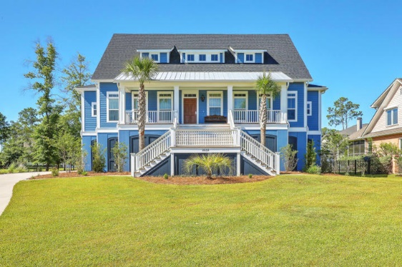
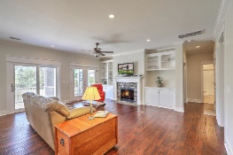
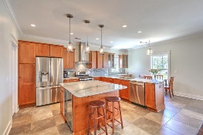
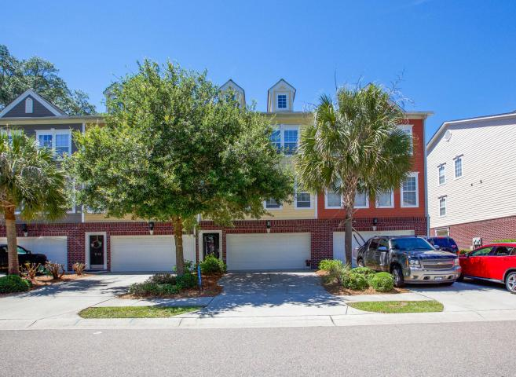
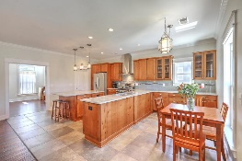
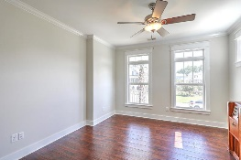
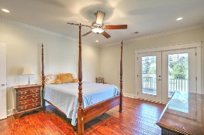
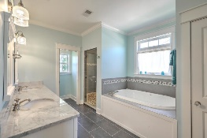
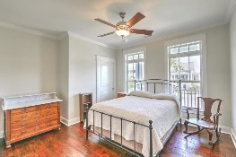
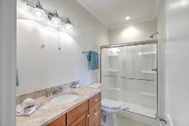
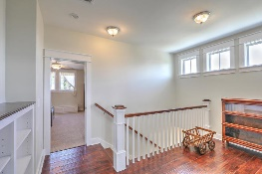
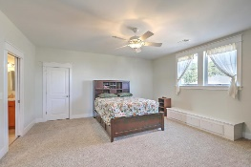
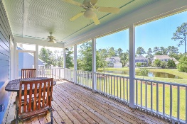
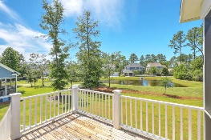
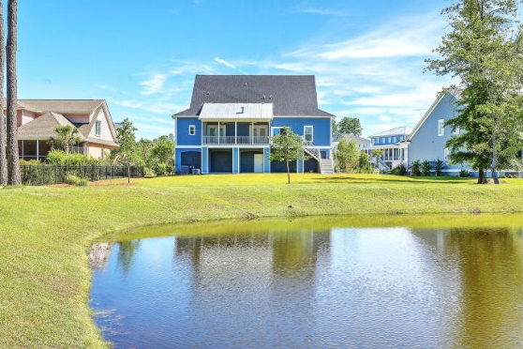

$5,000 AGENT BONUS
FOR RATIFIED CONTRACT BY 1/31/19!
(with BIC approval)
Like New Custom Home, Wando River Views!!!!
2833 Stay Sail Way
Dunes West ~ Mount Pleasant, SC 29466
MLS# 18019727 ~ $679,900
PREPARE TO BE AMAZED AS THIS HOME WILL NOT DISAPPOINT!!
As soon as you walk in to this amazing 3 story Lowcountry home you will find that the owners spared no expense with the attention to detail that exists at each and every level of this beautiful custom built home! On the first floor/level is a 2+ car garage, enough to fit your cars, plus jet skis, kayaks, small boat, etc. You will also find peg board throughout the parameter of the bottom floor as to allow for hanging tools, bikes, lawn equipment, etc. Also included in the garage level is separate heated and cooled room, currently used as a large exercise area. Bringing your groceries or bags home from the market or a day of shopping? Just push the button to call the elevator to the ground floor to load up all of those bags!
Take the elevator or choose to walk up to the main floor, you will immediately discover a wonderful open flow floor plan, allowing for tons of friends and family an entertainers dream! With the open floor concept floor plan you have the availability to host tons of family in friends inside or open up the doors (french and sliding glass) that leads to the large porches, screened and unscreened for an even bigger gathering! The kitchen is amazing to say the least! For the chef in you or your home, this gourmet kitchen will not disappoint! You will find beautiful, custom cabinetry throughout, soft-close cabinets and drawers, beautiful stainless steel LG appliances including a large, counter-depth french door refrigerator, wine cooler, 5 burner gas cooktop, double ovens, dishwasher and beautiful stainless steel hood over range. The exquisite Seapearl granite surround the kitchen and breakfast areas and tastefully appointed ceramic tile graces the floor in both of these highly trafficked areas, as well as the laundry room (conveniently off of the kitchen.) This level also allows the separate large dining room perfect for those formal dinners. The kitchen also opens to the family room and comes complete with custom shelving surrounding the stone gas fireplace. Your television will fit perfect wither above the mantle or on the bookcase, you choose! This home has stunning, hand scraped wood floors throughout, perfect if you have that puppy with nails that you're worried about tearing up the floors! The Master is on the main level and continues with high end touches/finishes in the ensuite bathroom. Here you will find a separate water closet with pocket doors, huge, tile surround walk-in shower and soaking tub...this ensuite truly gives off a "spa-like" environment not to disappoint! Another large bedroom complete with full bath is available on this floor as well. On the third floor, again accessible by elevator, you will find two additional over-sized bedrooms both on opposite ends of the home to allow for extra privacy. The hallway that separates the rooms includes beautiful custom shelving and a small sitting area off from the elevator landing. All of these amazing little touches and high-end finishes plus TONS and TONS OF STORAGE!!
This home is exquisite!! You really must see it for yourself! From the beautiful front porch where you can see the Wando River, to the back porches where you overlook a serene pond (or possible future pool)...attention to detail has not been spared in the least!! All of this in one of South Carolina's Premier Gated Communities, Dunes West!
Dunes West is a gated neighborhood (attendant always on duty) and offers residents Club Membership for an additional fee that includes access to three pools, a waterslide, crabbing dock, boat ramp/landing, multiple tennis courts, and exercise facility. Golf course membership and boat storage are all available for an additional fee. Make your appointment to view this spectacular home!
Deborah Meuli
(843) 822-0133
dmeuli@comcast.net
Wendy Deitsch
(843) 270-0433
wendy@lifetreeliving.com
LifeTree Real Estate, LLC | 3094 Hwy 17 North | Mt. Pleasant, SC 29466 | www.lifetreerealestate.com

