Slide 1
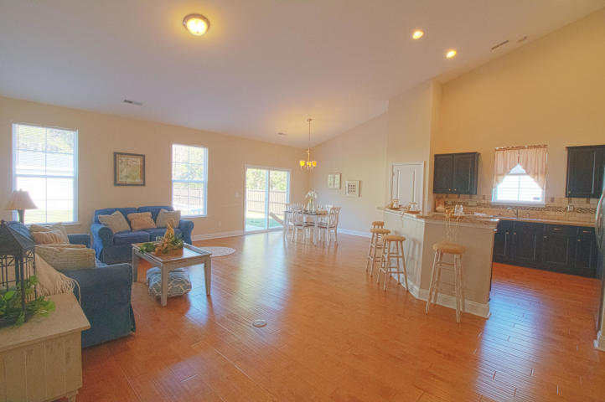
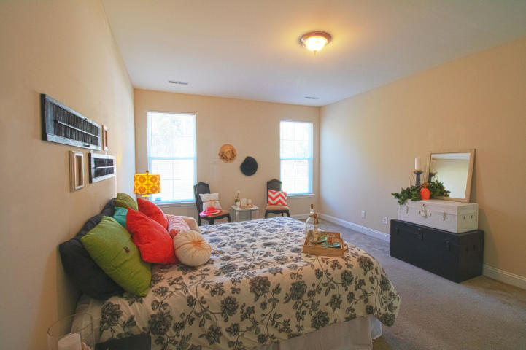
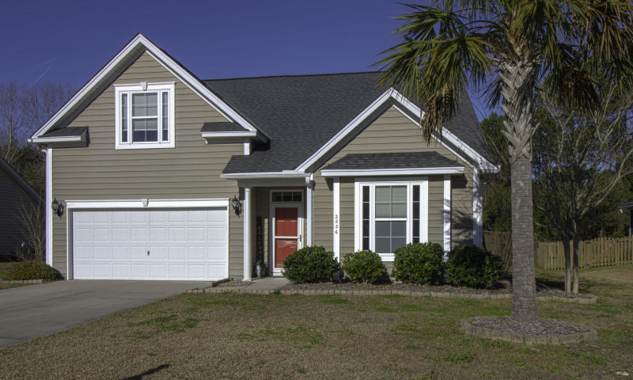
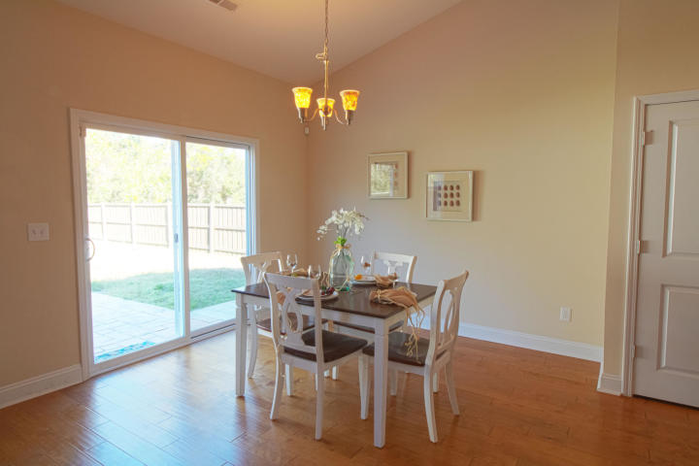
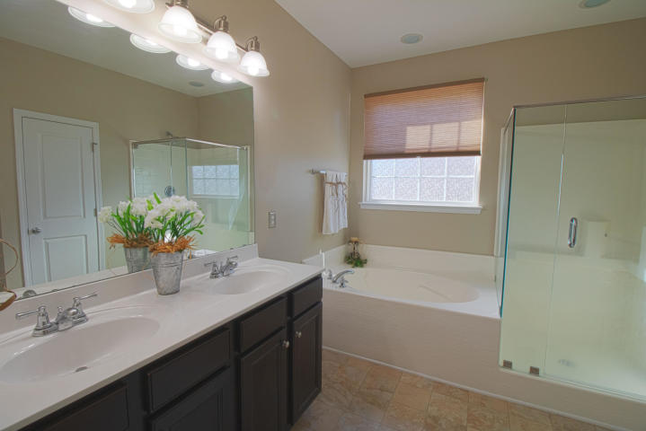
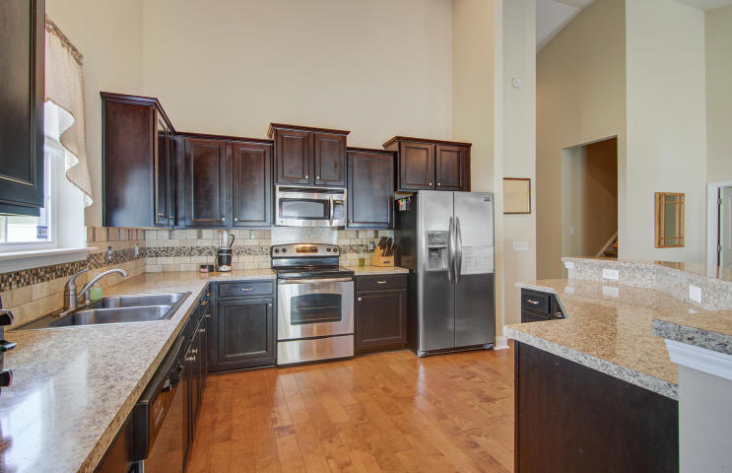
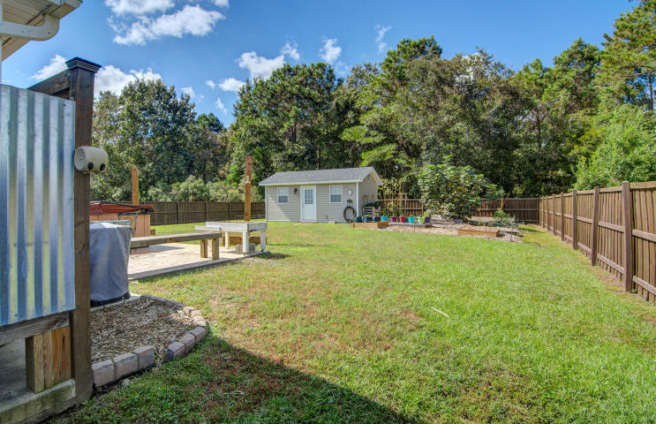
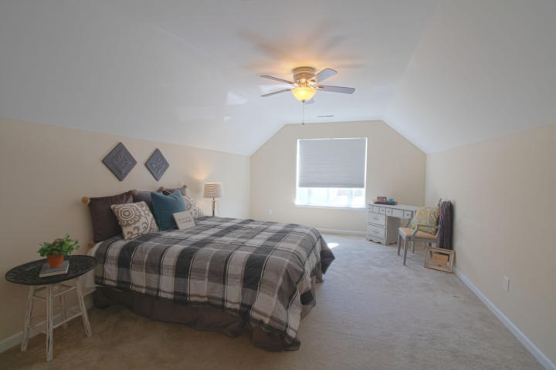
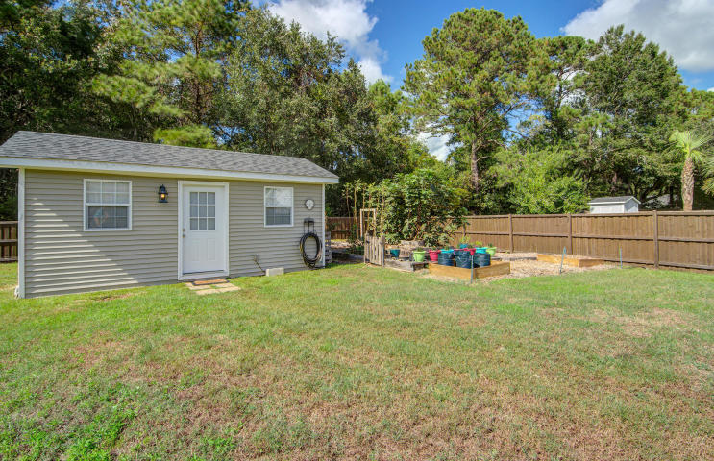


Just Listed!
Meticulously Maintained
2836 Sunchaser Lane
Sunchaser
Mount Pleasant, SC 29466
MLS# 19004546 ~ $384,000
Moving into 2836 Sunchaser Lane is like a breath of fresh air! This meticulously maintained home has so much to offer in regard to layout and lifestyle. The open concept home lives like a 3 bedroom 2 bath ranch and has the added benefit of a huge (bed)room over the garage with a large walk in closet and full bath! The upstairs makes for a fantastic guest suite, teen suite, or additional living space and home office for a family. When you enter this lovely home you will instantly notice the beautiful wood floors. As you proceed into the heart of the home, the soaring ceilings enhance the light, bright, open concept. The kitchen is amazing with tons of cabinets, a nice sized pantry, and stainless steel appliances all of which convey. The kitchen and adjacent eating area (which overlooks the huge back yard) are open to the family room. This layout is perfect for families and for those who love to entertain. The master bedroom is also very large with plenty of room for a sitting area that overlooks the back yard. In the master bath the dual sink vanity is quite convenient for the owners. A soaking tub is perfect for the homeowner who enjoys a spa-like bath, and the new rimless shower enclosure adds to the beauty of the master bath retreat. Clear across on the other side of the home are two additional guest bedrooms with another full bath. This layout ensures the ultimate privacy. As a matter of fact, a pocket door has been installed to quiet that part of the home if little ones are sleeping. Upstairs you will find the FROG you have been looking for: this one is large enough to double as a guest room and office/sitting room PLUS it has a full bath and another walk in closet! This is the perfect guest retreat or teen suite. Otherwise it can be used as a second family room/media room. The versatility of this home's floor plan is endless. If you have been looking for a home in Mt. Pleasant with a big private yard, look no further! This large yard is fully enclosed with a privacy fence. Home owners in Sunchaser are allowed to keep their boat in the yard if it is fenced, and this one is! What a rare opportunity for boaters and a great chance to save on storage fees and have the convenience of your boat on your premises. Best of all perhaps is the out building- it is finished on the interior with electricity, a sink, and AC! Talk about a perfect "man cave" or "she-shed " for the owner who has a hobby. If gardening is your thing, you will love this arrangement. Be sure to read the details of the outbuilding and garden created by the current owners which can be found in the documents section. Residents of Sunchaser enjoy the benefits of living minutes from award winning public schools, proximity to fantastic restaurants and shops, and it is a short ride to the beach or to Historic Downtown Charleston.
Don't delay in scheduling your tour of this wonderful home - it is a great value in Mt. Pleasant and is priced to sell!
Ellen O'Neil
Broker/Owner, ABR, e-PRO, CNE
Charleston Realtor of Distinction
(843) 300-8530
www.EllenONeilProperties.com

