Slide 1
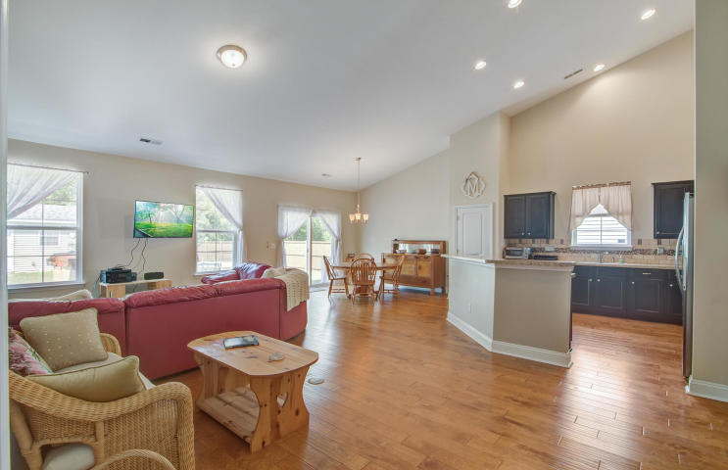
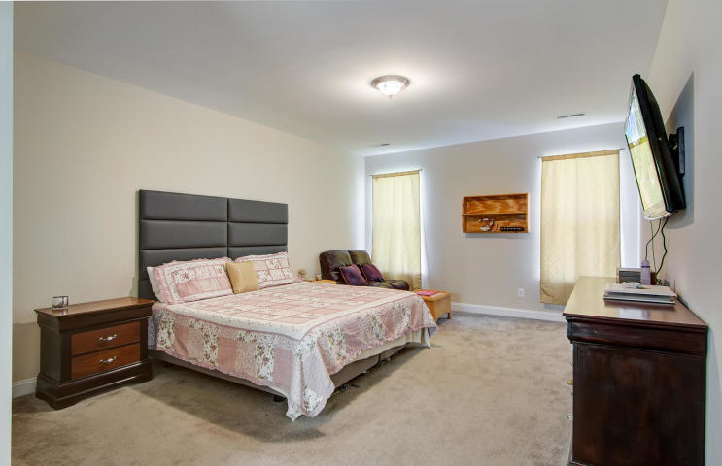
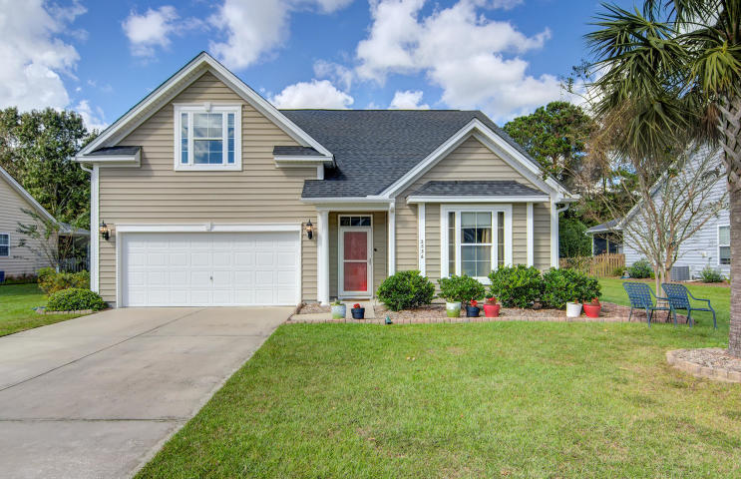
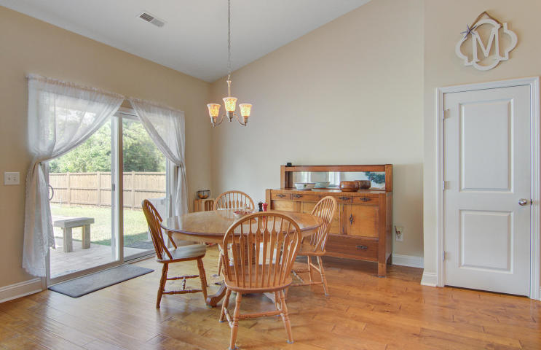
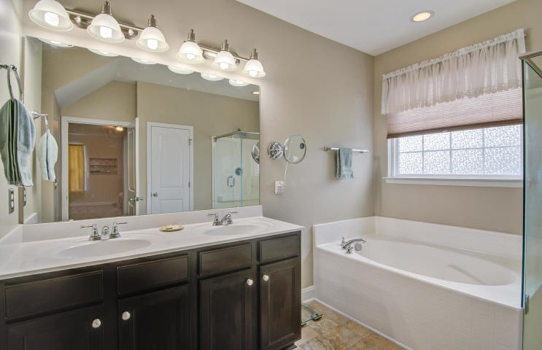
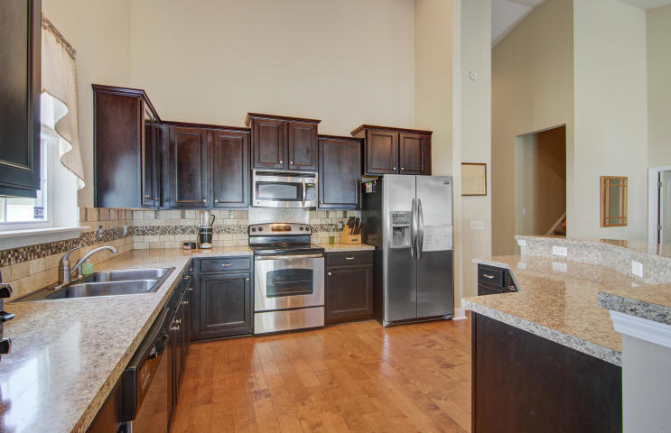
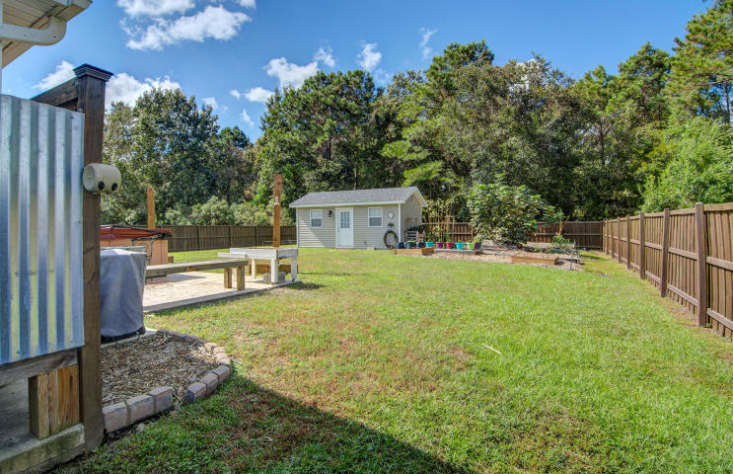
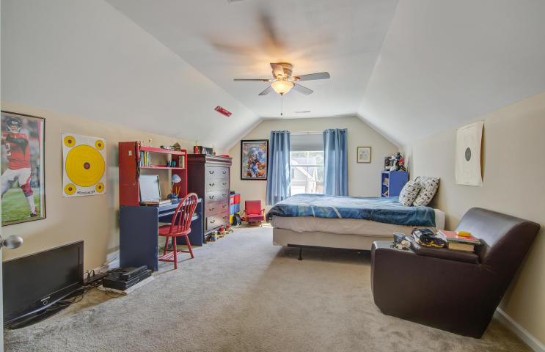
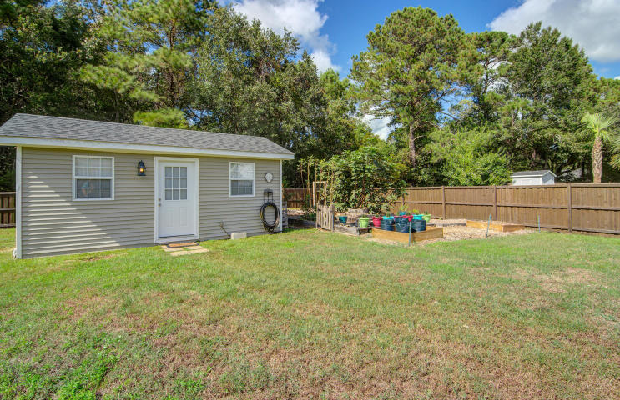


MOTIVATED SELLERS!
2836 Sunchaser Lane
Sunchaser
Mount Pleasant, SC 29466
MLS# 18028324 ~ $379,900
Amazing floor plan with HUGE kitchen overlooking the family room and dining area. Massive fenced in back yard with Outbuilding, Garden, and ROOM TO PARK YOUR BOAT! Low HOA fees and close to beaches, award winning Mt. Pleasant Schools, shopping and Historic Downtown Charleston.
SELLERS ARE MOTIVATED! Price reduced on this home-Tremendous Value! You will love the floor plan in this open concept home. There are four bedrooms and three full baths. The room above the garage is the fourth bedroom and it has a full bath making it the perfect guest retreat or teen suite. The open concept living in the heart of the home is perfect for families and entertaining. An added benefit is the split floor plan where the master suite is on one side of the home while the guest rooms and guest bath are their own wing on the opposite side of the house! This is one smart design! The chef of the household will simply love this kitchen. Abundant counter space for meal preparation and numerous cabinets in addition to the pantry make it a winner! The open layout allows the cook to feel connected to family and guests all the while! The vaulted ceiling in the main living area of the home adds a dramatic flair and the home is light, bright and airy! The master suite is on the main level of the home. There is plenty of room for a sitting area in this expansive suite and the walk in closet is generous in size. A garden tub and shower with its new shower enclosure grace the master bath. The guest bath has a traditional tub and shower combination and is conveniently located between the two guest bedrooms. A separate laundry room is another added convenience. Storage racks have been installed in the two car garage which has painted floors and a warm finished feel. Neutral colors have been painted throughout the home. Not only is this versatile floor plan a rare find, but the yard as well! The rear yard is enclosed with a privacy fence and is a true Gardener's Delight! The current owners have gone to great lengths to create a productive, environmentally friendly garden and watering system that is sure to impress anyone with a green thumb! Please read the details in the document section to learn about the unique and thoughtful features implemented in this incredible design. Adjacent to the garden is an outbuilding perfect for any hobbyist! Currently being used to store gardening equipment and set up for inside planting, the possibilities for this building are endless. It is air conditioned and has an inside kennel for a small dog. The interior has been finished by the current owners and can be used for additional living space or any hobby- let your imagination run wild. Again, in the documents section, there are details about the features of this structure. A large stamped concrete patio along the rear of the home is the perfect setting for al fresco dining and relaxing outdoors while you enjoy the privacy of this large yard with a wooded buffer behind the home. Did I mention you are allowed to store your boat and trailer in your back yard? Rare find in Mt. Pleasant! The Sunchaser neighborhood is conveniently located close to shopping, restaurants, and award winning schools. The beach at Isle of Palms is a short ride away and Historic Downtown Charleston is also within 20 minutes of this lovely home. Be sure to check out the 3D Walk Through Tour and then schedule you in-home tour while this awesome home is still available!
3D Walk thru tour: https://my.matterport.com/show/?m=WFUVAsJaoFM
Ellen O'Neil
Broker/Owner, ABR, e-PRO, CNE
Charleston Realtor of Distinction
(843) 300-8530
www.EllenONeilProperties.com

