Slide 1

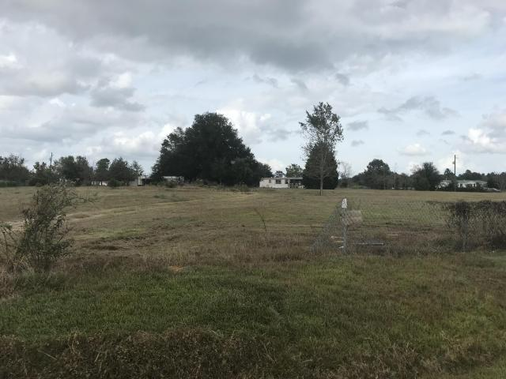
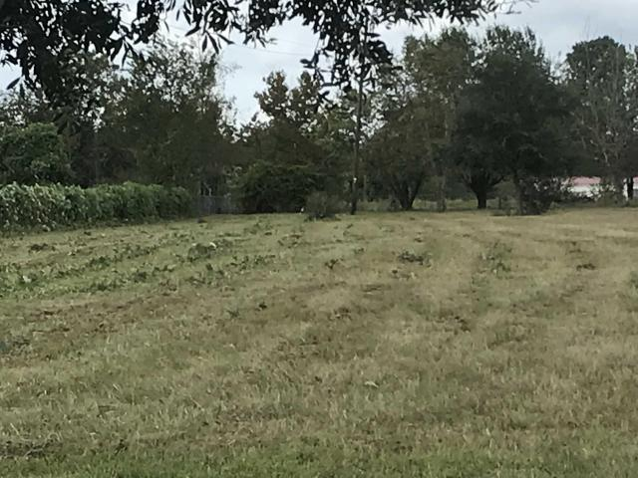
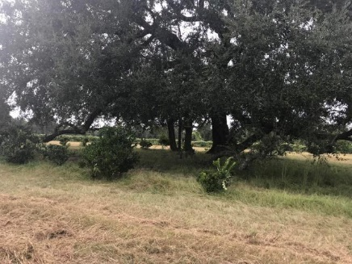
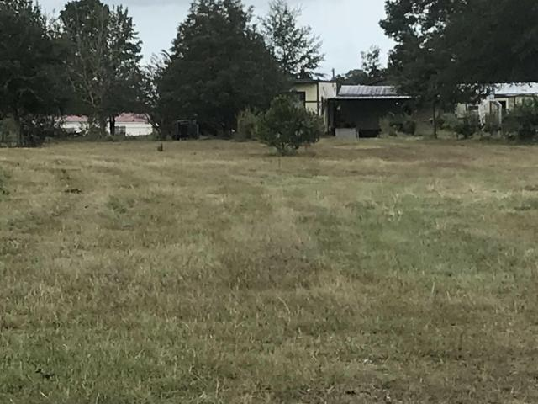
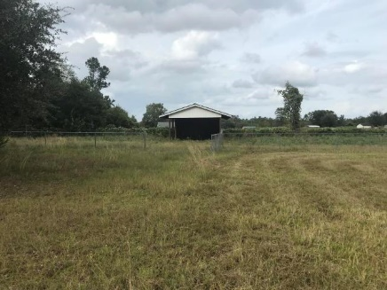

Great Country Property
Jacqui Swain
Office (843) 871-1710
Mobile (843) 295-9484
jacquiswainc21@gmail.com
www.JacquiSwain.c21.com
283 Michelle Street
Eutawville, SC 29048 · MLS# 17027173 · $40,000
2,451 sq ft
5 beds · 2 baths
5 Acre Property with Lots of Potential! Two mobile homes on the property, neither property is currently in livable condition and the value is in the land only. Main property is hooked into septic and well. It has one bedrooms 1 bath, a huge bonus room addition that leads out to an enclosed pool area. Home and pool needs Rehab. Second home on property is 2 bedroom 1 bath, it is not tied down nor attached to any utilities, also needs TLC. Lots of options for the new owner, fix up both homes, remove one or both to build your own home.
Century 21 Expert Advisors | 100 Seven Oaks Lane | Summerville, SC 29485-8514

