Slide 1
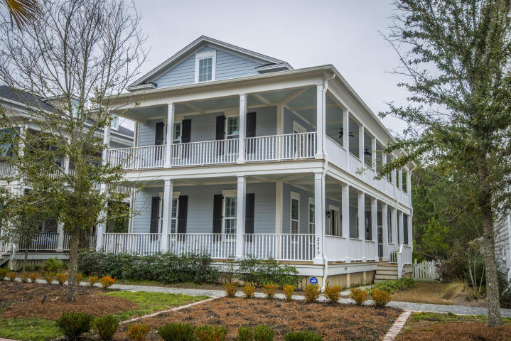

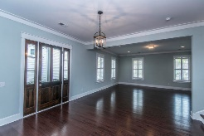
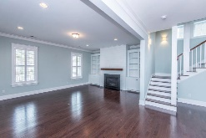
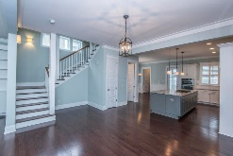
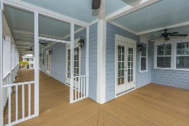
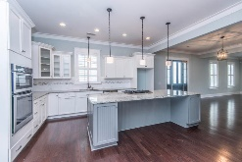
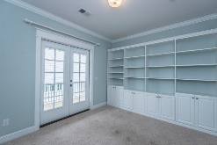
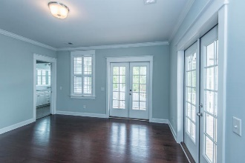
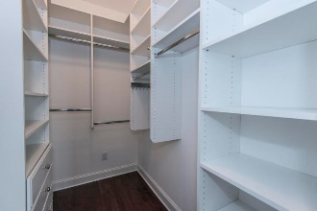
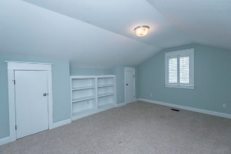
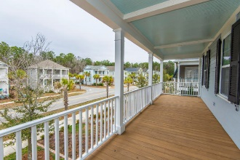
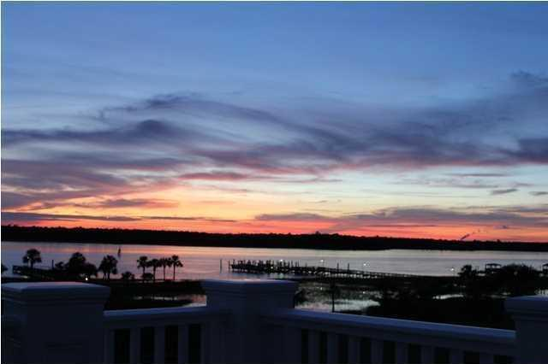
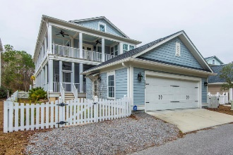


2840 Rivertowne Parkway
Rivertowne On The Wando
Mount Pleasant
Great Value!
Like new!
Coastal breezes, sunshine and lazy afternoons on the porch ~ these are all things that will come to mind the minute you walk up to this gorgeous coastal inspired, cottage styled home. Backing up to a protected green space and pond with walking trails, this home offers privacy as well as easy access to the beautiful natural surroundings. Inside, no detail was left unattended. The gorgeous dark hardwood flows throughout the entire downstairs and up onto the hardwood treads. The crisp white trim, including crown molding, six-panel doors and plantation shutters throughout speak to the custom finish details found in this spectacular home. The large living area, featuring a focal point fireplace with custom built-ins and ship lap wall, is open and flows seamlessly to the Formal Dining Room and Kitchen. This home is perfect for entertaining and offers a kitchen the most discerning home chef would love! Located in the prestigious Rivertowne on the Wando Neighborhood with three community docks for fishing, boating or just to relax and watch the amazing Wando River sunsets. Enjoy golf at Rivertowne Country Club's Arnold Palmer Signature Course then meet friends at the club for dinner. Additional amenities include neighborhood pool, tennis courts, walking trails and play park all conveniently located to beaches and the world class dining and shopping of historic downtown Charleston.
Asking $534,900
MLS# 18004281
3,000 SqFt
4 Bed/3½ Baths
Detached Garage
Don Dawson
843-514-0452
ddawson@carolinaone.com
Carolina One Real Estate • 2713 Highway 17 North • Mount Pleasant, SC 29466
www.TeamDawsonSC.com

