Slide 1
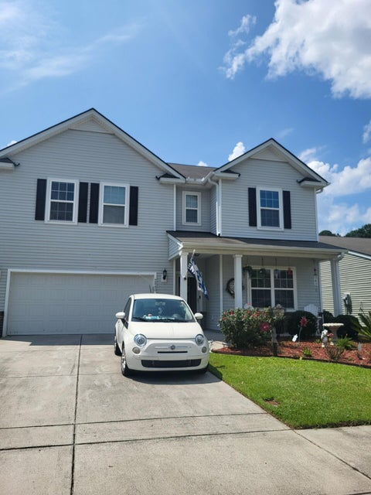
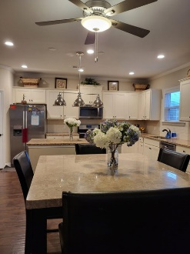
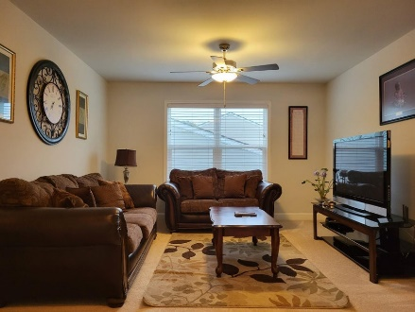
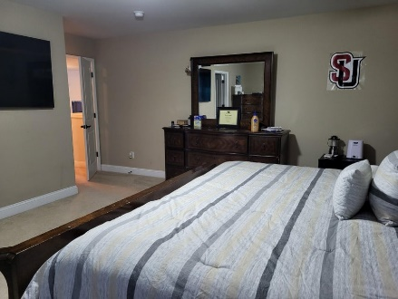
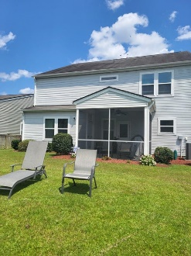
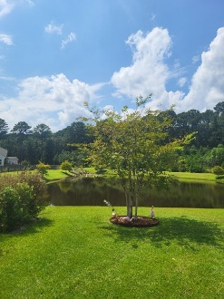
Open House Tuesday 11 am - 1 pm Agents come preview this gem conveniently located to downtown. This was the builders' model home. Leave a business card to enter the gift card drawing.
2840 Conservancy Lane
Carolina Bay
Charleston, SC 29414
MLS# 24021458 | $775,000
Are you ready to be impressed? This house has everything you want. Come see this one-of-a-kind floor plan in beautiful Carolina Bay! This is the only floor plan of this design in the entire community. This home features a massive open-floor concept living/kitchen space with a large dining room attached. The first floor has a room that can be used as a bedroom for visiting older family members or an office. Plus, there is a full bath next door. Wood floors and crown molding throughout the first floor. Fireplace in the living room. The owner has replaced the bland light fixture in the formal dining room with a spectacular chandelier. It also has wainscoting. The windows provide lots of natural light. The kitchen is equipped with an island, granite count tops, off white 42-inch cabinets plus gas range. Whirlpool appliances. Faux blinds throughout. There are 9-ft smooth ceilings throughout the first floor. Plenty of recessed can lights throughout and an energy efficient tankless hot water heater. Go upstairs and see the loft that is now used as a lounge area with television. This house has a ton of closet space. The bedrooms upstairs are huge. All the bathrooms upstairs have lots of space. There is a massive linen closet in the hall plus there is a laundry room big enough to accommodate two washers and dryers. The master bedroom has an ensuite that will make you sin. The toilet has its own door, and the walk-in closet is big enough for everyone's clothes.
This home includes classic oil rubbed bronze finishes throughout. Go outside and enjoy the spacious screened porch overlooking a gorgeous pond. Sit on the porch or lay on the grass and read a book and enjoy the view. There is also a sprinkler system for the lawn. All of this in beautiful Carolina Bay, West Ashley's premier community, complete with 3 swimming pools, 3-acre park and trails!
Linda Brown
843-343-9147
linda@trinitypropertiesone.com
Trinity Properties of Charleston
846-D Dupont Rd
Charleston, SC 29407
www.trinitypropertiesone.com

