Slide 1
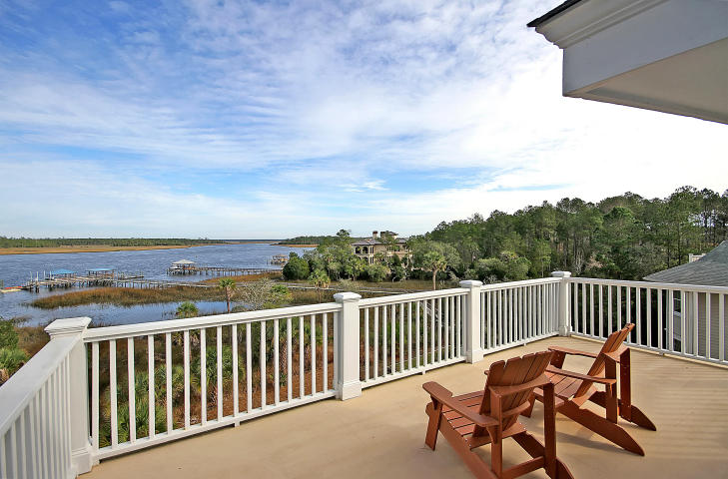
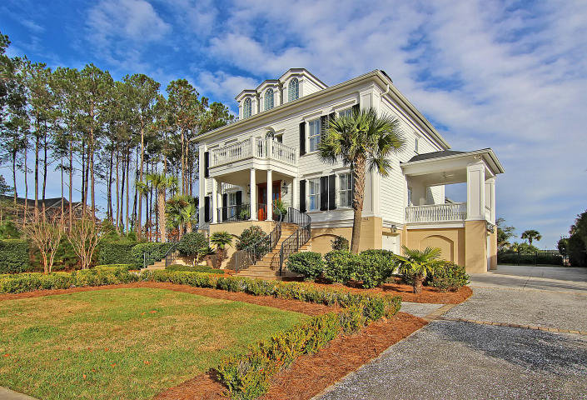
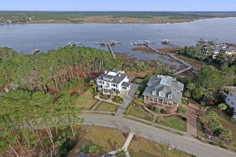
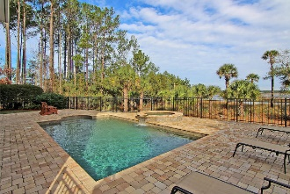
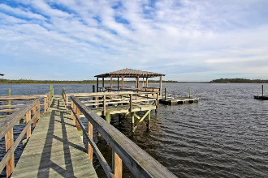
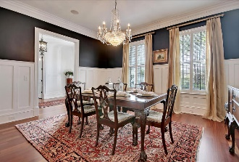
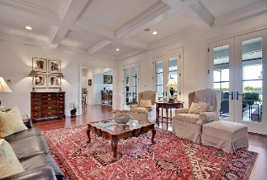
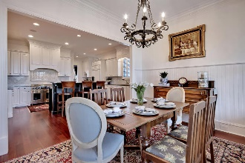
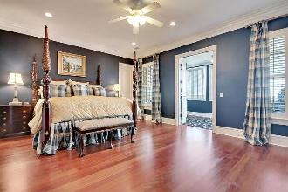
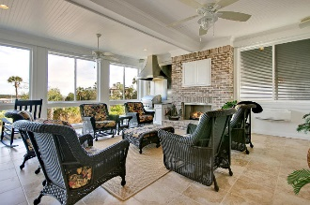

Price Reduced!
$10,000 Bonus!
2848 River Vista Way ~ Mt Pleasant ~ MLS# 16000842 ~ $1,925,000
Seller would like to offer the following time sensitive sales incentive on 2848 River Vista Way. Seller is willing to pay $10,000 to the buyers agent (at closing) for an acceptable offer received between now and March 15. All of the following must be met to earn this additional $10,000 payment: Offer is deemed acceptable by sellers; Offer is received on or before 3/15/16; Payment ($10,000) is made only after successful completion of transaction (at closing)
Luxurious craftsmanship and function collide in this four story 5BR, 5.1BA home that peacefully sits on the Wando River. Enjoy views of the tranquil water backdrop from the gorgeous four seasons room, the forth floor deck or while sitting in the hot tub that overflows into the sparkling pool. Or if you’d like a closer vantage point, walk down the dock to relax in the covered pavilion while you feel the breeze. This home leaves nothing to the imagination with highlights including an in-law suite on the first floor with a full kitchen, the enormous media room on the forth floor and an unbelievable four seasons room off the kitchen with an outdoor BBQ and fireplace. If you like to entertain, be out on the water, love great views and appreciate attention to detail, this is the home for you!
Additional features include:
High ceilings
Hardwood floors
Coffered ceilings
Plantation shutters
Elevator
Deck located off of the living room
Fireplace in family room and sunroom
Wainscotting, chair rail molding, crown molding
Built-in surround sound
Kitchen features granite counters, breakfast bar on center island, gas range, eat-in area, recessed lighting and marble backsplash
Master bedroom has walk-in closet and beautiful sitting room with views of the river
Master bath has a dual vanity and walk-in shower with rain fall shower head as well as two other shower heads
In-law suite on first floor has a bedroom, full kitchen, full bath and access to the covered patio and pool area
Book your showing today!
For more information, contact
Matt O'Neill | matt@mattoneillteam.com | 843-501-2900

