Slide 1
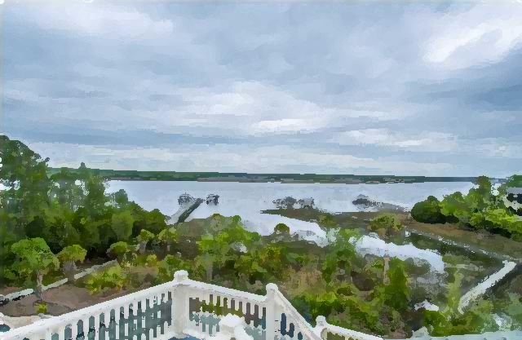
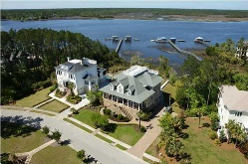
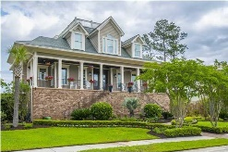
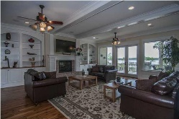
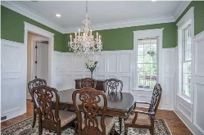
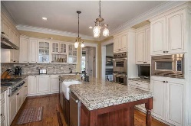
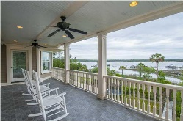
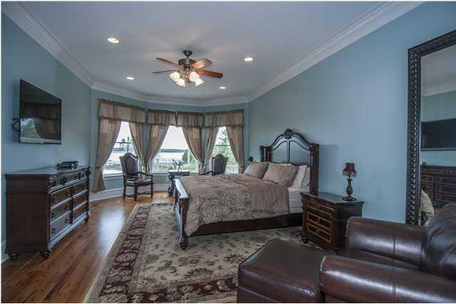
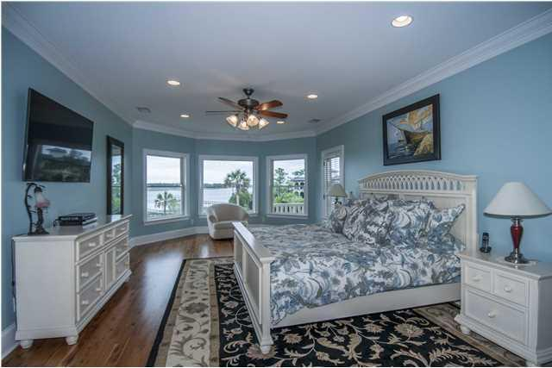

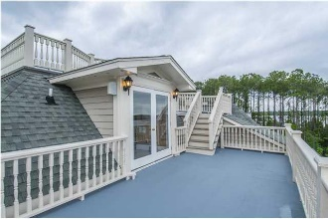
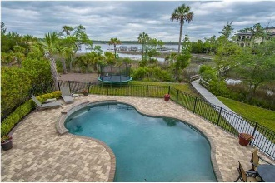
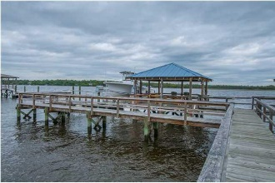


2852 River Vista Way
Dunes West ~ Mt Pleasant
Expect to be impressed!
Stunning deep water executive retreat on the Wando River - dock with covered pier head, 22,000 lb boat lift and dual jet ski dock. This luxuriously appointed home has it all. Upon entering the foyer with beautiful hardwood floors, you will be welcomed to an open floor plan and river views for almost every room. The large great room has a fireplace and built-ins and opens to one of the many decks for relaxing and entertaining special friends. The chef's gourmet kitchen features a huge granite center island, custom cabinets, Viking and Subzero appliances, and two dishwashers. The second floor game room is a special retreat for relaxing with a game of pool. Both the game room and upper master suite open to a deck overlooking the heated salt water pool and gorgeous professionally landscaped grounds. The third floor has the ultimate getaway media room and deck; plus, a roof top deck for that private get away overlooking spectacular river views and sunsets. The ground level has a wonderful mother-in-law's suite and tons of storage; plus, a three car garage. Access is made easy with an elevator to all floors. Home features all the latest technology with surround sound, security with cameras, cable and wifi, and much more. New HVAC filtration system, the ultimate in allergy control and clean air. Conveniently located in The Harbour section of Dunes West. Close to shopping, dining, hospitals, and beaches.
Asking $1,850,000
MLS# 16003205
6,527 SqFt
5 Bed/5½ Baths
22,000-lb Boat Lift
Don Dawson
843-514-0452
ddawson@carolinaone.com
Carolina One Real Estate • 2713 Highway 17 North • Mount Pleasant, SC 29466
www.TeamDawsonSC.com

