Slide 1
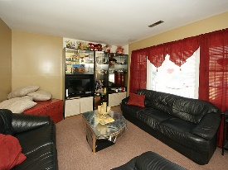
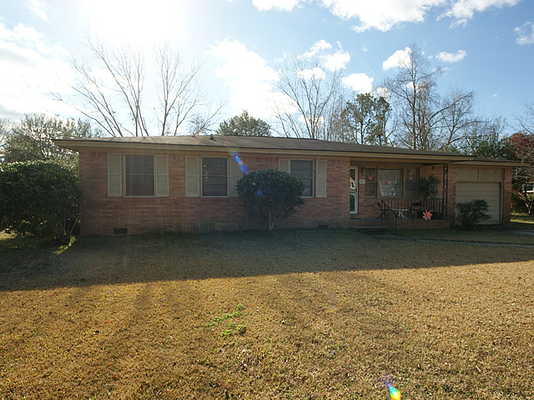
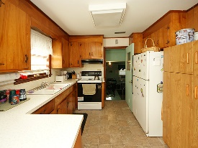
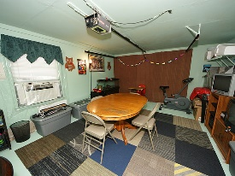
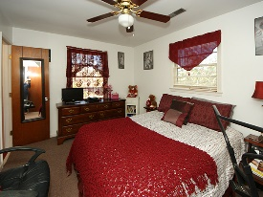
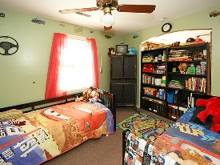
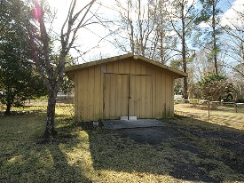
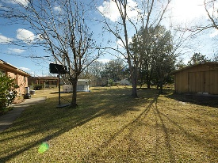


Wonderful New Price!
2853 Shadow Lane
Deer Park
North Charleston, SC 29406
Open House Canceled!
Under Contract In 3 Days!
MLS# 17010892 | $160,000
3 Bed / 2 Bath
Great opportunity to own a brick home on .36 acres of land in North Charleston.
Originally this was a 4 bedroom home but the seller removed the walls to create a den which opens to the dining and kitchen area for a more spacious floor plan.
Per seller, there could be hardwood floors under the carpet. Shed will convey with no value.
Connie White, Broker
C: 843-532-3356
conniesyouragent@gmail.com
Charleston Homes
597 Old Mt. Holly Road
Suite 301
Goose Creek, SC 29445

