Slide 1
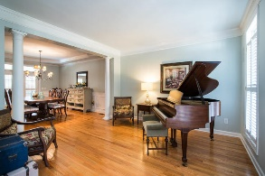
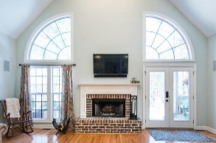
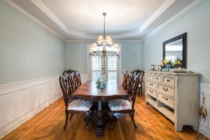
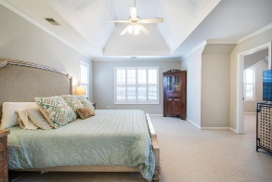
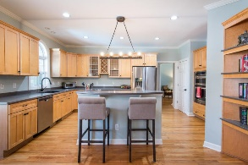
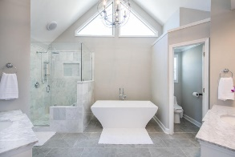
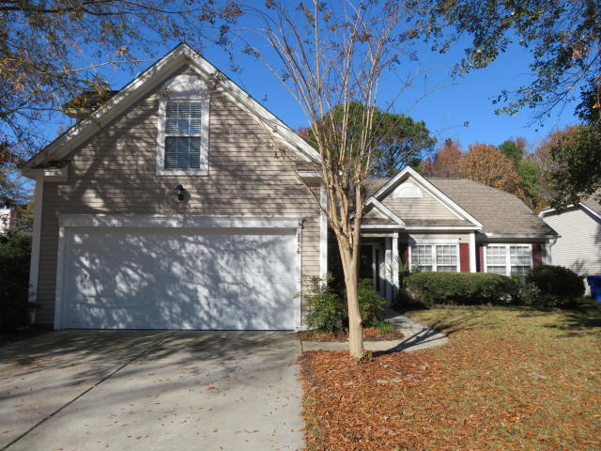
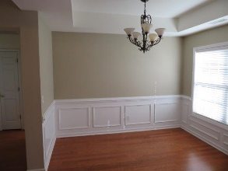
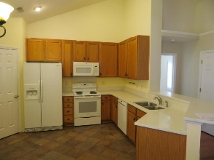
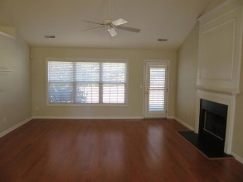
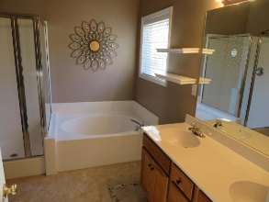
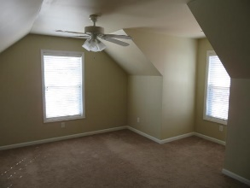
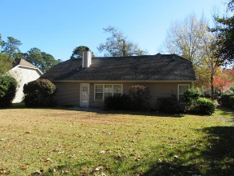

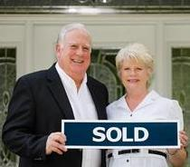
2856 Curran Place
Planters Pointe ~ Mount Pleasant, SC 29466
MLS# 18033238 ~ $369,900
BEST VALUE IN MT PLEASANT!!!
OPEN HOUSE SAT AND SUN 1-4
$550,000
THIS IMMACULATE 3BR, 2BA RANCH WITH FINISHED BONUS ROOM FEATURES OPEN FLOOR PLAN, VAULTED GREAT ROOM WITH FIREPLACE, SEPARATE DINING ROOM, EAT-IN KITCHEN, WONDERFUL MASTER BEDROOM WITH VAULTED MASTER BATH WITH SHOWER AND TUB, BONUS ROOM OVER 2-CAR GARAGE AND LARGE PARTIALLY-FENCED YARD. ASK ABOUT BUYER CLOSING COST CONCESSIONS AND/OR RENT TO OWN FOR IMMEDIATE OCCUPANCY. RARELY DOES A BUY LIKE THIS COME ALONG! $369,000
Tommy Lovett
Tommy - (843) 442-1276
tlovett@carolinaone.com
www.tommylovettrealestate.com
Carolina One Real Estate
628 Long Point Rd.
Mt Pleasant, SC 29464-3032

