Slide 1
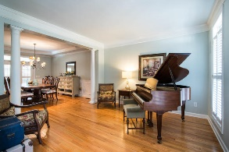
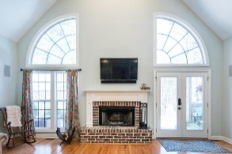
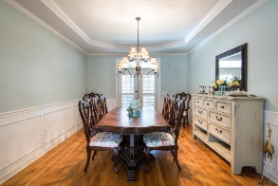
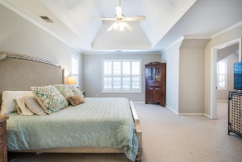
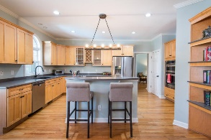
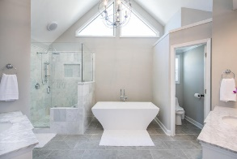
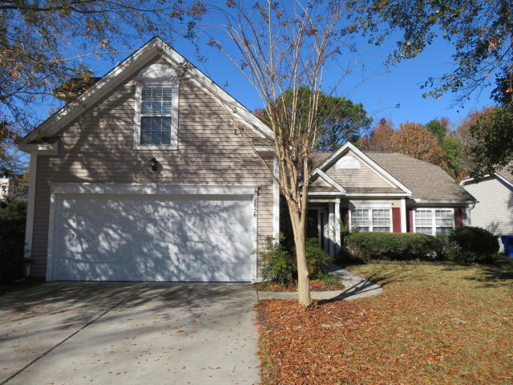
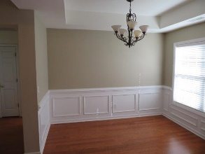
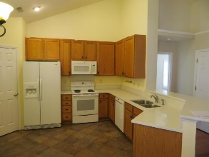
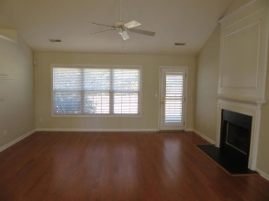
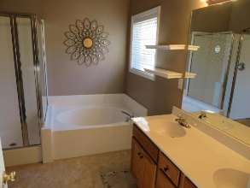
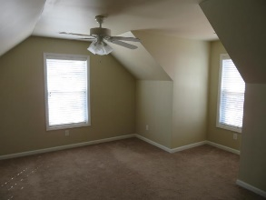
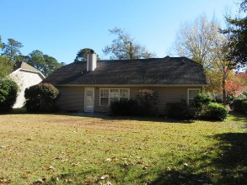

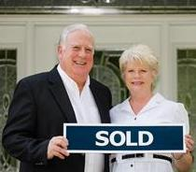
2856 Curran Place Planters Pointe ~ Mount Pleasant, SC 29466 MLS# 18033238 ~ $368,500
PRICE REDUCED PLUS $5250 IN BUYER CONCESSIONS
OPEN HOUSE SAT AND SUN 1-4
$550,000
IMMACULATE RANCH STYLE 3 BR, 2 BA HOME WITH FINISHED BONUS ROOM OVER GARAGE. SELLER WILL PROVIDE $3500 TOWARDS BUYERS CLOSING COST AND AN ADDITIONAL $1750 AVAILABLE IN BUYERS CONCESSIONS IF BUYER USES CAROLINA ONE MORTGAGE. THAT'S RIGHT! $1750 WHICH WILL BE APPLIED TOWARDS BUYERS CLOSING COST AND PREPAIDS THIS CREDIT IS IN ADDITION TO ANY NEGOTIATED SELLERS CONCESSIONS. $3500 PLUS $1750 TOTALS $5250.
RARELY DOES A HOME IN THIS CONDITION, IN THIS LOCATION AT THIS PRICE WITH THIESE CONCESSIONS COME ALONG. THE SELLER HAS REPLACED HVAC WITH HIGH EFFICIENCY 15 SEER HEAT PUMP, REPLACED THE KITCHEN COUNTER TOPS WITH QUARTZ SOLID SURFACE TOPS, INSTALLED CERAMIC FLOORING IN ENTRY FOYER, KITCHEN AND BOTH BATHROOMS AND READY FOR IMMEDIATE OCCUPANCY. RENT TILL CLOSING WITH APPROVED CREDIT!
Tommy Lovett Tommy - (843) 442-1276
tlovett@carolinaone.com www.tommylovettrealestate.com
Carolina One Real Estate
628 Long Point Rd.
Mt Pleasant, SC 29464-3032

