Slide 1
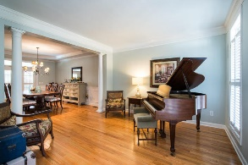
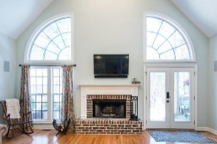
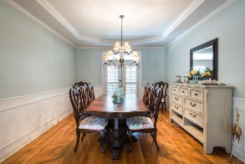
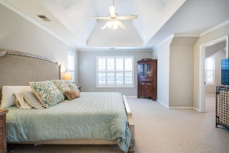
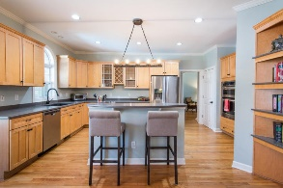
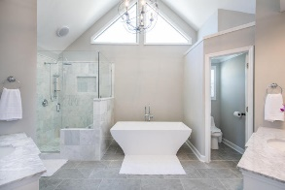
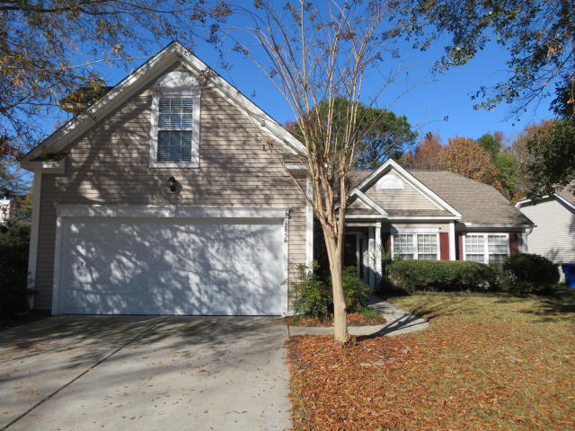
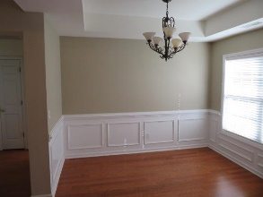
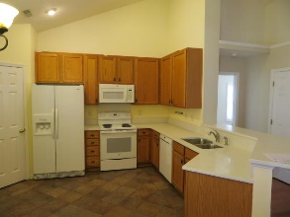
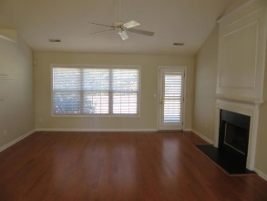
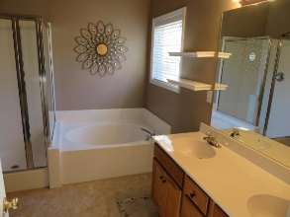
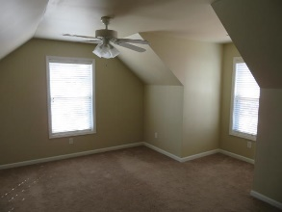
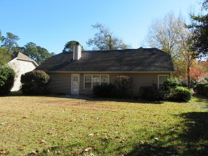

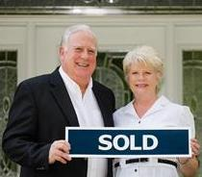
2856 Curran Place Planters Pointe ~ Mount Pleasant, SC 29466 MLS# 18033238 ~ $364,900
PRICE REDUCTION $$ PLUS BUYER CONCESSIONS $$
Rent to Own!
IMMACULATE RANCH STYLE 3 BR, 2 BA HOME WITH FINISHED BONUS ROOM OVER GARAGE. SELLER WILL PROVIDE $3500 TOWARDS BUYERS CLOSING COST AND AN ADDITIONAL $1750 AVAILABLE IN BUYERS CONCESSIONS IF BUYER USES CAROLINA ONE MORTGAGE . THAT'S RIGHT ! $1750 WHICH WILL BE APPLIED TOWARDS BUYERS CLOSING COST AND PREPAIDS THIS CREDIT IS IN ADDITION TO ANY NEGOTIATED SELLERS CONCESSIONS. RARELY DOES A HOME IN THIS CONDITION, IN THIS LOCATION AT THIS PRICE WITH THESE CONCESSIONS COME ALONG. THE SELLER HAS REPLACE HVAC WITH HIGH EFFICIENCY 15 SEER HEAT PUMP., REPLACED THE KITCHEN COUNTER TOPS WITH QUARTZ SOLID SURFACE TOPS, INSTALLED CERAMIC FLOORING IN ENTRY FOYER, KITCHEN AND BOTH BATH ROOMS , INSTALLED NEW FAN W/LIGHT IN GR. READY FOR IMMEDIATE OCCUPANCY. RENT TILL CLOSING WITH APPROVED CREDIT
Tommy Lovett Tommy - (843) 442-1276
tlovett@carolinaone.com www.tommylovettrealestate.com
Carolina One Real Estate
628 Long Point Rd.
Mt Pleasant, SC 29464-3032

