Slide 1
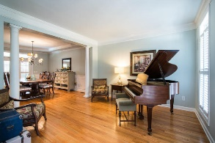
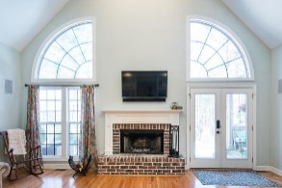
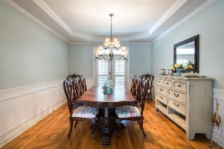
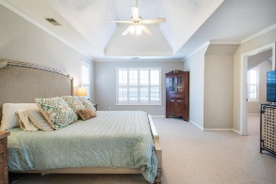
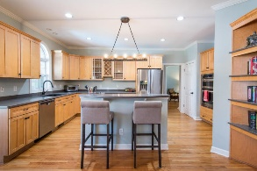
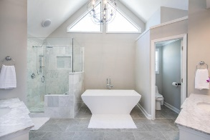
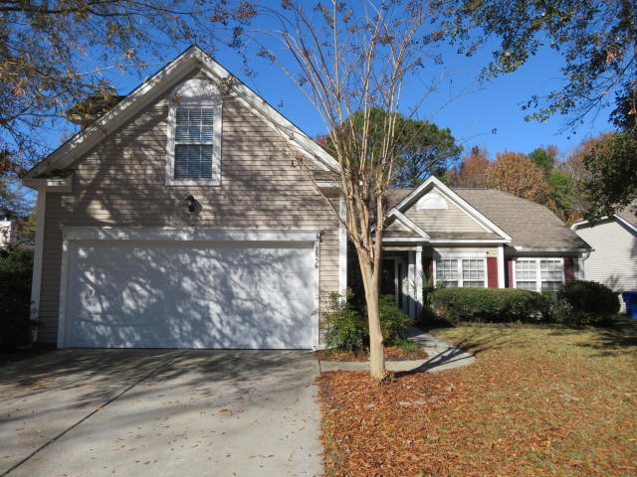
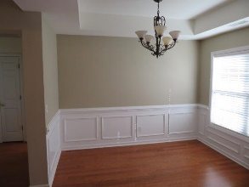
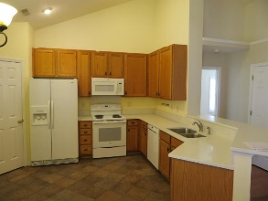
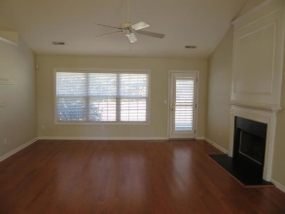
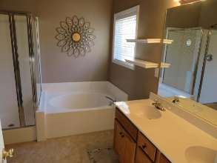
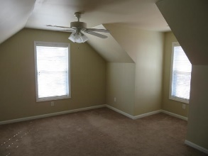
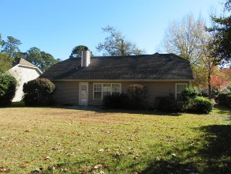


2856 Curran Place Planters Pointe ~ Mount Pleasant, SC 29466 MLS# 18033238 ~ $356,900
PRICE REDUCTION $$ PLUS BUYER CONCESSIONS $$
Rent to Own!
OPPORTUNITY AWAITS! DO NOT DELAY!
IMMACULATE RANCH STYLE 3/4 BR, 2 BA HOME WITH FINISHED BONUS ROOM OVER GARAGE. $1750 LENDER CREDIT IS AVAILABLE AND WILL BE APPLIED TOWARDS BUYER'S CLOSING COSTS AND PRE-PAIDS IF THE BUYER CHOOSES TO USE CAROLINA ONE MORTGAGE. THIS CREDIT IS IN ADDITION TO ANY NEGOTIATED SELLER CONCESSIONS. RARELY DOES A HOME IN THIS CONDITION, IN THIS LOCATION AT THIS PRICE WITH THESE CONCESSIONS COME ALONG. THE SELLER HAS REPLACE HVAC WITH HIGH EFFICIENCY 15 SEER HEAT PUMP., REPLACED THE KITCHEN COUNTER TOPS WITH TOP OF THE LINE QUARTZ SOLID SURFACE COUNTER TOPS, INSTALLED CERAMIC TILE FLOORING IN THE KITCHEN, FOYER, AND BOTH BATH ROOMS , INSTALLED NEW CEILING FAN W/LIGHT FIXTURE IN GREAT ROOM. READY FOR IMMEDIATE OCCUPANCY. RENT TILL CLOSING WITH APPROVED CREDIT.
Tommy Lovett Tommy - (843) 442-1276
tlovett@carolinaone.com www.tommylovettrealestate.com
Carolina One Real Estate
628 Long Point Rd.
Mt Pleasant, SC 29464-3032

